Slide 1
Learning Intention: To design a wolf trap.

Slide 2
Year 1,
Moorside Primary School,
Beaconsfield Street,
Newcastle upon Tyne,
NE4 5AW

Slide 3
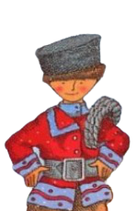
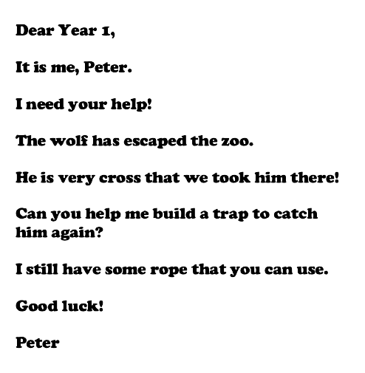
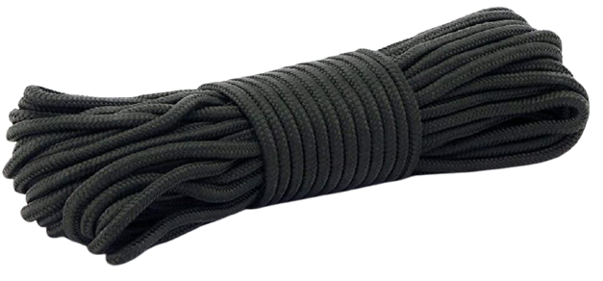

Slide 4
Your turn:
On the worksheet, draw your design to trap the wolf before he finds the bird.
You can use Peter’s rope and any other materials you can think of.
Challenge: Can you label your design?

