Slide 1
Learning Intention:
To identify fact families

Slide 2

What is a fact family?
A fact family is a set of number sentences (facts) you can make using the same three numbers (number family)
20 4 5

Slide 3
20 4 5
4 and 5 are a number fact family because you can multiply and divide them and they work.
4 x 5 = 20? Yes!
4 and 10 are not a fact family because when we multiply or divide, they don’t work.
3 x 4 = 10 ? No!

Slide 4
We are going to look at fact families for
X and ÷

Slide 5

This is an array
What facts do you know?
2 across
4 down
2 x 4 = 8
8 in total
These numbers are our number fact family.
We can write different number sentences to show this
2 x 4 = 8
4 x 2 = 8
8 ÷ 4 = 2
8 ÷ 2 = 4

Slide 6
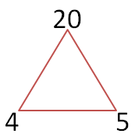
÷
÷
x
Example:
From this number family I can make different number facts using x and ÷.
4 x 5 = 20
5 x 4 = 20
20 ÷ 4 = 5
20 ÷ 5 = 4

Slide 7
18
3 6
÷
÷
x
Example 2 :
From this number family I can make different number facts using x and ÷ too. What could they be?
3 x 6 = 18
6 x 3 = 18
18 ÷ 3 = 6
18 ÷ 6 = 3

Slide 8
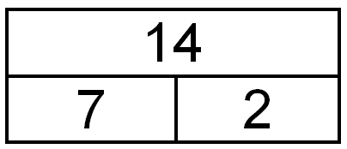
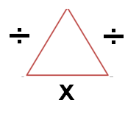
We can see number families in different ways but they all give the same information.
14
2 7
2 x 7 = 14 14 = 7 x 2
14 ÷ 2 = 7 2 = 14 ÷ 7

Slide 9
Your Turn
Find sheet, ‘Math's-Multiplication and Division Fact Families.’
Here is an example.
8 groups of 5
____ X ____ = _____
____ X ____ = _____
____ ÷ ____ = _____
____ ÷ ____ = _____
8 groups of 5 = 8 x 5 = 40
So my fact family numbers are
8 5 40
These are the only numbers I need to complete the question
5 40
8 40
40 5 8
40 8 5
Now complete the sheet

