Slide 1
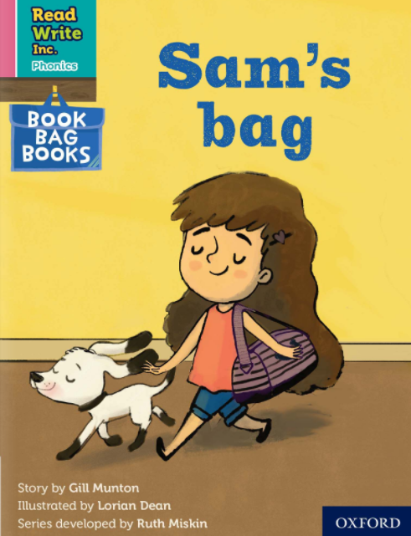


Slide 2
f ff | l ll le | m mm | n nn kn | r rr | s ss se | v ve | z zz s | sh | th | ng nk
b bb | c k ck | d dd | g gg | h | j | p pp | qu | t tt | w wh | x | y | ch tch
Speed Sounds

Slide 3
a at | e hen | i in | o on | u up | ay day | ee y see | igh high | ow blow
oo zoo | oo look | ar car | or for | air fair | ir whirl | ou shout | oy boy
Speed Sounds

Slide 4
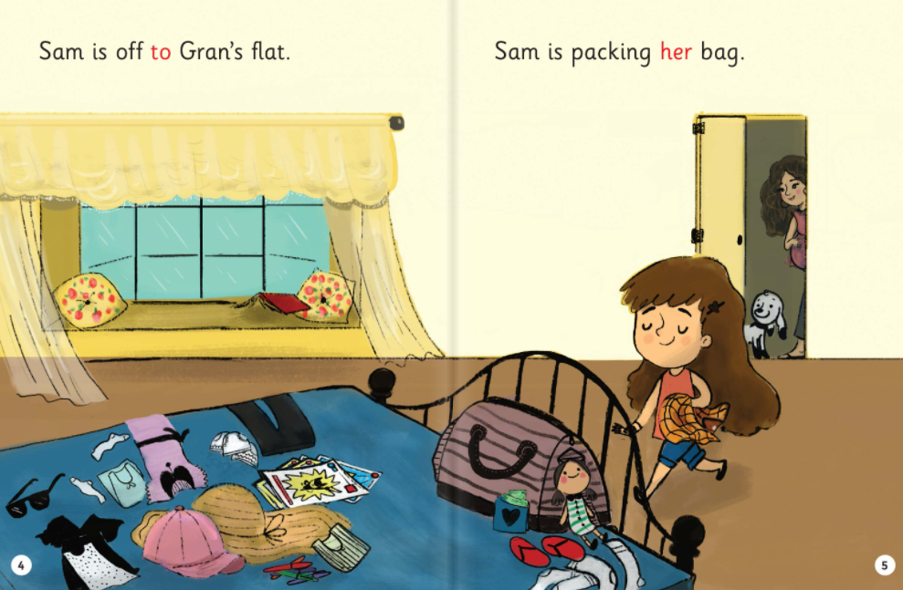

Slide 5
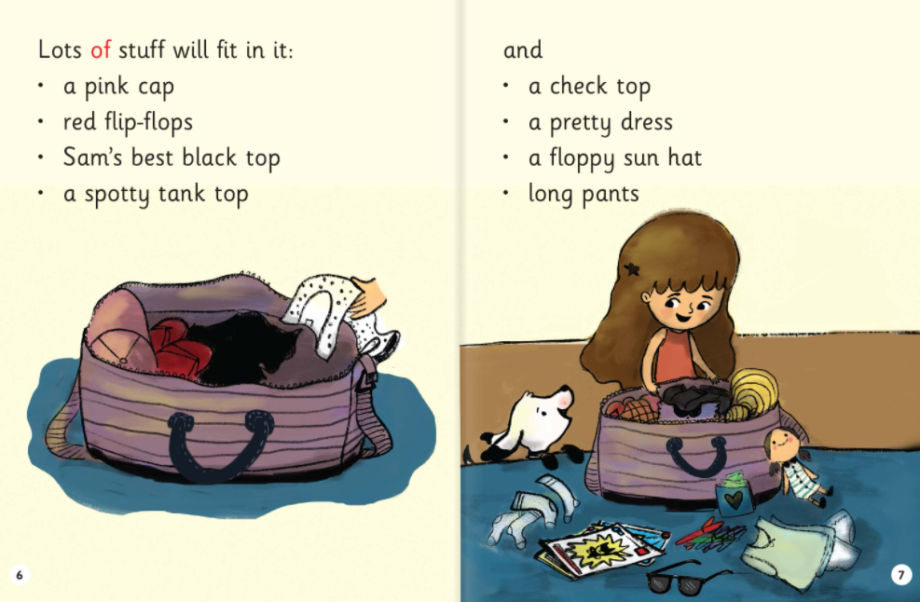

Slide 6
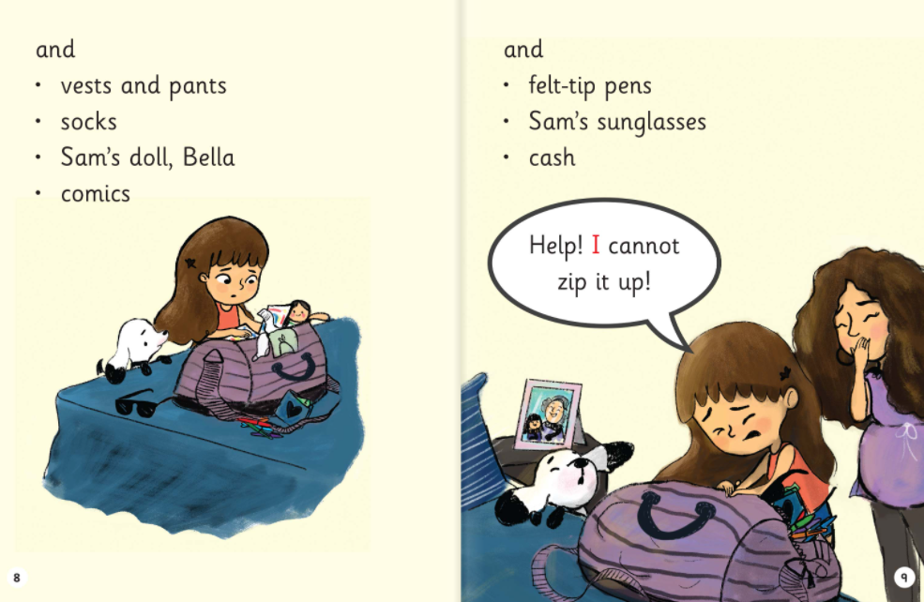

Slide 7
1. Where is Sam going?
2. What colour is Sam’s cap?
3. What is Sam’s doll called?
4. What does cash mean?
5. How is Sam feeling at the end?

