Slide 1
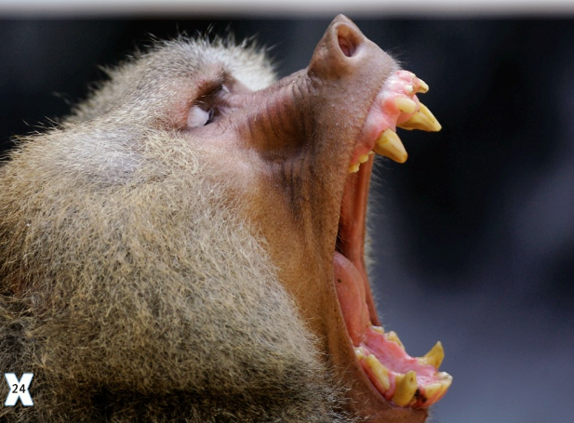

Slide 2
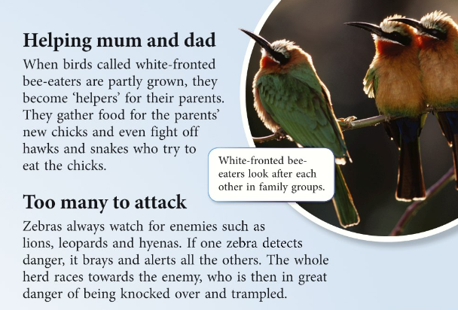

Slide 3
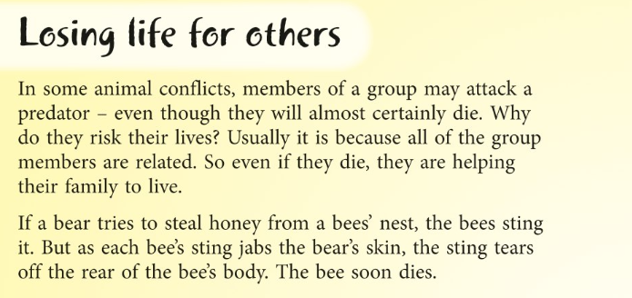
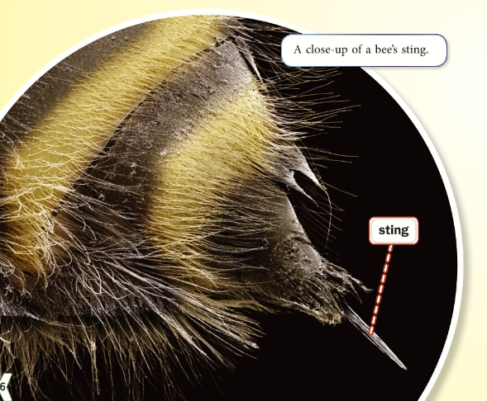

Slide 4
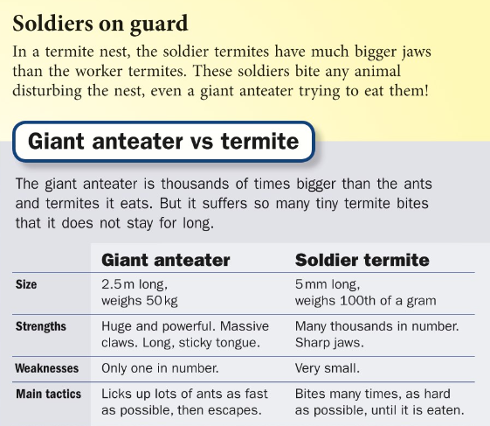
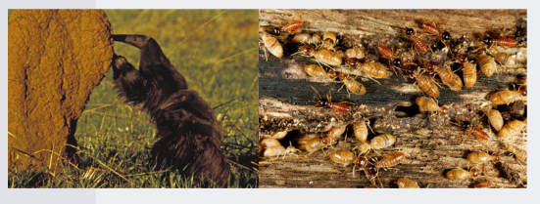

Slide 5
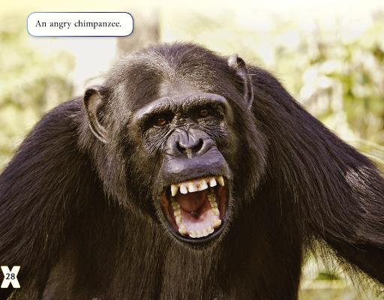

Slide 6
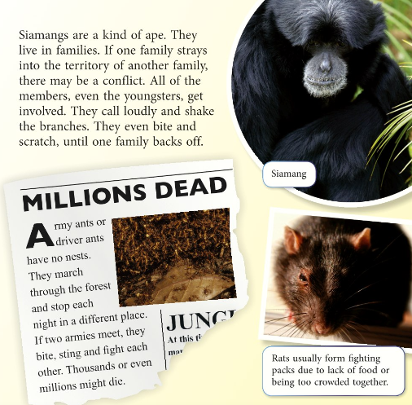

Slide 7
word | definition
p.24 conflict | discovers or notices something
p.24 predator | a serious fight or argument
p.25 detects | a type of ape
p.25 brays | an area of land defended by a group of animals
p.28 territory | an animal that hunts or eats other animals
p.28 resist | makes a loud crying noise
p.29 Siamings | refuse to do something

