Slide 1
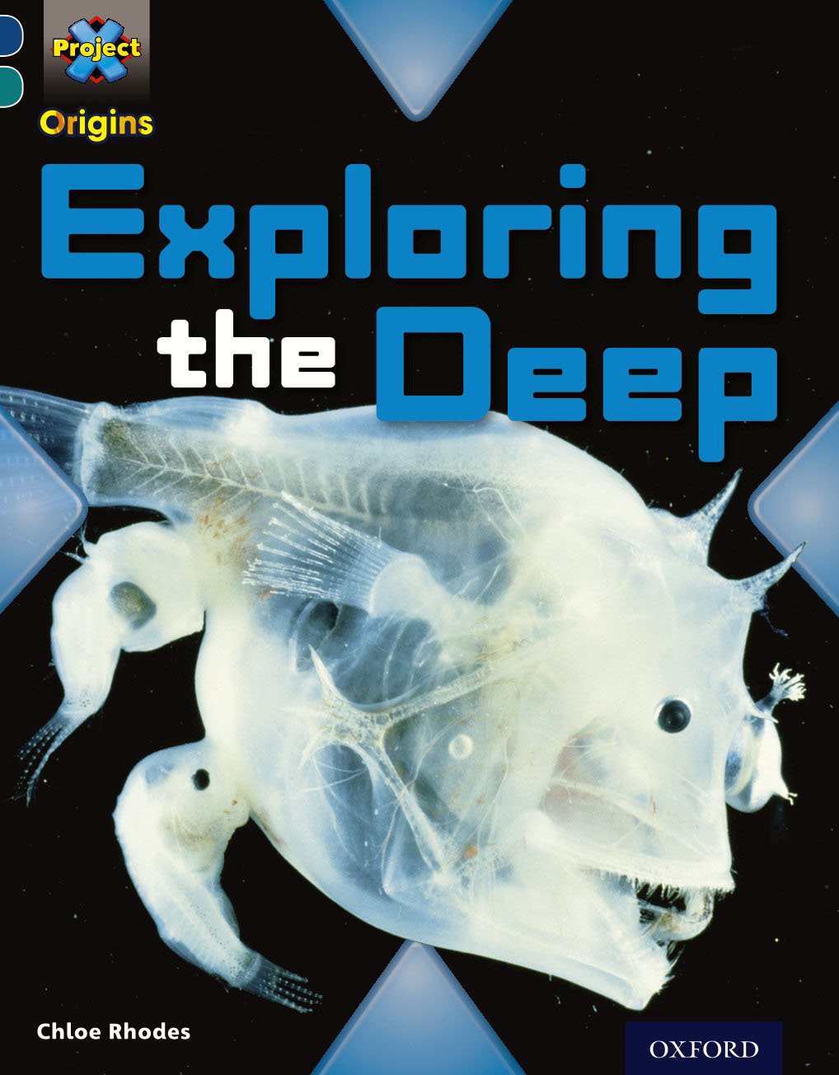

Today I would like you to read this book.

Slide 2
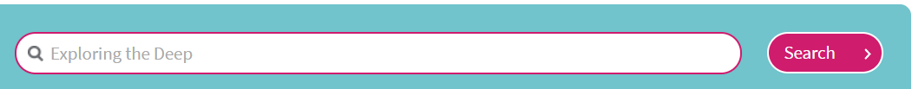
Here’s how to find the book
Log in to Oxford Owl using the details provided in your learning pack
Click on ‘Read Oxford Owl eBook library’
Type the name of the book in the box and click to search
Scroll down until you find the book
Click on

Slide 3
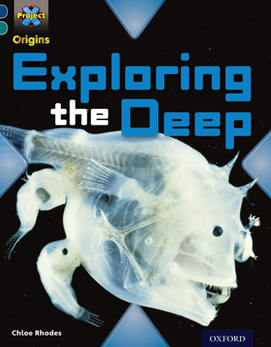
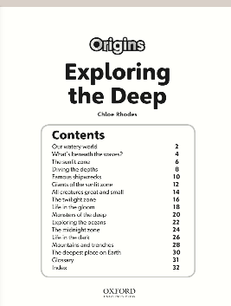
Before you start reading, have a look at the front cover. What kind of things would you expect to see in this book?
Will it be fiction or non-fiction?
What is the purpose of the contents page?
List the other features of a non-fiction text?

Slide 4
Now it’s time to read the book!
Why not share it with another person in your home so that you might be able to discuss some of the interesting parts! You never know they might learn something new too!

Slide 5
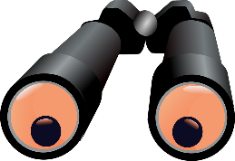
Now that you have read the book
the following pages will
have questions for you to answer.
But first don’t forget to use the strategies you have learnt to help find the answers:
Skim and scan.
Look for key words from questions to find in the text.
Read around sentences and words for context and meaning.

Slide 6
Pages 2/3
What percentage of our planet is covered in water?
How many oceans are there and can you name them?

Slide 7
Pages 8/9
What do you need to be able to dive?
Why is the word ‘licence’ in bold?
Would you like to be a diver? Give your reasons.

Slide 8
Pages 10/11
There are 4 famous shipwrecks can you put them in date order starting with the oldest?
Which one have you heard about before?
Research and find out about another shipwreck?

Slide 9
Pages 14/15
Why are Phytoplankton so important?
Explain the word ‘camouflage’ and how it protects the shark from predators.

Slide 10
Pages 16/17
Explain the twilight zone and why humans can’t dive there?
What is a Jim Suit?

Slide 11
Pages 22/23
Who was Jacques Piccard?
Why was his descent in the Trieste particularly significant?
If you interviewed Jacques Piccard what questions would you ask him?

Slide 12
Pages 26/27
What are Hydrothermal vents?
How do the vents support life in the deepest, darkest part of the ocean?
What creatures live there?

Slide 13
Page 30
Where is the deepest place on earth?
Who were the only people to visit this gorge and what did they find?
What has happened since they visited?

Slide 14
Finally, where would you like to explore and find out more about?
Do some research and make your own fact file!

