Slide 1
Thursday 14th October 2020
To use a timeline to sequence an international event

Slide 2
Vocabulary
Timeline - a graphical representation of a period of time, on which important events are marked
Czechoslovakia - a former republic in central Europe: formed after World War I now known as Czech Republic and Slovakia
Chronology - the arrangement of events or dates in the order of their occurrence
Chancellor - a senior state or legal official
Influential - having great influence on someone or something
Nazis - a member of the National Socialist German Workers' Party
Adolf Hitler - Nazi dictator of Germany, born in Austria: Chancellor 1933–45; dictator 1934–45.

Slide 3
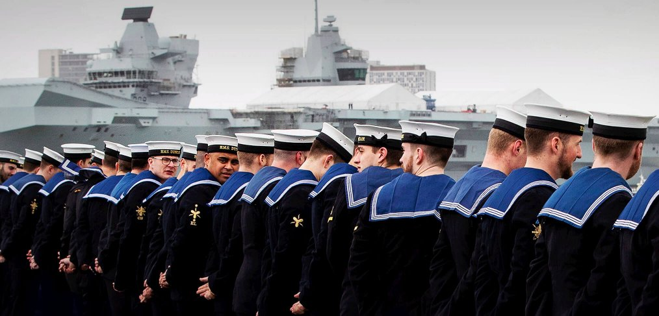
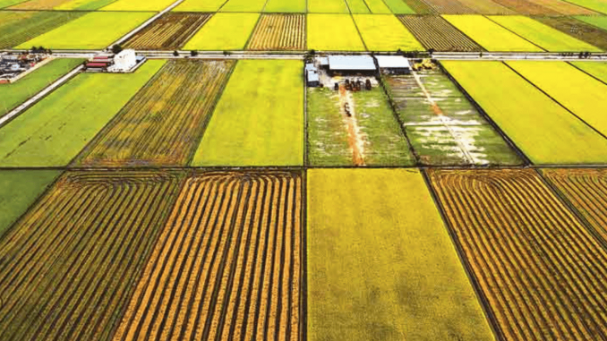
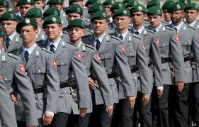
1918
Germany were defeated in WW1. As a punishment they had to give up much of their land. They were not allowed to have an army or navy either and this made a lot of the German people angry.

Slide 4
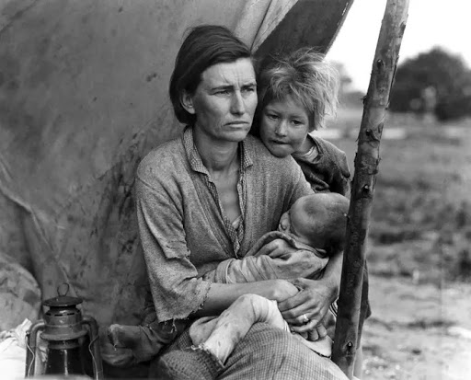
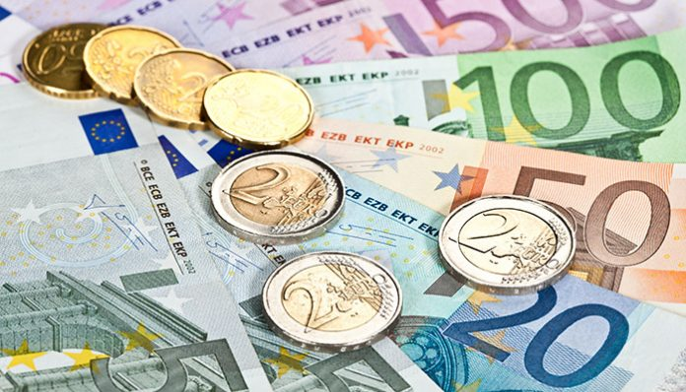
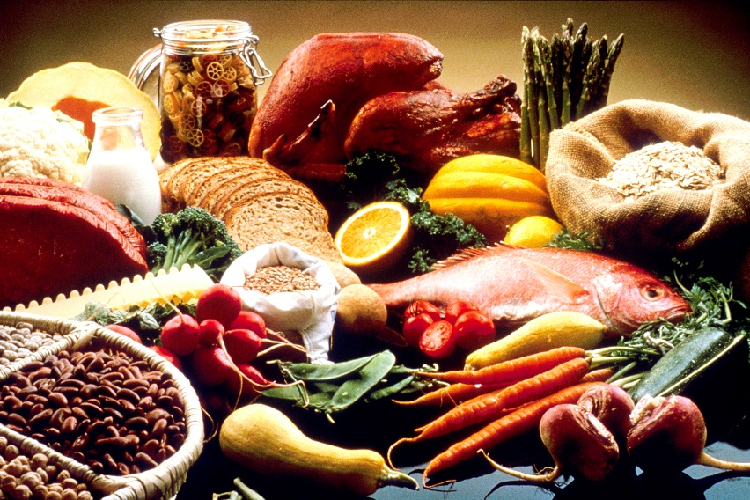
1929
The great depression began and Germany suffered heavily. There was a shortage of food and money.

Slide 5
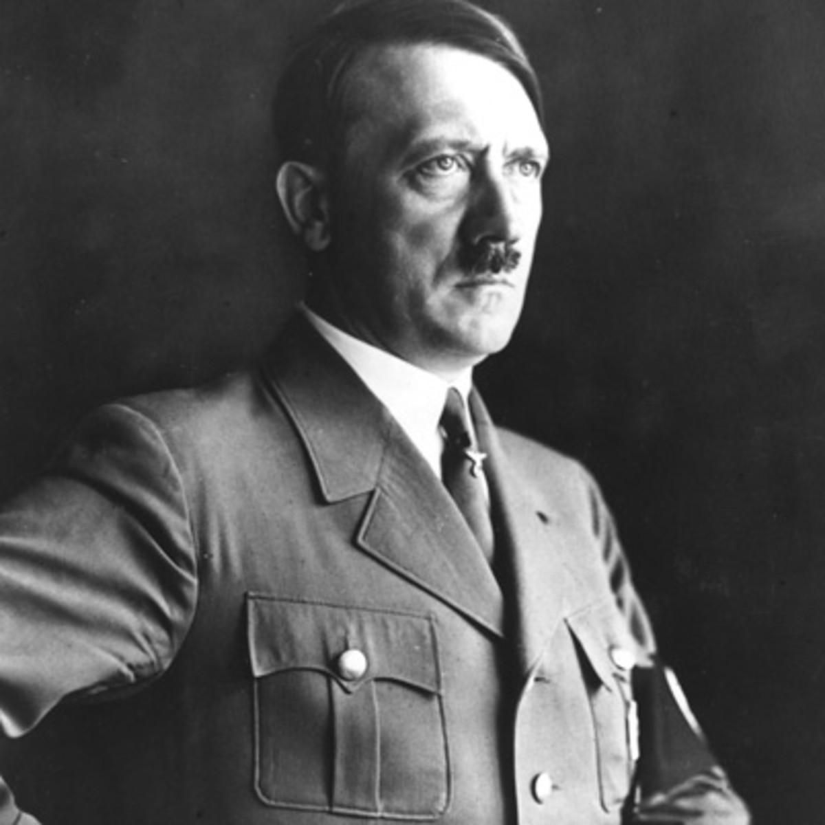
1933
Adolf Hitler became chancellor of Germany and created the National Socialist party, known as the Nazis. Many people hoped he would bring positive change and make the country better. However, he brought lots of negativity and hatred to the country.

Slide 6
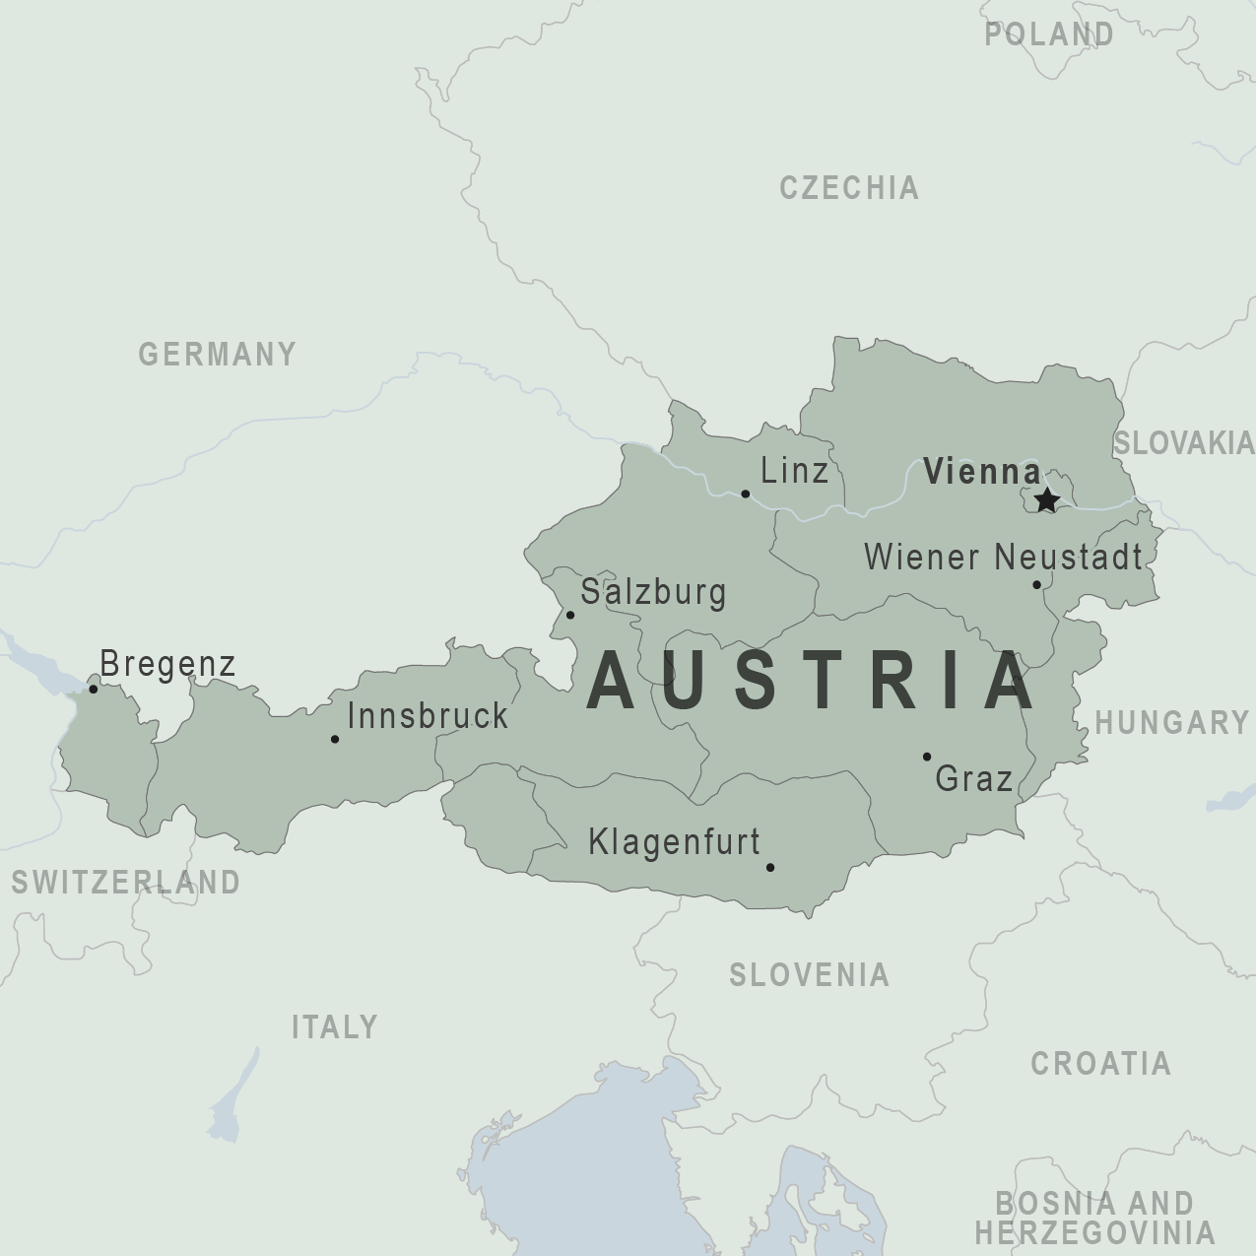
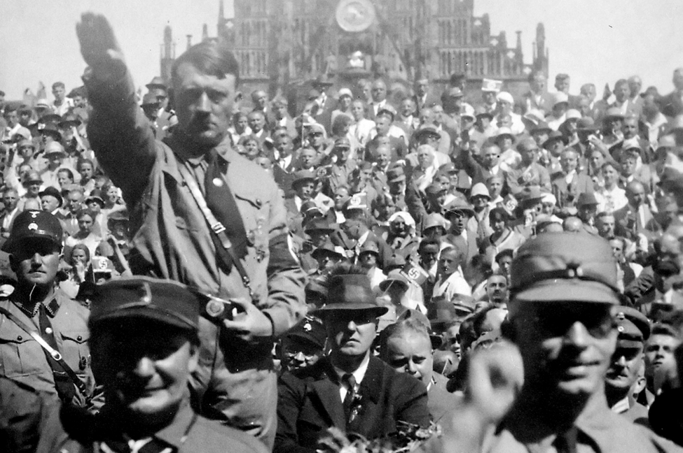
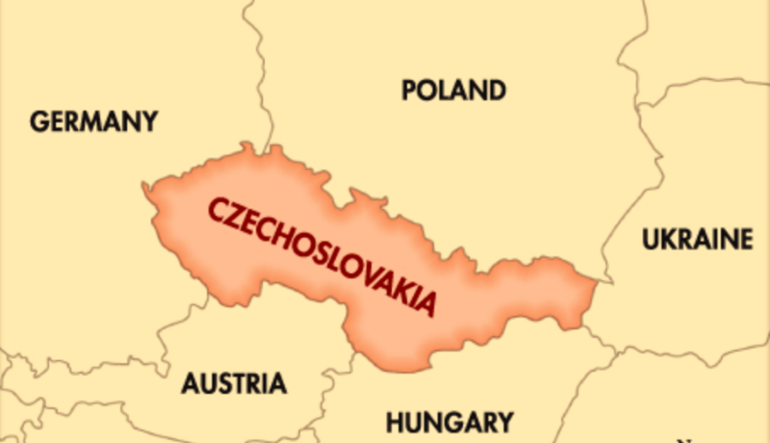
1938
Hitler sent German troops to ‘occupy’ Austria and Czechoslovakia.

Slide 7
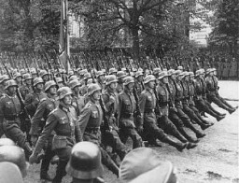
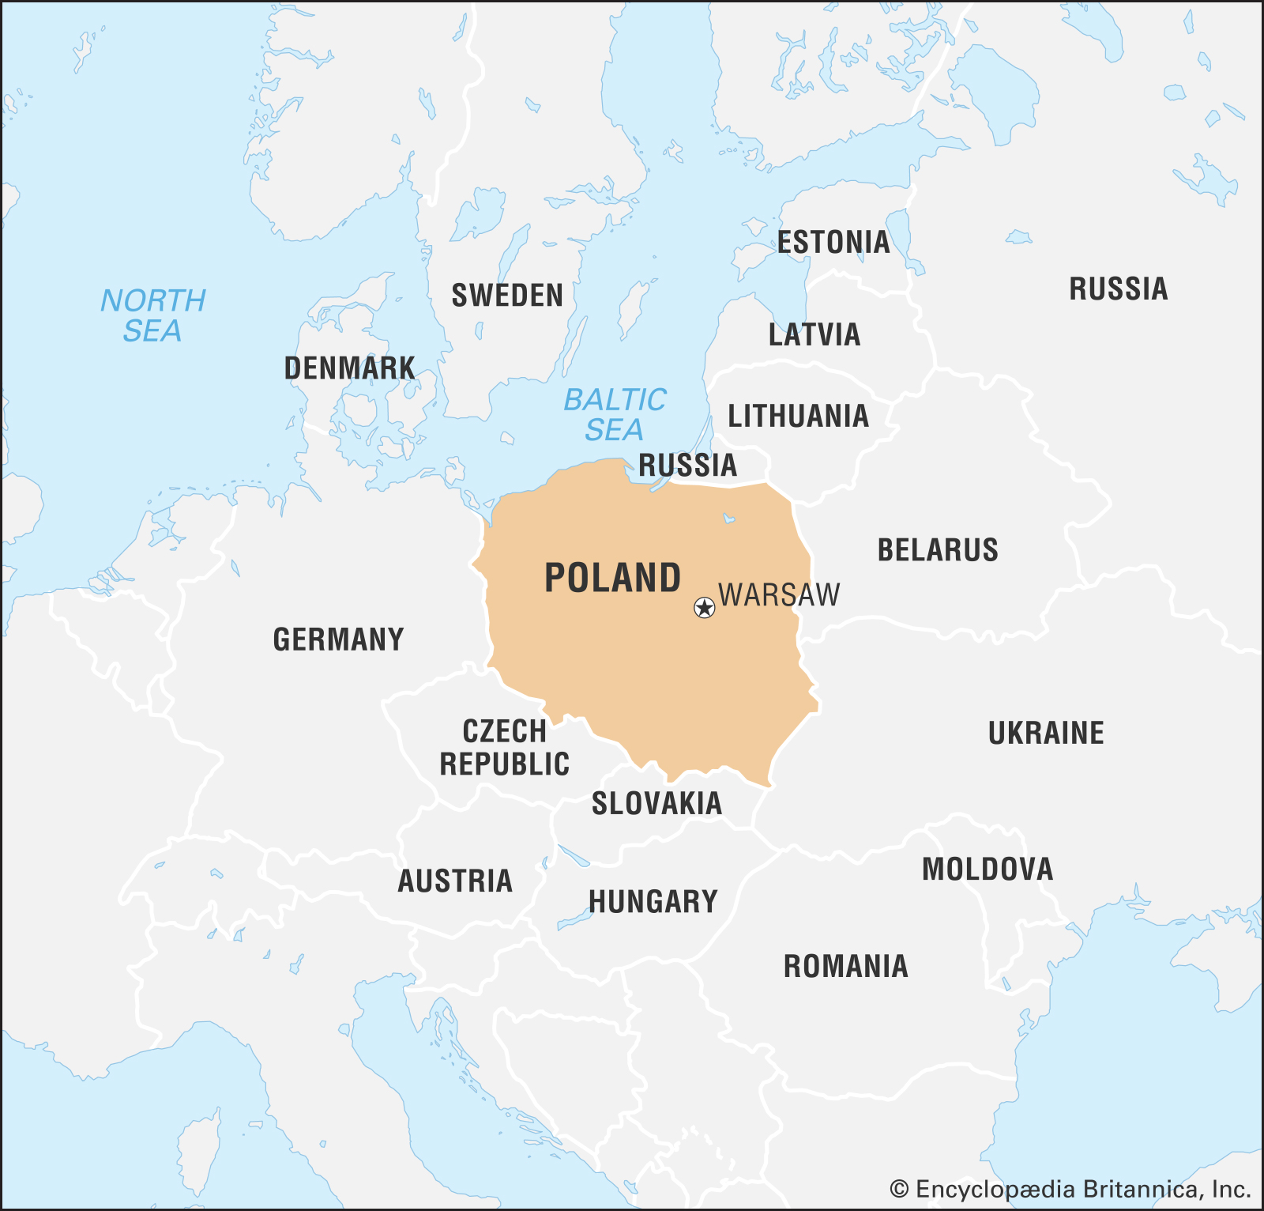
1939
German troops invaded Poland.

Slide 8
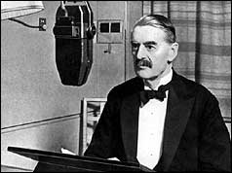
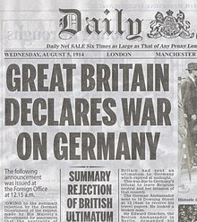
1939
Britain and France, who were allies of Poland, gave Hitler an ultimatum - withdraw the troops or they would declare war. Hitler refused so Britain and France declared war on Germany. So on September 3rd 1939 Neville Chamberlain, Prime minister of Britain, declared the beginning of WW2.

