Slide 1
Set 1 Sounds ch

Slide 4
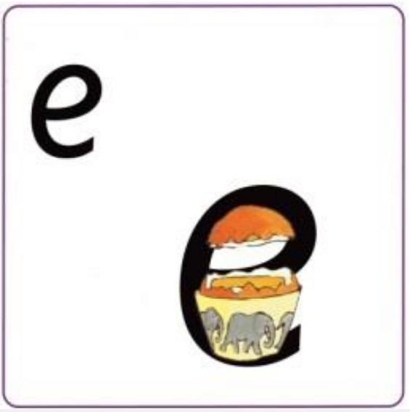
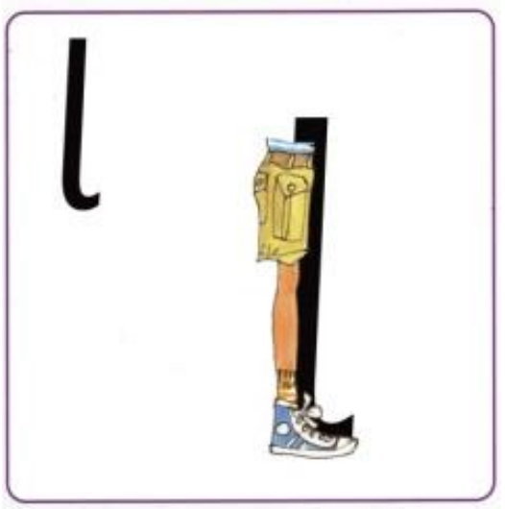

Slide 5
ch

