Slide 1
Learning Intention, uses talk to organise, sequence and clarify thinking, ideas, feelings and events.

Slide 3
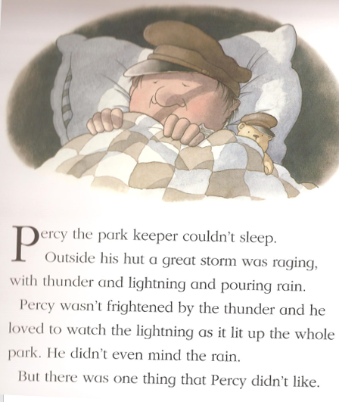
Can you remember what the one thing Percy did not like was?

Slide 4
How do you think Percy is feeling?

Slide 5
Look closely, what do you think has happened to the branch of the tree?

Slide 6
Can you name some of the animals that lived in the oak tree?

Slide 7
What do you think it would feel like in pine wood?

Slide 8
What were the two things that happened to Percy and the animals?

Slide 9
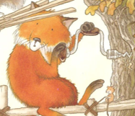
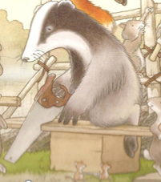
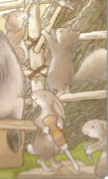
Which jobs were the squirrel, fox, badger and mice given by Percy to do?

Slide 10
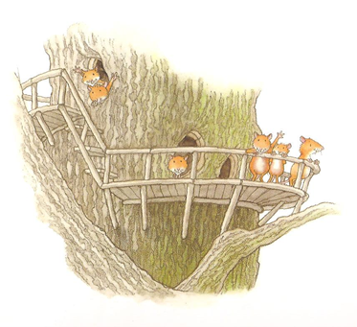
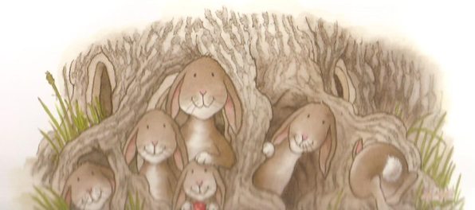
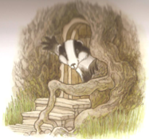
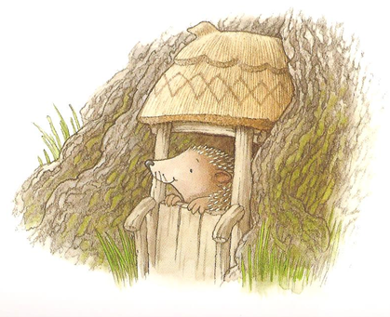
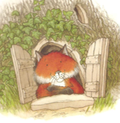
How do you think Percy’s friends feel in their new homes?

