Slide 1
Understanding the key features of fractions

Slide 2
Numerator
This is the top part of a fraction.
It is used to show how many parts are being discussed.
numerators

Slide 3
Denominator
The denominator is the bottom part of a fraction.
It is used to show how many parts there are in total.
Denominators

Slide 4
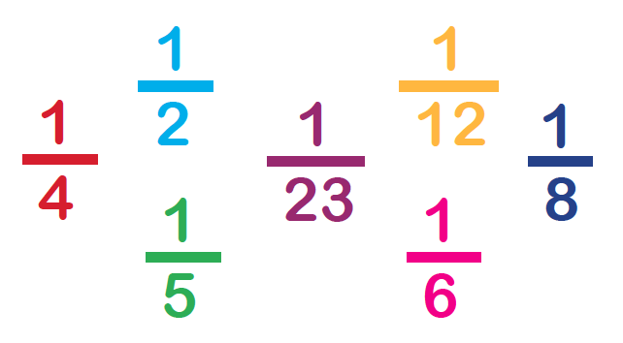
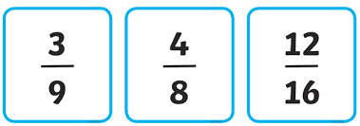
Unit and non-unit fractions
A unit fraction is a fraction where the numerator is 1.
A non-unit fraction is where the numerator is more than 1.
Unit fractions Non-unit fractions

