Slide 1
Learning intention: To represent numbers in different ways.

Slide 2
Use the number line to count to 10.

Slide 3
Today we are going to look at teen numbers, numbers between 11 and 20 and represent them using Numicon.

Slide 4
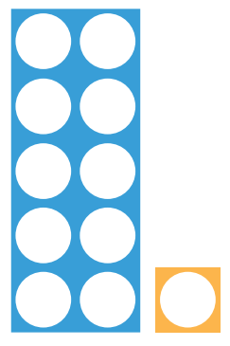
11

Slide 5
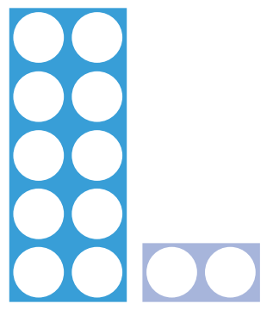
12

Slide 6
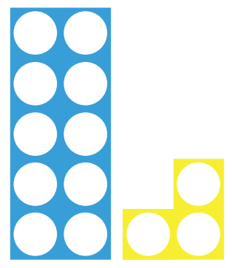
13

Slide 7
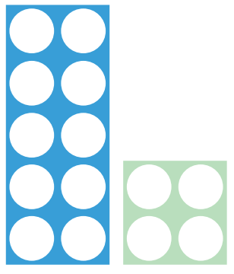
14

Slide 8
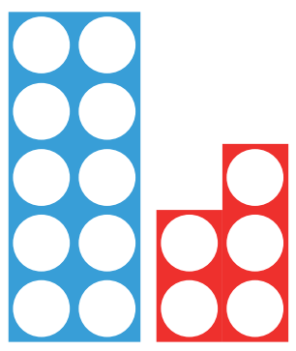
15

Slide 9
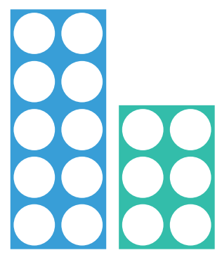
16

Slide 10
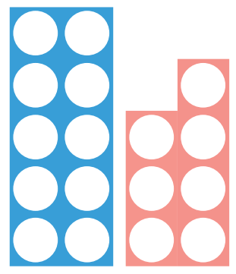
17

Slide 11
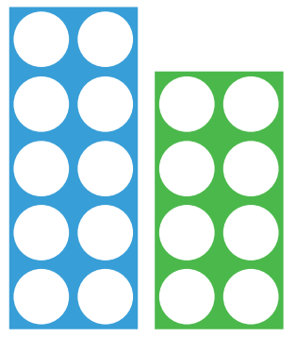
18

Slide 12
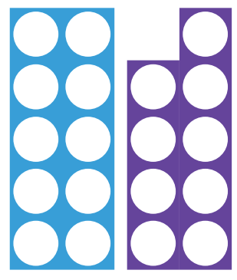
19

Slide 13
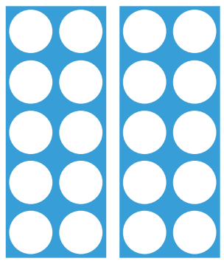
20

Slide 14
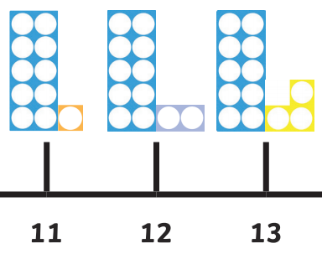
Use the number line to see if you can count from 11 to 20.

