Slide 1
Poetry
To identify some features of a poem.
To read a poem aloud.
Vocabulary:
poem
line
verse
rhyme
rhythm
pattern
repeated

Slide 2
Line:
This can be long or short and does not always have a full stop at the end like a sentence.
Verse :
A section of the poem
Rhythm:
Regular repetition of sounds.
We clapped our hands to the rhythm of the drums.
Rhyme:
Two words sound the same when spoken out loud. They don’t need to be spelt the same. EG- me, sea
Repetition:
When a word or phrase is used more than once.
Pattern:
Sometimes the same lines are repeated in the poem so it creates a pattern

Slide 3
These are called ellipsis. You have little pauses between the words. In this line it makes you slow down as you are counting backwards
These two words are not spelt the same but rhyme.
These two words rhyme.
This verse has two pairs of rhymes.
We call this rhyming couplets.
I wonder if the other verses will have these.

Slide 4
This comma makes you take a very short pause and helps with the rhythm of the poem.
Three words in this line start with the same letter sound. This is called alliteration.
Was there any rhyme in this verse?
Was it the same rhyme pattern as the first verse?
Is there a rhythm when you read this?

Slide 5
An exclamation mark. Can you read this and use your voice to sound excited.

Slide 6
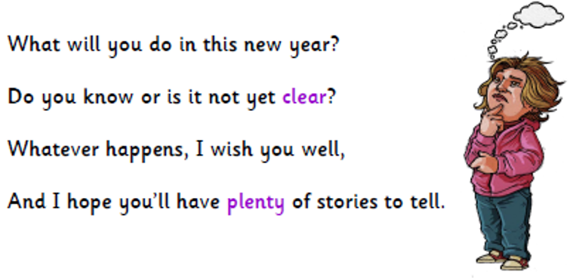
When we see a question mark as we read our voice goes up a little bit. So we know you are asking a question. You try it.
Remember this punctuation mark

Slide 7
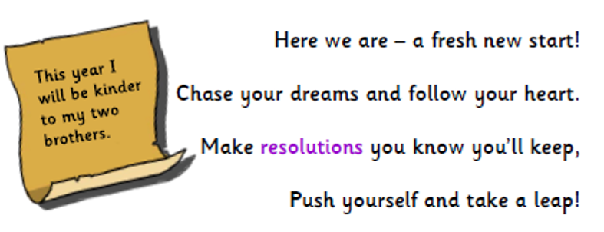

Slide 8
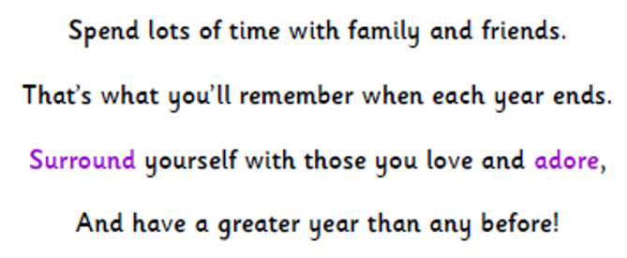
Read this verse and make the purple words stand out more by using your voice.

Slide 10
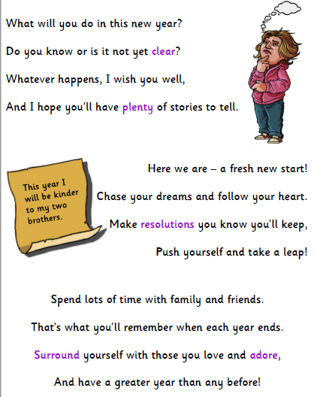

Slide 11
Task:
Either read or listen to the poem again. This time make sure you look out for the punctuation.
Can you hear the rhythm and pattern when you are reading it?

