Slide 1
LI: To retell a traditional tale.
English
To create a new story map with the three new characters

Slide 2
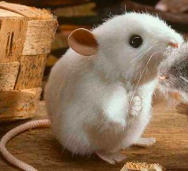
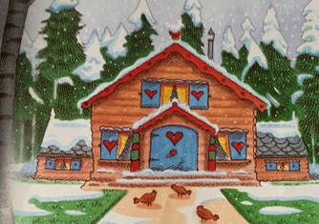
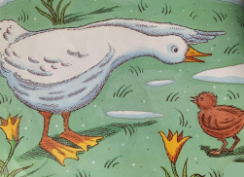
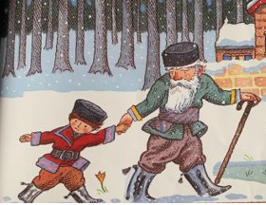
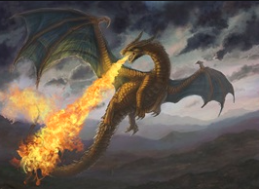
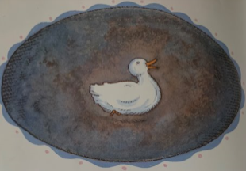
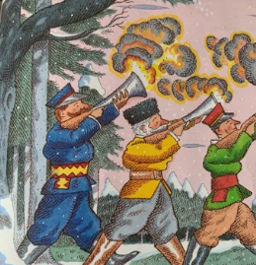
I am going to retell my story using my new characters.

Slide 3
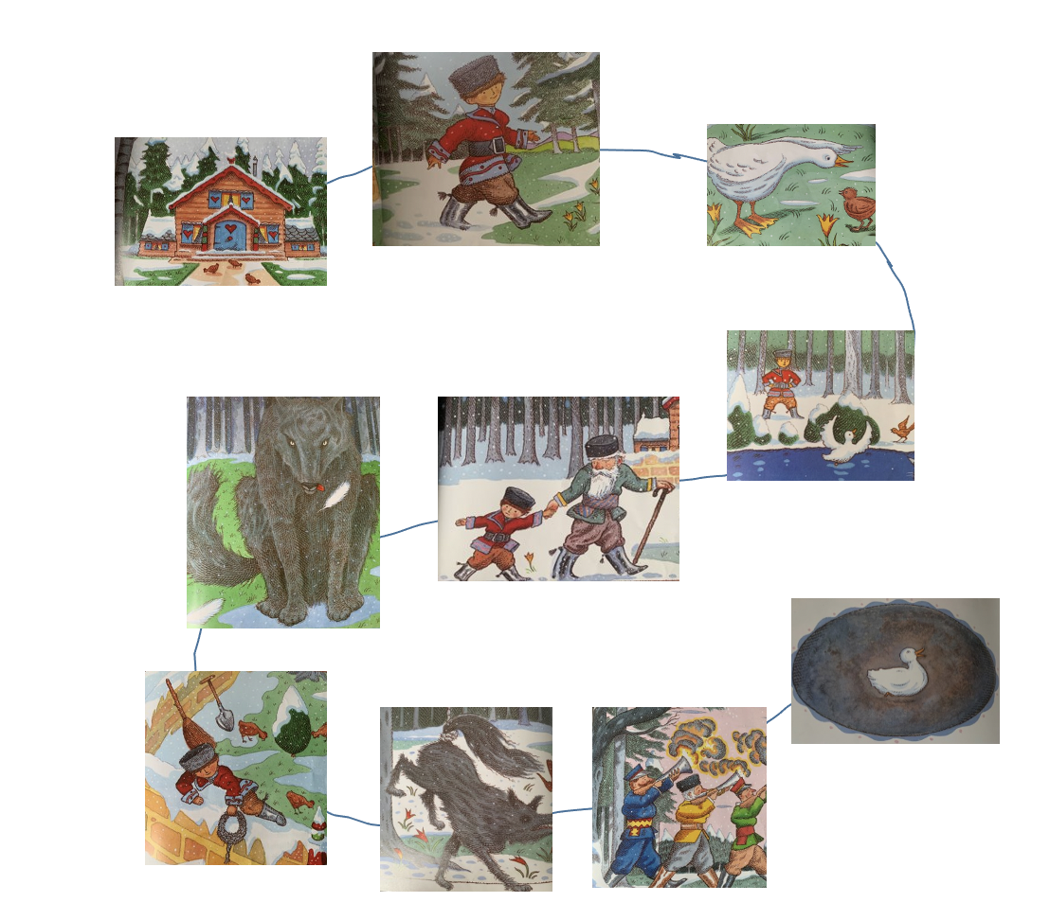
Spot the difference:

Slide 4
It’s the same story…
with new characters!

Slide 5
You designed new characters:

Slide 6
Now you need a new story map:

