Slide 1
What am I?
Read the clues and guess
How many clues will you need?

Slide 2
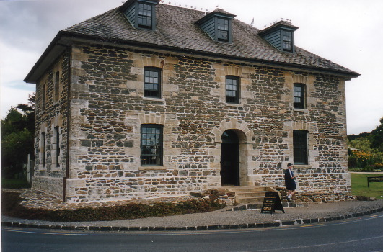
I am made of rock
But I’m not a building

Slide 3
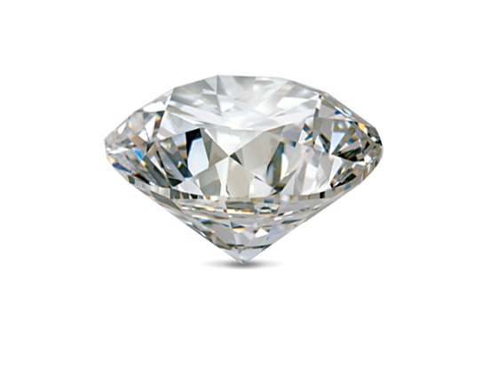
I am very precious
But I’m not a diamond

Slide 4
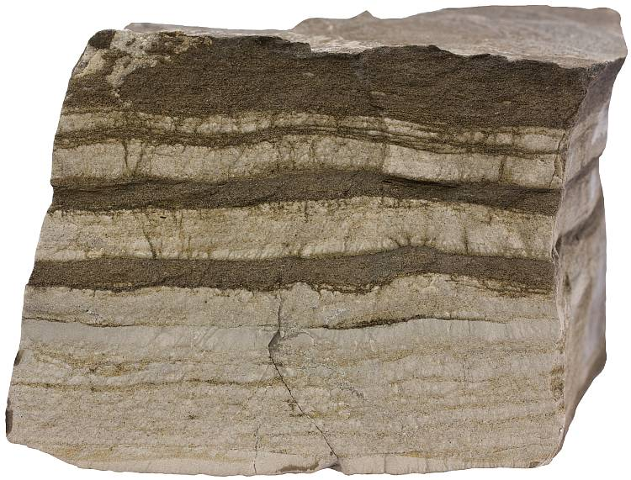
I am made of different layers
But I am not sedimentary rock

Slide 5
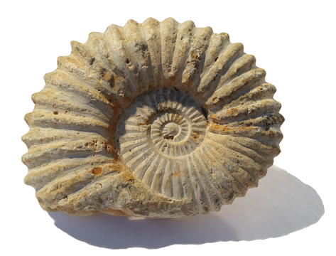
It takes 500 years to make 2cm of me
But I’m not a fossil

Slide 6
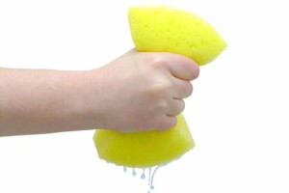
Half of me is made of air and water
But I’m not a wet sponge

Slide 7
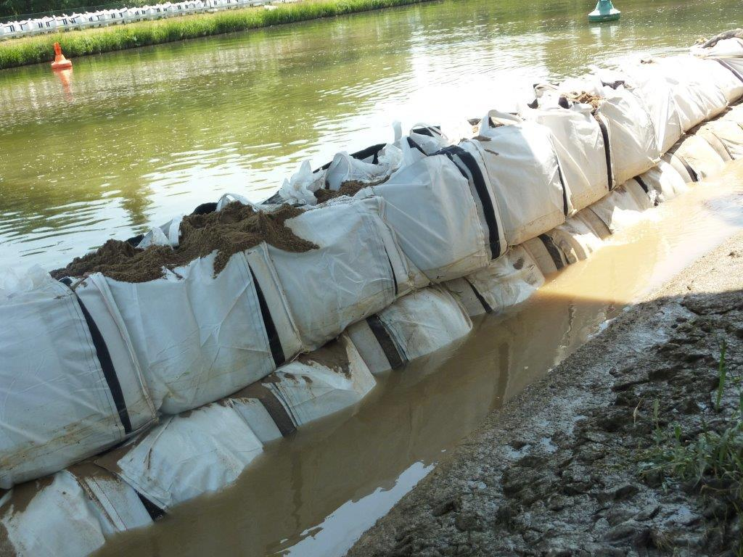
I can help prevent flooding
But I’m not a flood barrier

Slide 8
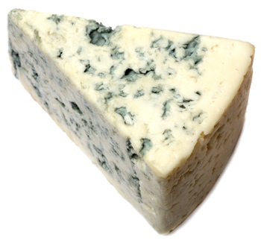
A handful of me contains more micro-organisms than there are people on the Earth
But I’m not mouldy cheese!

Slide 9
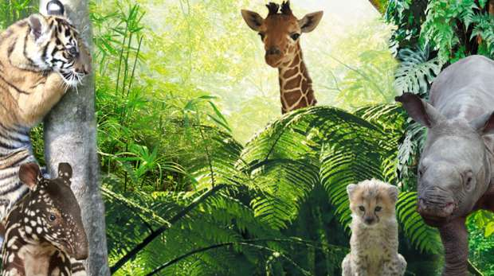
I am home to many creatures
But I’m not a zoo or a farm

Slide 10
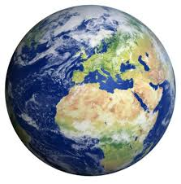
Without me there would be no life on Planet Earth!

Slide 11
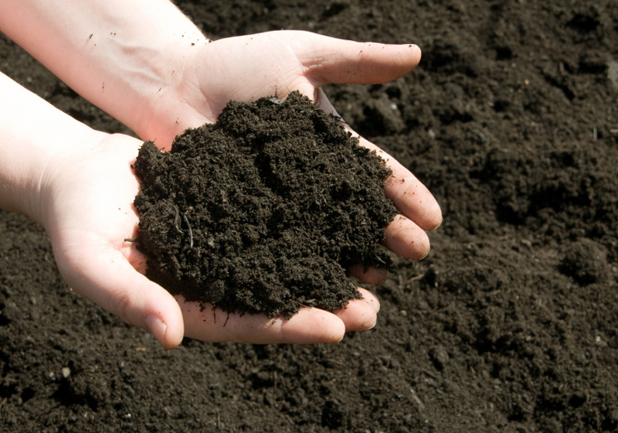
?
Have you guessed what I am?
Soil

Slide 12
Science
Learning intention: Recognise what soil is made from

Slide 13
What is soil?
https://www.bbc.co.uk/bitesize/topics/zjty4wx/articles/ztvbk2p#:~:text=Soil%20is%20a%20mixture%20of,properties%20depending%20on%20their%20composition.&text=It's%20made%20from%20very%20old,crumbly%20and%20rich%20in%20nutrients.
Soil is a mixture of rock, dead plants and animals, air and water.
It is a loose material that lies on top of the land.
Where do we find soil?

Slide 14
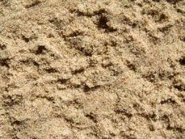
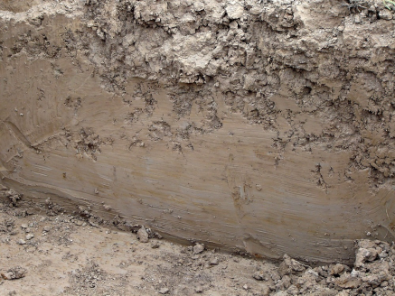
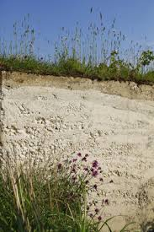
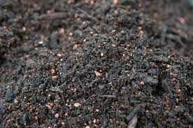
Different types of soil
There are different types of soil which have different properties.
Sand- A pale coloured soil with air gaps. Water drains through sand easily so it often feels dry.
Clay- A sticky soil with hardly any air gaps.
Chalky soil- Soft, light brown soil. Water drains through it quickly.
Peat- A soil made from old, decayed plants. It is dark, crumbly and rich in nutrients.

Slide 15
How soil is formed
Soil is formed through weathering. This can be physical, biological or chemical.
Rocks are broken down into smaller pieces over a long period of time which creates top soil.

Slide 16
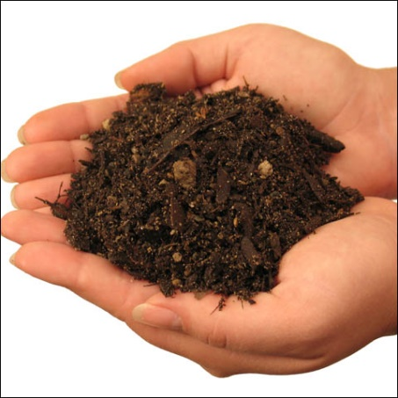
A handful of soil contains more micro-organisms than there are people on the planet
Without soil there would be no life on Earth
It can help prevent flooding because it can absorb large amounts of water
Is made from rock and other things
Half of it is made of air and water
Is very precious because everything needs it to survive
Soil
Is made of different layers in the ground
It takes more than 500 years to make 2cm of soil

