Slide 1
Alternative 2 - Maths Quiz

Slide 2
Place Value
How many tens in the number 421?
What does the 7 represent in the number 750?
Write the number three hundred and nineteen.

Slide 3
Fractions
4) What is the numerator in the fraction ¼ ?
5) Is 3/5 a unit fraction or a non-unit fraction?
6) Is ¼ equivalent (the same as) to 2/8?
7) What is 1/4 of 20

Slide 4
Addition and Subtraction
8) 487 + 303 =
9) 684 – 129 =
10) Fill in the ? 68?
+ ?06
9?7

Slide 5
Money
11) £6.30 = …… p
12) How much money do I have here?

Slide 6
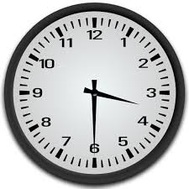
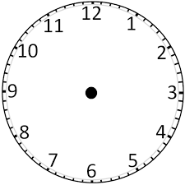
Time
13) What is this time?
14) Draw the time 8 o’clock on the clock
15) It is 7 o’clock and I play games for 30minutes. What time do I finish?

