Slide 1
Learning intention Identify a text style

Slide 2
Let’s read these examples of diaries together.

Slide 3
Friday 30th November 2012
Dear Diary,
I had the best day EVER today. I woke up this morning, the sun was shining through the curtains and I could smell breakfast cooking downstairs. I jumped out of my bed, threw on my school clothes and skipped down to the kitchen.
Talk to you later,
Ben

Slide 4
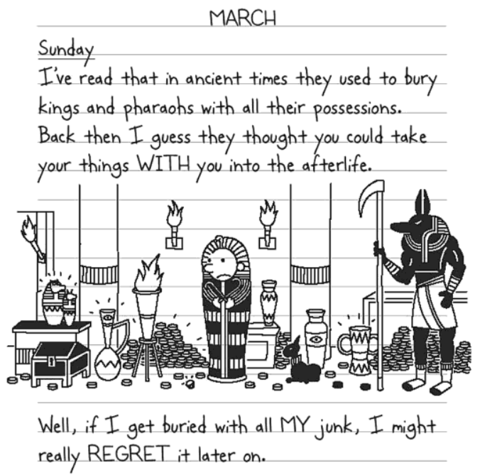

Slide 5
Saturday 11.6.13
Dear Diary,
Today has been great! It was my birthday today and I got a lot of presents from my friends and family. My favourite was a big, green dinosaur. After I opened all my presents I went to my friend Paul’s house and we played football.
Peter

Slide 6
Wednesday 7.7.15
Dear diary,
Today has been really fun! First I went to Chester Zoo with my sister, Grandma and Grandad. I saw a huge gorilla and it was playing with a ball!
Then I went to the elephant pen and saw an elephant drink with its trunk! Next we went to a sea lion show and I got really wet.
Gemma

