Slide 1
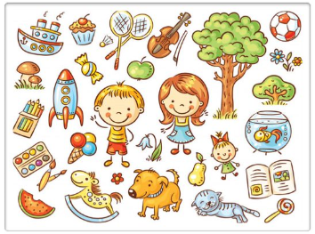

Warm up!
Can you find:
dog
doll
cat
melon
ball
apple
Notes:
Hello! Before we start, let’s warm up our brains and see if you can find the following…
A dog, a doll, a cat, a melon, a ball and an apple. The answers are at the end of the powerpoint.

Slide 2
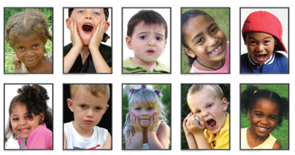
How are the children feeling?
Notes:
How are the children feeling? Point to who is feeling happy. How do you know?
Is anyone feeling sad? Point to them. Is anyone feeling scared? Point to them too. Can you see any other feelings?

Slide 3
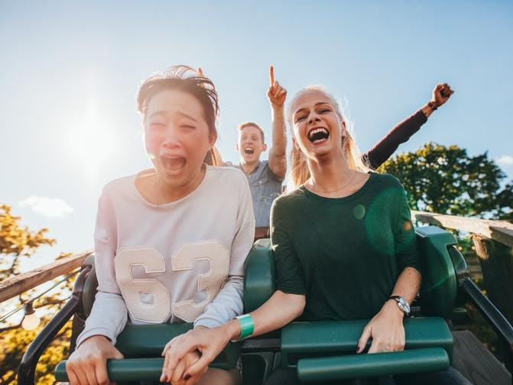
We are working on our inference skills…
Notes:
We will be working on our inference skills today. This means that we are using what we know and looking for clues to find out more!
For example, in this picture I think that the lady with brown hair is scared because her eyes are nearly closed, she looks like she is shouting and her friend is holding her hand. I think that the lady next to her is excited and happy because she has a huge smile on her face. The man at the back looks a little nervous but like he is having fun! Do you agree?

Slide 4
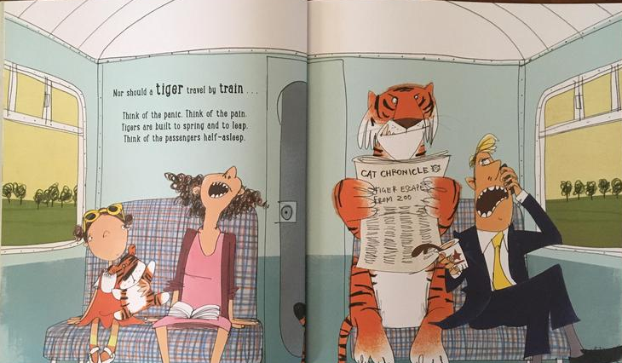
Now it’s your turn…
Notes:
Now it’s your turn! How does each character feel? Think about which word or face you would draw to describe it.

Slide 5
Let’s share ideas!
cross
curious
grumpy
Notes:
Let’s share ideas! I think that the little girl might like tigers because of her teddy, so she is curious about the tiger on the train. I think that the tiger is cross as the man next to him is being very loud on the phone! Finally, I think that the man on the phone is feeling grumpy about his phone call because he is frowning.

Slide 6
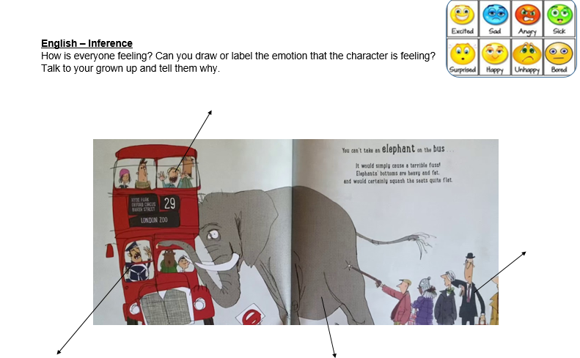
Have a go at the worksheet…
Notes:
Have a go at the worksheet now, can you tell how they are feeling? Can you write how they are feeling? You can also draw a face like I did, use the box to help you.

Slide 7
Warm up - Answers
Can you find:
dog
doll
cat
melon
ball
apple

Slide 8
Commentary:
Slide 1: Hello! Before we start, let’s warm up our brains and see if you can find the following… A dog, a doll, a cat, a melon, a ball and an apple. The answers are at the end of the powerpoint.
Slide 2: How are the children feeling? Point to who is feeling happy. How do you know? Is anyone feeling sad? Point to them. Is anyone feeling scared? Point to them too. Can you see any other feelings?
Slide 3: We will be working on our inference skills today. This means that we are using what we know and looking for clues to find out more! For example, in this picture I think that the lady with brown hair is scared because her eyes are nearly closed, she looks like she is shouting and her friend is holding her hand. I think that the lady next to her is excited and happy because she has a huge smile on her face. The man at the back looks a little nervous but like he is having fun! Do you agree?
Slide 4: Now it’s your turn! How does each character feel? Think about which word or face you would draw to describe it.
Slide 5: Let’s share ideas! I think that the little girl might like tigers because of her teddy, so she is curious about the tiger on the train. I think that the tiger is cross as the man next to him is being very loud on the phone! Finally, I think that the man on the phone is feeling grumpy about his phone call because he is frowning.
Slide 6: Have a go at the worksheet now, can you tell how they are feeling? Can you write how they are feeling? You can also draw a face like I did, use the box to help you.

