Slide 1
Maths
Multiplying by 10

Slide 2
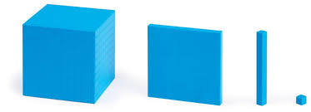
Thousand
Hundred
Ten
One
Multiplying by 10.

Slide 3
47 x 10 =
470
Th
H
T
O
4
7
4
7
0
Multiplying by 10.

Slide 4
390 x 10 =
3900
Th
H
T
O
3
9
0
3
9
0
0
Multiplying by 10.

Slide 5
3.2 x 10 =
32
Th
H
T
O
$$\frac{1}{10}$$
3
2
3
2
Multiplying by 10.

Slide 6
53.62 x 10=
536.2
Th
H
T
O
$$\frac{1}{10}$$
$$\frac{1}{100}$$
5
3
6
2
5
3
6
2
Multiplying by 10.

Slide 7
0.7 x 10 =
7
Th
H
T
O
$$\frac{1}{10}$$
0
7
0
7
Multiplying by 10.

Slide 8
0.95 x 10 =
9.5
Th
H
T
O
$$\frac{1}{10}$$
$$\frac{1}{100}$$
0
9
5
0
9
5
Multiplying by 10.

