Slide 1
Britain defending themselves against The Picts

Slide 2
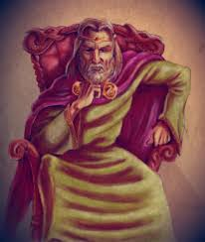

The Ruler of Britain at the time
The Ruler of Britain after the Roman’s left was called King Vortigern. Once the Romans were all gone, he was very worried about the Picts coming to attack and invade Britain.

Slide 3
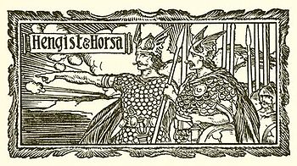
Who did he get to help him?
King Vortigern was a wealthy man with lots of land. He decided to use his wealth and power to invite someone to come and help him fight the Picts and keep them in Scotland.
He invited two Saxon brothers,
Hengist and Horsa.

Slide 4
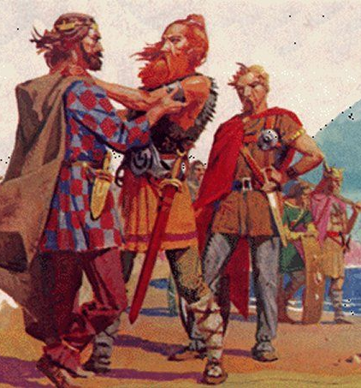

Did they decide to help?
Hengist and Horsa accepted the King’s invitation and arrived in England to help the King.
They did a very good job and kept the Picts away from English land.

Slide 5
Today’s task
You are going to imagine that you are King Vortigern. You need to write a letter to the Saxon brothers, persuading them to come and fight for you.
Things to possibly include in your letter:
Compliments saying how good you think they are at fighting
What the job you need them to do is
What reward will they get if they help you
I have written an example on the next slide.

Slide 6
To brothers Hengist and Horsa.
I am the King of Britain, King Vortigern. I have searched in many countries for great warriors, and I believe you are the strongest and cleverest warriors there are.
I am having some trouble with some Scottish warriors called The Picts. I am worried they will attack my country, so I need you to come and attack them. I want them to be so scared they will never attack me again.
To reward you for your hard work I will give you any many gold coins as you can carry and you will be allowed to live on your own small island near Britain.
I hope you accept my offer.
Sincerely,
King Vortigern
The first part explains who I am and why I have picked the brothers.
The second part tells them what the problem is
The final part tells them the reward they can have if they help.
Use this example letter to help you but don’t just copy it exactly!

