Slide 1

Maths Quiz!

Slide 2
Place Value
How many tens in the number 3,421?
What does the 7 represent in the number 7,342?
Write the number two thousand, three hundred and nineteen.

Slide 3
Fractions
4) What is the numerator in the fraction ¼ ?
5) Is 3/5 a unit fraction or a non-unit fraction?
6) Is ¼ equivalent to 2/8?
7) ?/5 of 25 = 10. What is the ?

Slide 4
Addition and Subtraction
8) 5887 + 4323 =
9) 6284 – 3529 =
10) Fill in the ? 368?
+ 2?09
61?5

Slide 5
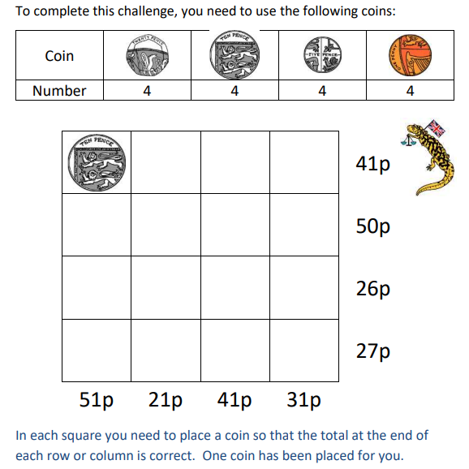
Money
11) £16.33 = …… p
12) Try complete the grid so each row and column adds up to the correct total →

Slide 6
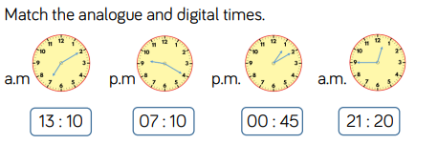
Time
13) It is quarter past seven now, what time will it be in 20 minutes?
14) It is 20 past 3 now and I started my work 25 minutes ago, when did I start?
15)

