Slide 1
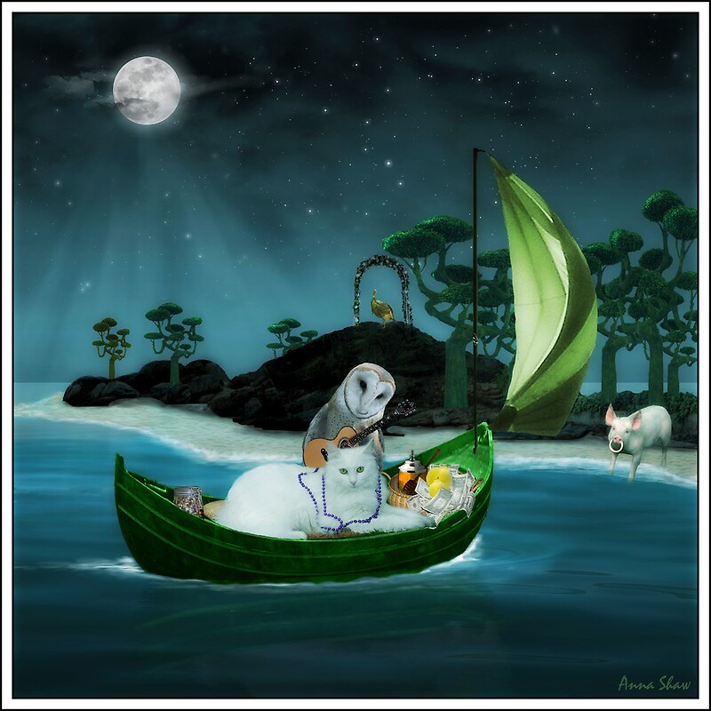
Learning Intention To discuss and respond to themes in a poem

Slide 2
Poem 1: The Owl and the Pussycat by Edward Lear
The Owl and the Pussy-Cat went to sea In a beautiful pea-green boat, They took some honey, and plenty of money, Wrapped up in a five pound-note. The Owl looked up to the stars above, And sang to a small guitar, 'O lovely Pussy! O Pussy, my love, What a beautiful Pussy you are, You are, You are! What a beautiful Pussy you are.'
Pussy said to the Owl, 'You elegant fowl, How charmingly sweet you sing. O let us be married, too long have we tarried, But what shall we do for a ring?' They sailed away for a year and a day, To the land where the Bong-tree grows, And there in the wood a Piggy-wig stood, With a ring in the end of his nose, His nose, His nose!
'Dear Pig, are you willing, to sell for one shilling Your ring?' Said the Piggy, 'I will.' So they took it away, and were married next day, By the Turkey who lives on the hill. They dined on mince, and slices of quince, Which they ate with a runcible spoon; And hand in hand, on the edge of the sand, They danced by the light of the moon, The moon, The moon! They danced by the light of the moon

Slide 3
Can you describe what is happening in this picture? When we describe a setting or character, we need to use adjectives.
Adjectives are describing words. They tell us what something looks likes, smells like, feels like or tastes like.
dark sky
green trees

