Slide 1
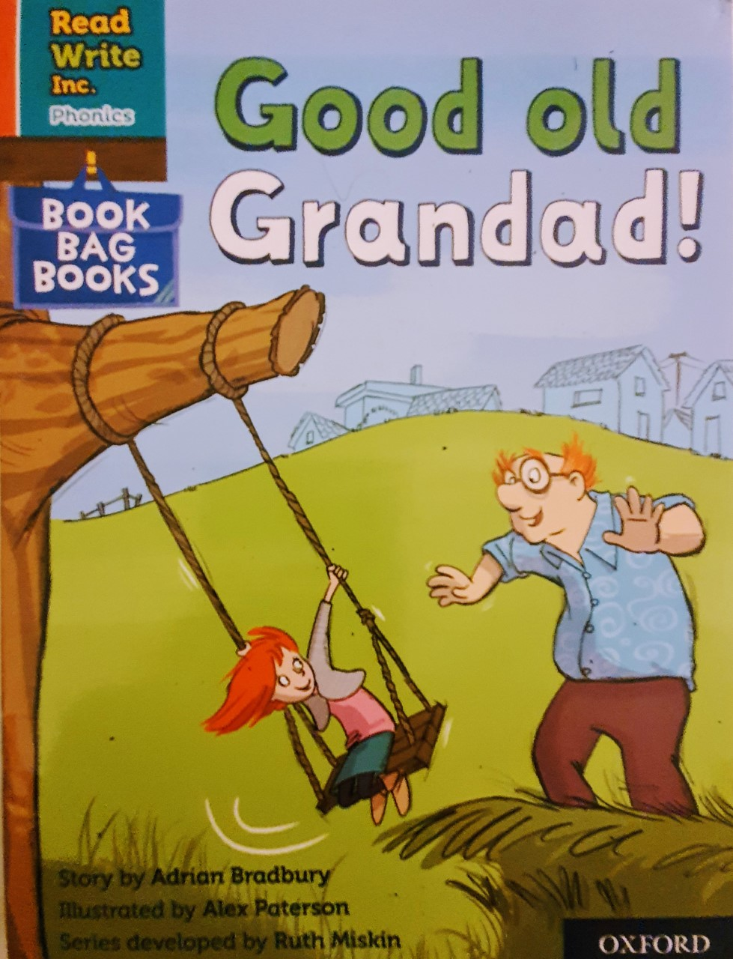

You are going to read the story ‘Good Old Grandad’
In this story you will hear words with the sound:
oo
The oo sound is in the word:
zoo
Can you write two words with the oo sound in?
Look at the picture. What can you see? What will happen in the story?

Slide 2
Let’s read these words together. These are words you will come across in the story.
Green Words
chicken
Grandad
Red Words
he’s I
I’m you
my be
the what
her me
she
old

Slide 3
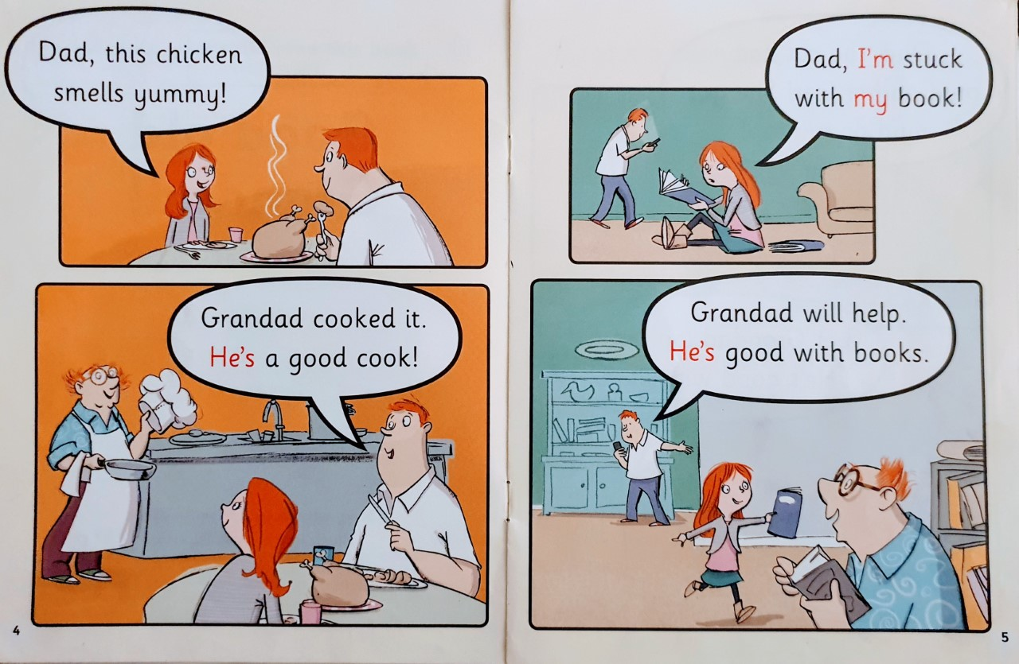
Write down all of the words you can see with the oo sound we are learning today.
What smells yummy?
What is the girl stuck with?
What two things is Grandad good at?

Slide 4
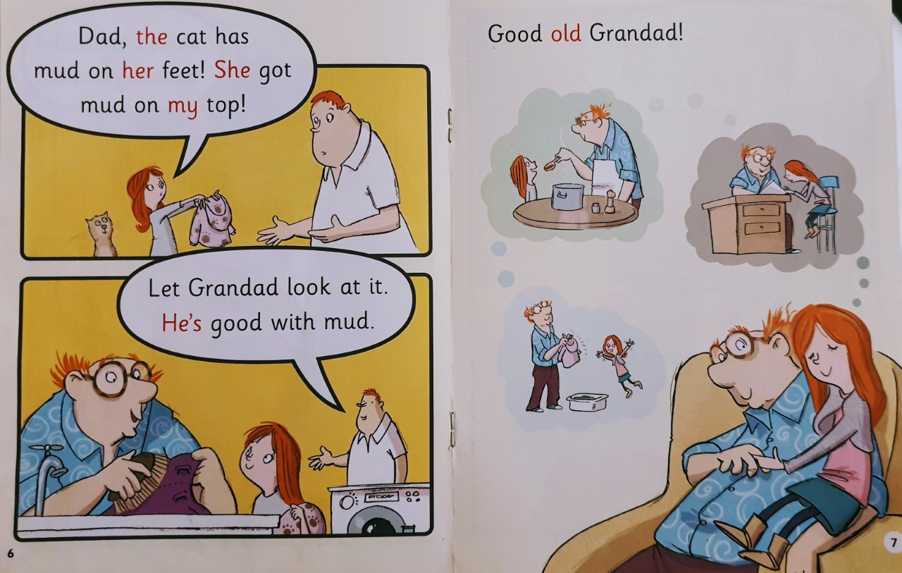
What did the cat get mud on?
What is the girl thinking about on page 7?

Slide 5
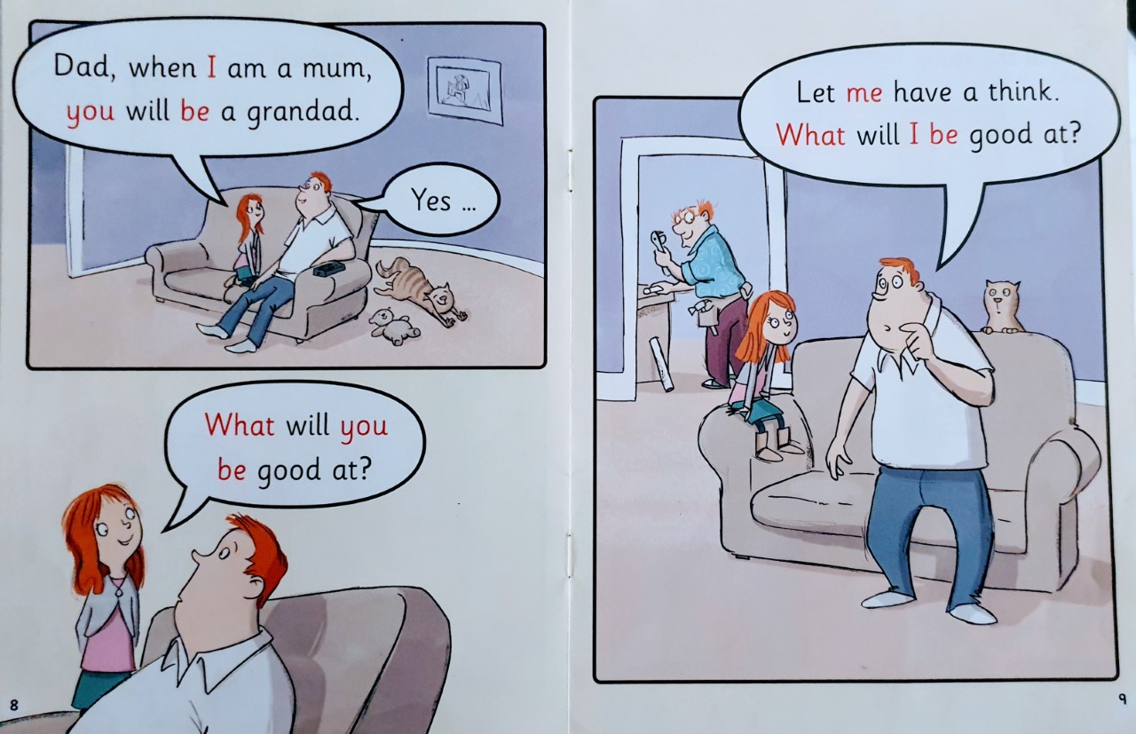
When the girl is a Mum what will her Dad be?
What question does the girl ask her Dad?

Slide 6
Recap Questions
p.4 Who cooked the chicken?
p.5 Why does the girl need Grandad’s help?
p.6 How did the girl’s top get mud on it?
p. 8-9 What do you think Dad will be good at when he is a Grandad?

