Slide 1
Can you remember from yesterday what a ‘traditional tale’ is?

Slide 2
Features of traditional tales:
Fairy tale language such as ‘once upon a time’
Magic
Good and evil characters
They are fiction

Slide 3
Snow White
Jack and the Beanstalk
Little Red Riding Hood
Examples
The Pied Piper
Peter and the Wolf

Slide 4
Today we are going to continue looking at pictures from our story.
Did you come up with questions like ours yesterday about the first five pictures? Have a think about the example questions.

Slide 5
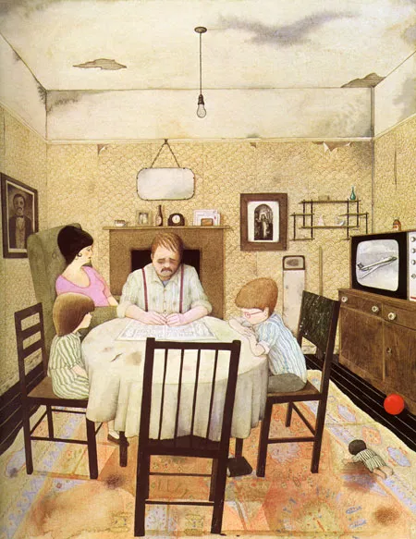
Teacher examples:
Who are these people?
Are they a family?
Why isn’t the lady sat with the others?
Why does the roof look so old?

Slide 6
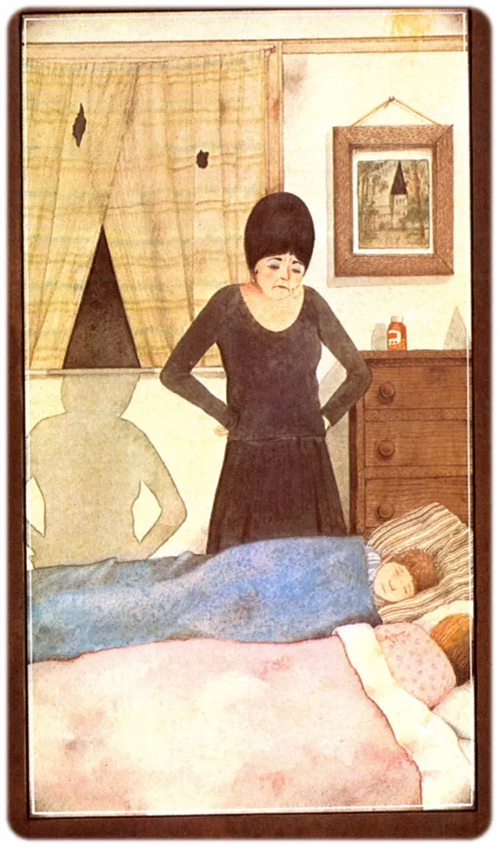
Teacher examples:
Is the lady angry?
Why does her shadow look like a witch?
Are the children awake or asleep?

Slide 7
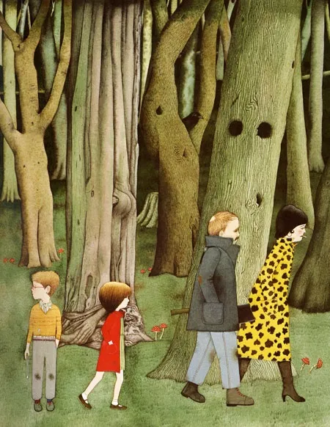
Teacher examples:
Where are they going?
Has the boy left something behind?
Is it a happy place?

Slide 8
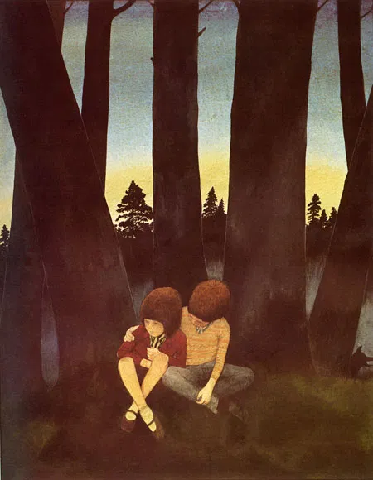
Teacher examples:
Why are they alone?
Where are the adults?
?

Slide 9
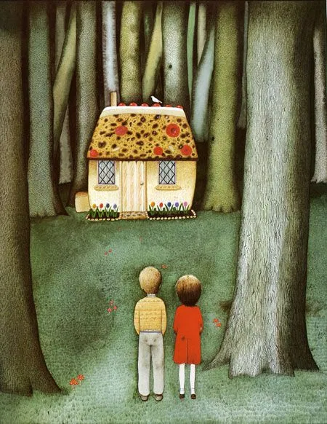
Teacher examples:
Who lives in the house?
Why is there a house in a spooky forest?
Will the children go inside?

Slide 10
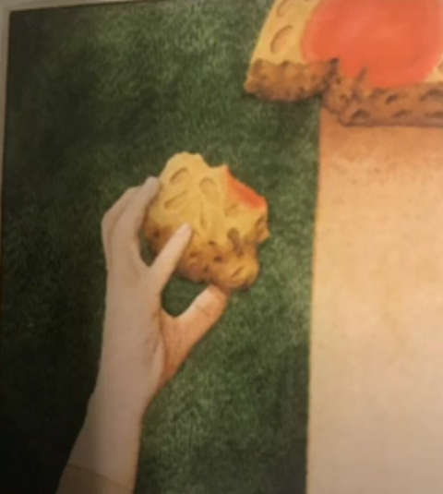
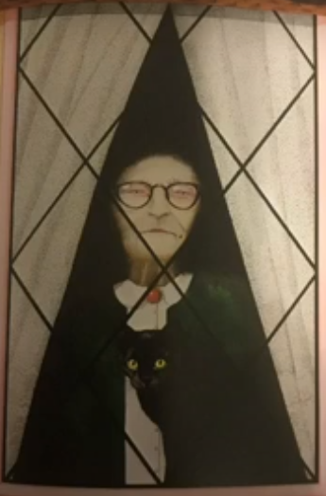
What do you think happens next in the story? Use these images to help you.

Slide 11
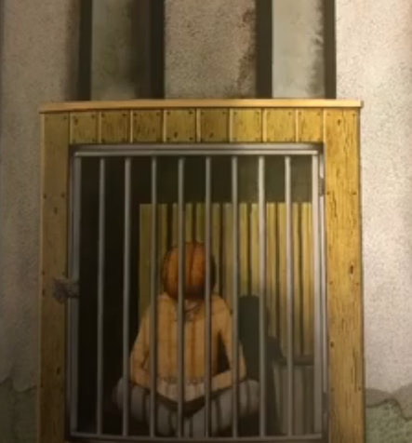
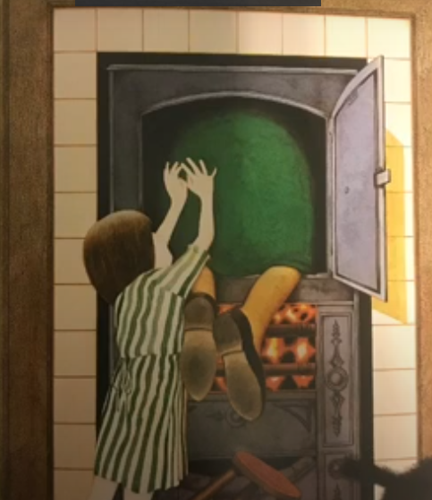
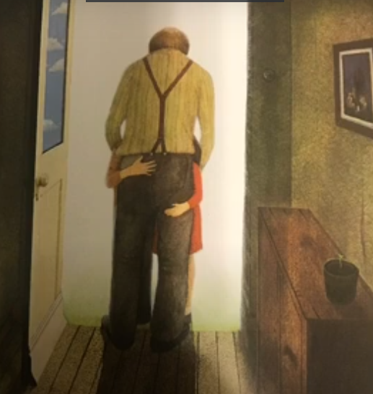
What do you think happens next in the story? Use these images to help you.

