Slide 1
20.1.21
To stay safe online.

Slide 2


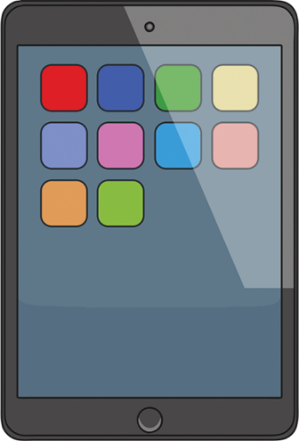

How do you access the internet?

Slide 3

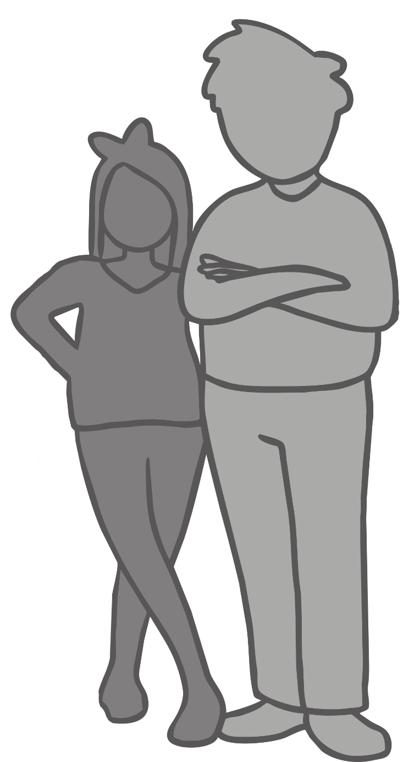

Strangers.
A stranger is someone you or your family does not know.
Anyone can be a stranger until you get to know them.
If you were on the street you would not talk to a stranger or go places with them.

Slide 4

Keeping safe with strangers online.
When you are playing games or using the digital devices that link to the internet, a stranger might try and contact you.
A stranger online might not look scary.
They can be nice and friendly.

Slide 5
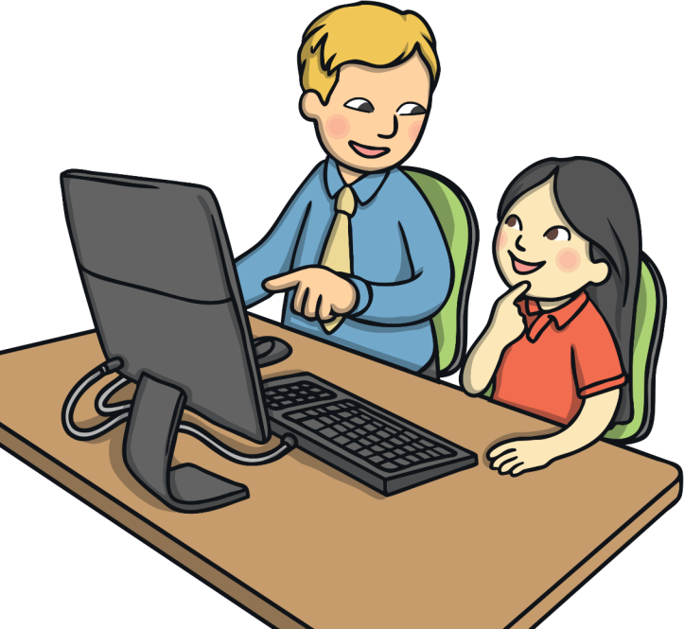
Keeping safe with strangers online.
Do not talk to strangers online. Sometimes they are not who they say they are.
Do not give any personal information to anyone online.
If someone does try and contact you, always ask a trusted grown up for help. Do not talk back to them.
If you are still unsure, always use an electronic device
around a grown up.

Slide 6

Can you help?
“Someone on the internet has asked me to be their friend. What should I do?”
Ann

