Slide 1
Starter
Where do the capital letters and full stops need to be in this sentence?
hansel and gretel were lost in the forest

Slide 2
Answer
CL- start of the sentence, names
FS - end of the sentence
Hansel and Gretel were lost in the forest .
✓
✓
✓

Slide 3
Use the story map to retell the story using what you have learned about the beginning, middle and end of the story.
Tell the story in your own words. Then listen to the adult retell the story.

Slide 4
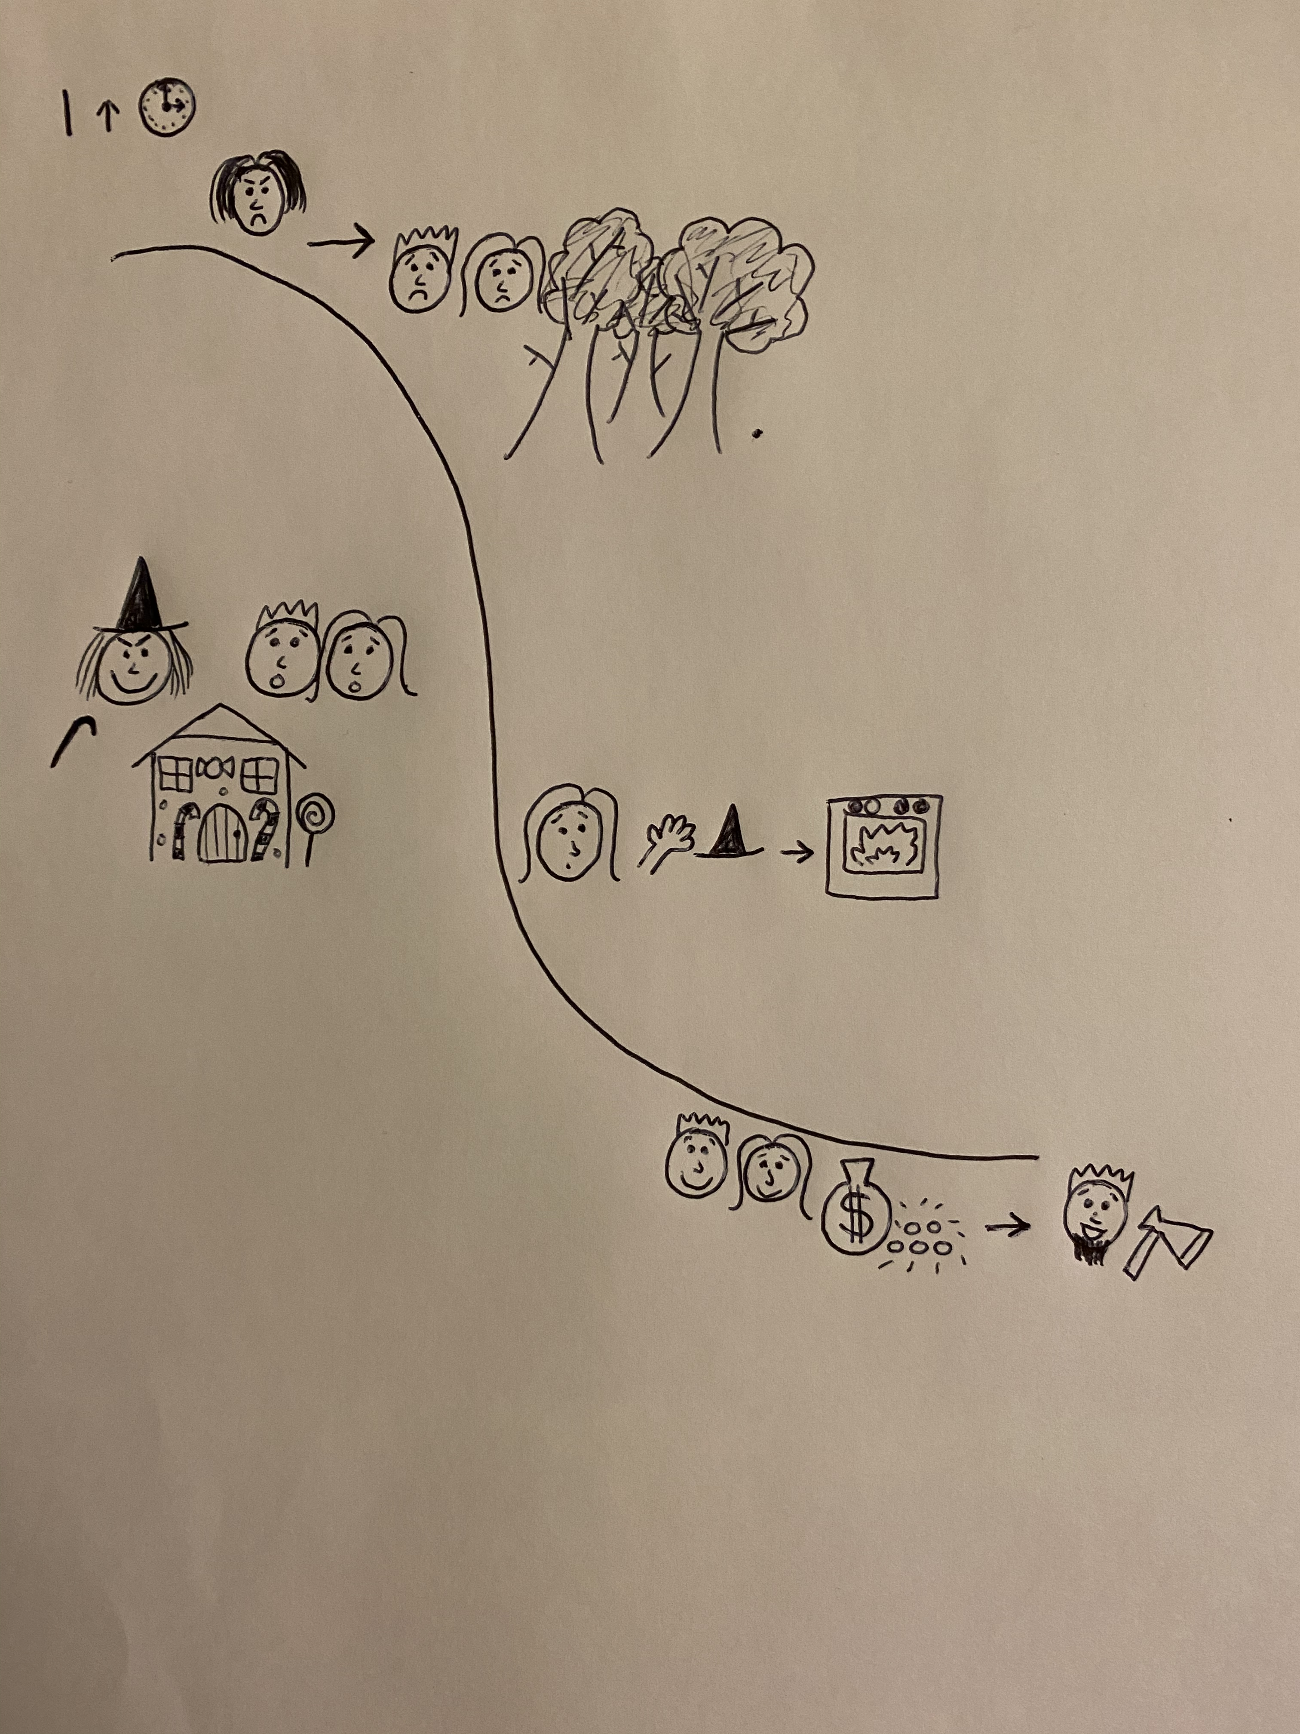

Slide 6
Listen to the adult retell the middle of the story.
The first sentence is written for you - where have I used full stops and capital letters?
Try to write the next sentence using the story map and word bank to help.

Slide 7
They went into a witch’s house but she was evil.
Word bank
house
evil
Gretel
oven

