Slide 1
PSHE
Learning Intention: To learn what positively and negatively affects physical and mental health

Slide 2
Physical and Mental Health
Physical Health
Mental Health

Slide 3
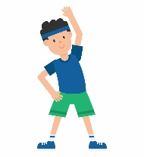
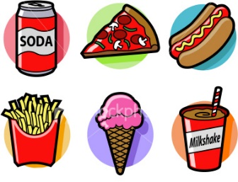
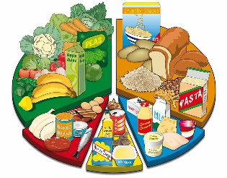
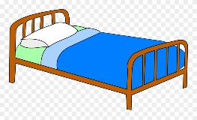
Physical Health
Positive √
Negative X
Exercising regularly
Eating a balanced diet
Getting enough sleep
Having an unhealthy diet
Not exercising
Smoking
Drinking too much alcohol

Slide 4
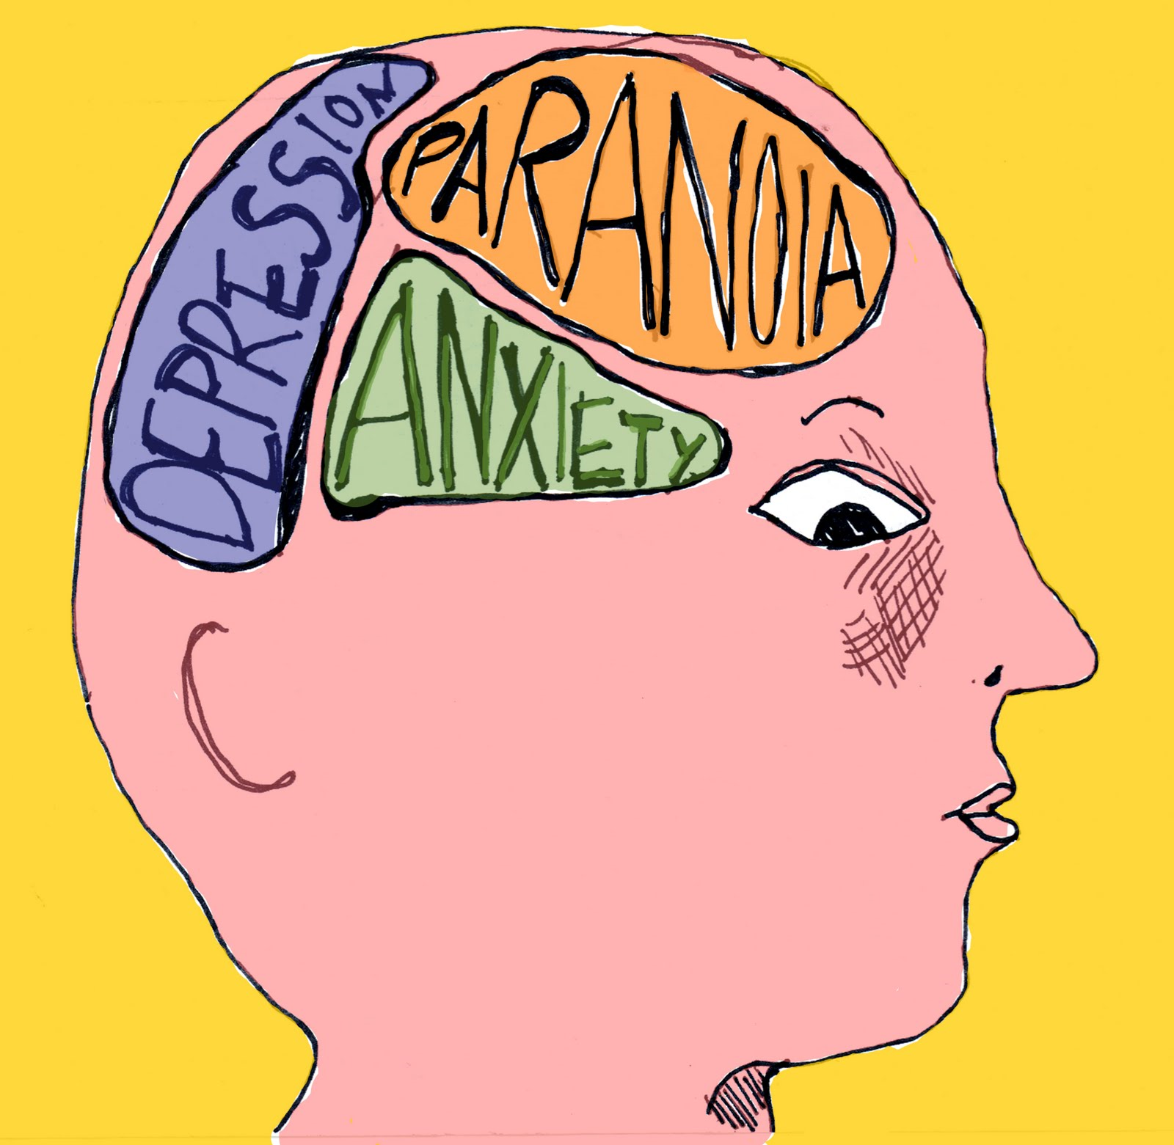
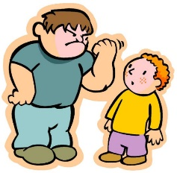
Mental Health
Positive √
Negative X
Exercising regularly
Getting enough sleep
Having good relationships with family and friends you can trust
Not exercising
Not getting enough sleep
Stress about family, friends, school, money or work
Death or illness of someone you care about
Bullying

