Slide 1
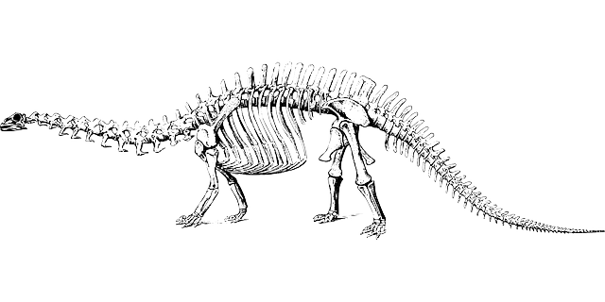
Learning intention: Describe how fossils are made

Slide 2
Key Vocabulary
Fossil- Fossils are the remains or traces of plants and animals.
Sediment- Solid material that settles at the bottom of a liquid.
Permeable- Allows liquid to pass through
Impermeable- An object which liquid can’t pass through.
Sedimentary rock- Formed when sand, mud or rock get laid down in
layers.

Slide 3
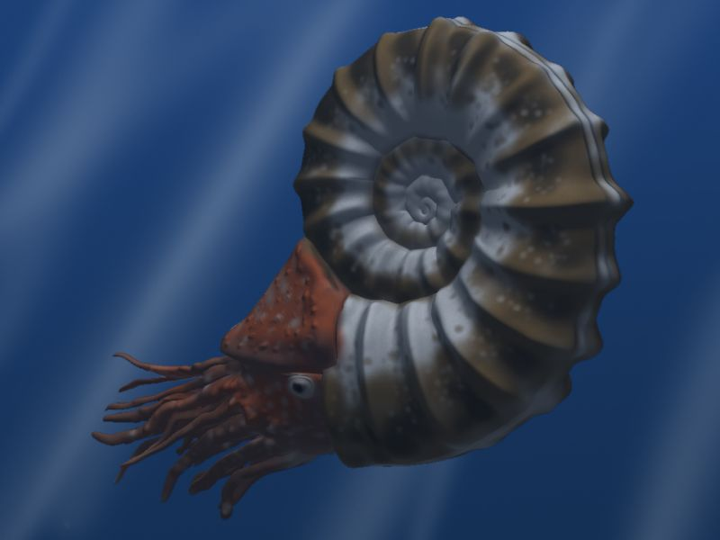
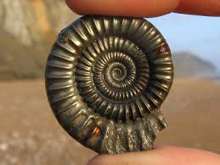
What is a fossil?
Fossils are the stone remains of animals or plants that were once living. Fossils are at least 10,000 years old.
The dinosaurs became extinct 65 million years ago.
My ammonite is 165 millions years old.

Slide 4
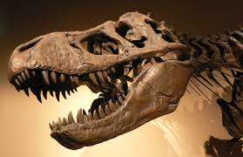
What is a fossil?
They are rare, as most animals and plants that die rot away into the soil.
The conditions have to be perfect for a fossil to form.
There are different ways that a fossil can be created, but the most common is the ‘mould’. and cast’.

Slide 5
Step 1: An animal (such as a dinosaur or fish) dies.

Slide 6
Step 2: The animal rots away leaving just the hardest parts – bones or shell.

Slide 7
Step 3: Sediment falls and covers the remains.

Slide 8
Step 4: Pressure forces the sediment layers together, turning them into sedimentary rock.

Slide 9
Step 5: Small amounts of water come through the permeable rock and the remains are slowly washed away.

Slide 10
Step 6: Left behind is an open space in the exact size and shape of the skeleton, this is called a mould.

Slide 11
Step 7: The water transports tiny pieces of impermeable rock, which are left inside the mould.
Pieces of rock

Slide 12
Step 8: The mould starts to fill up with these pieces of rock, in the shape of the skeleton.
Pieces of rock

Slide 13
Step 9: Over time the whole skeleton, or remains, will become solid rock, called a cast.

Slide 14
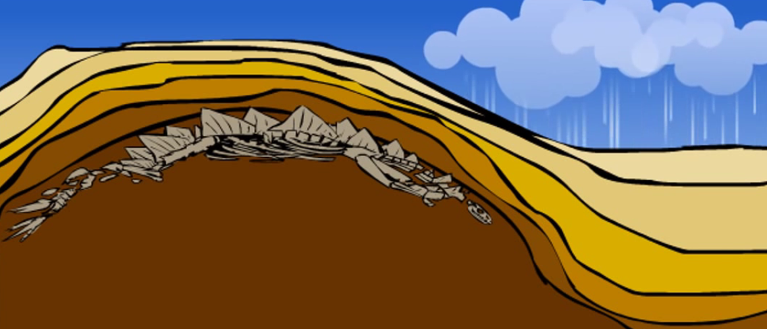
Step 10: After millions of years the ground underneath the cast will rise up, and weathering will wear away the rock from above.

Slide 15
Step 11: This brings the stone cast near the surface, and people dig them up.

Slide 16
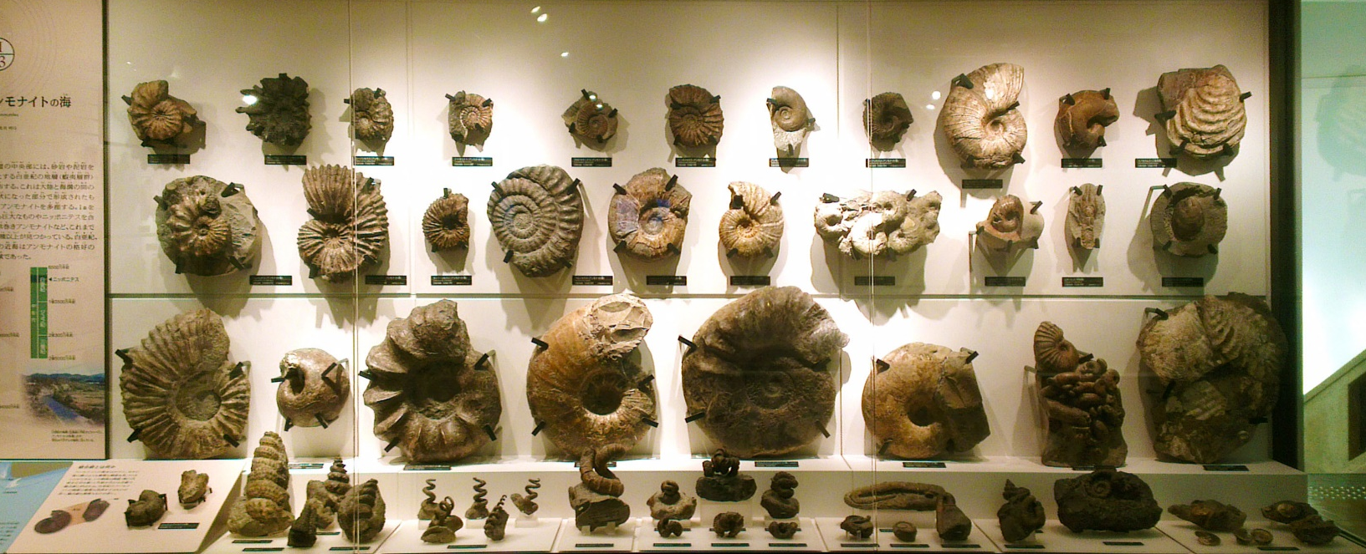
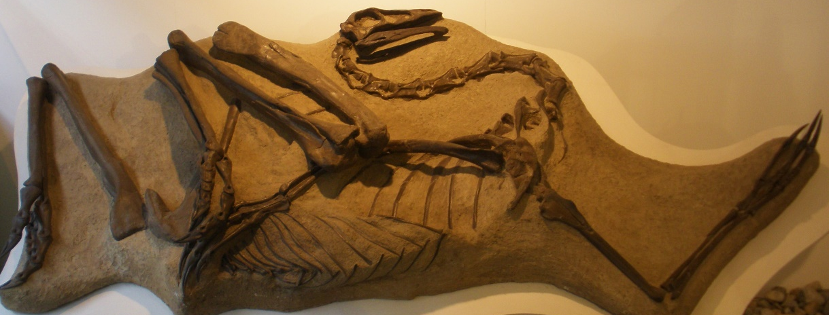
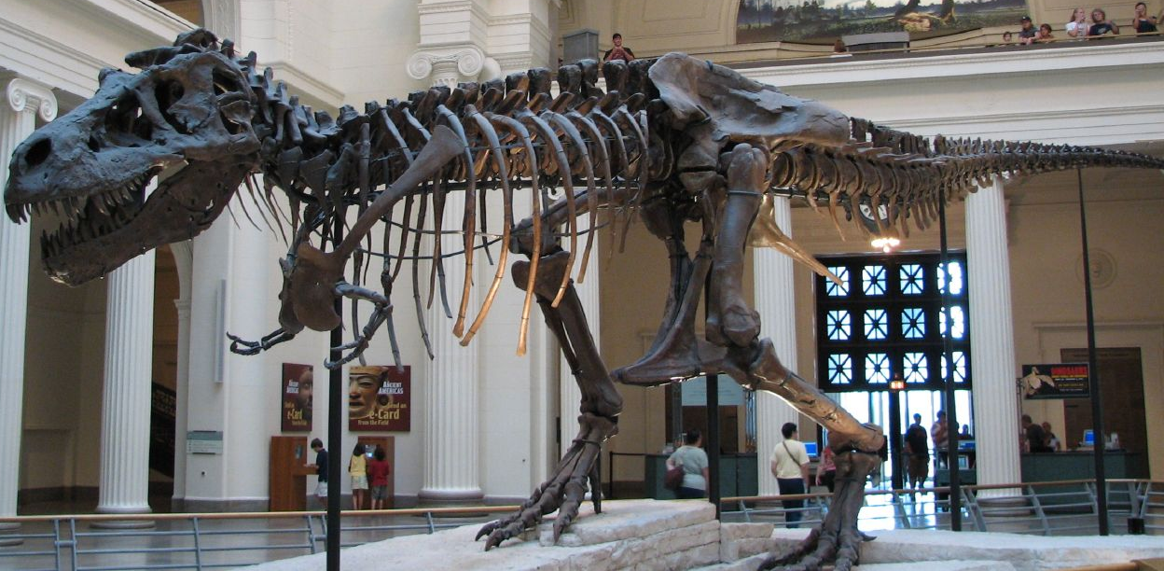
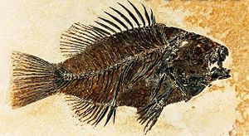
Now we see these fossils in museums

