Slide 1
Warm up! Be the teacher.
thecatisfluffy
Amjed
The cat is fluffy.
Destiny
Notes:
Amjed and Destiny have both wrote a sentence about the cat, who has made a mistake and what have they done wrong?

Slide 2
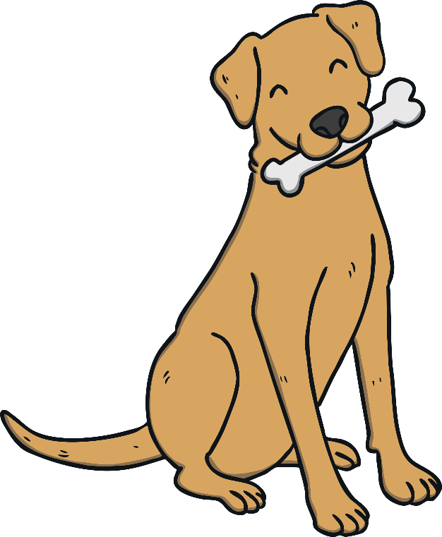
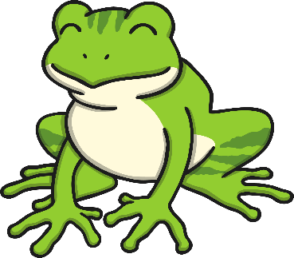
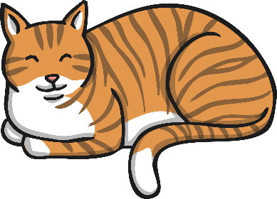
Notes:
Can you spot which one of the pictures rhymes with d-o-g dog?
Answer: frog

Slide 3
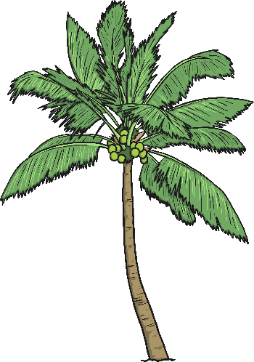
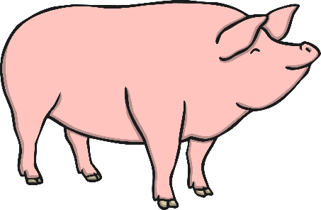
Notes:
Well done! It was frog. Now can you find the picture of the word that rhymes with c-a-t, cat?

Slide 4
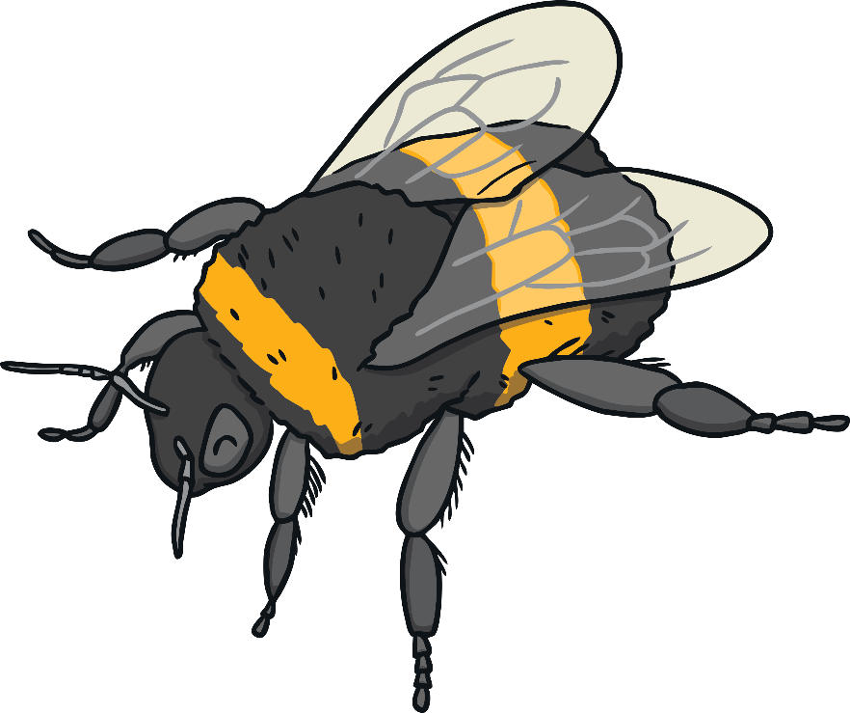
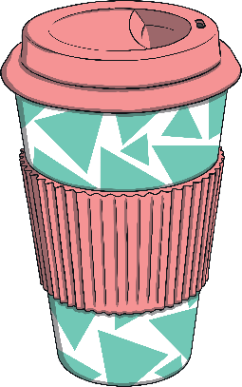
Notes:
It was hat! Cat, hat. Now which one rhymes with bee?

Slide 5
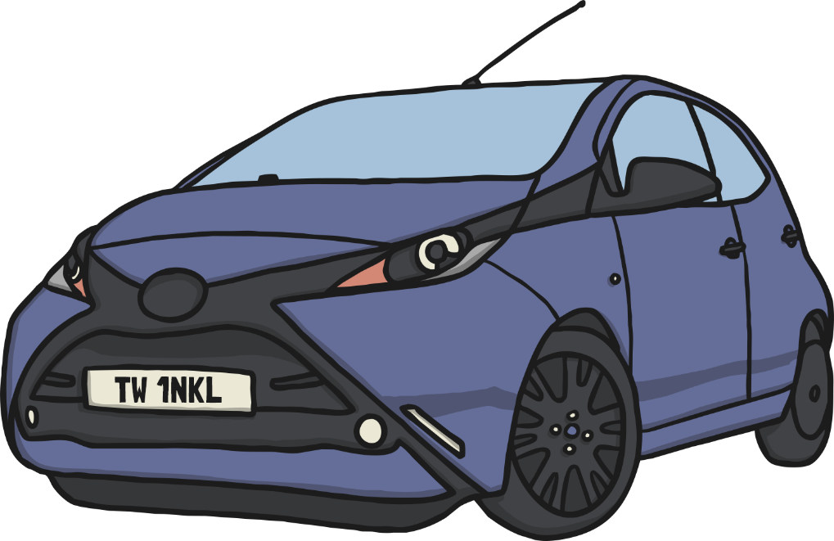
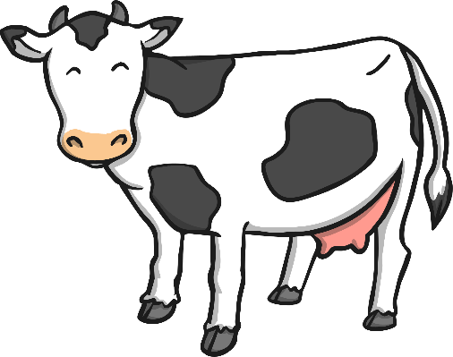
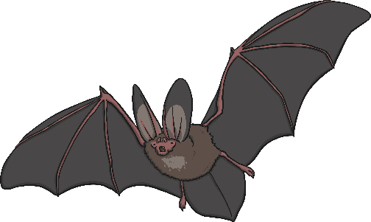
Notes:
Bee, tree! Now the last one, which one rhymes with c-ar, car? --- That’s right s-t-ar, car star.

Slide 6
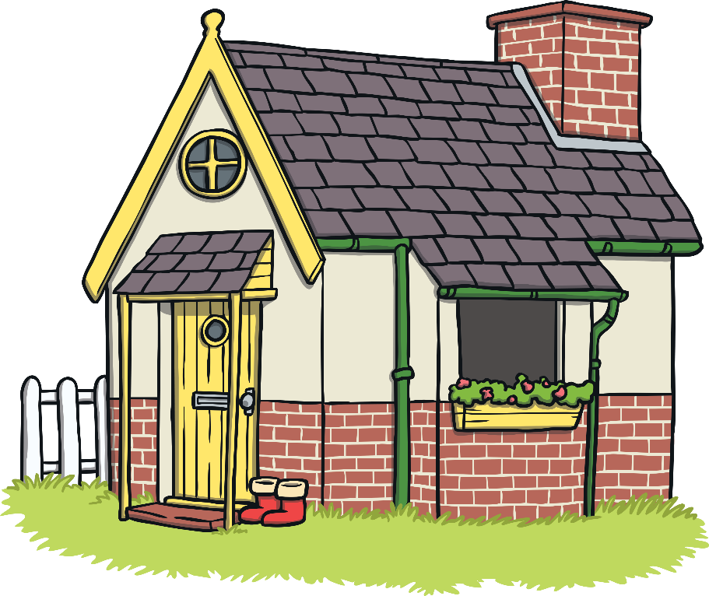
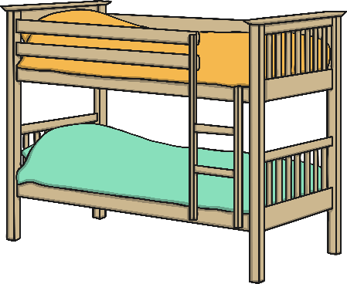
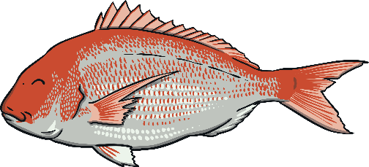
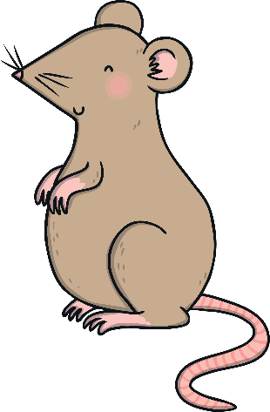
Notes:
Here you will find a range of pictures, some of these words rhyme with each other. Can you spot them?

Slide 7
Notes:
Tree and bee, house and mouse. Now let’s have a go at writing a rhyming string!

Slide 8
Finish the rhyming string:
tree
bee
Notes:
Finish the rhyming string, we have our t-r-ee and b-ee. Remember they need to have the same sound at the end. So is it the –u-n sun? r-i-ng ring? S-ea sea?

Slide 9
Finish the rhyming couplet:
Here is Jack the __________,
He lives in a brick __________.
Notes:
It was the sea! The ee sound at the end really stood out. Now let’s use the other pair to make a couplet. Finish the rhyming couplet here is Jack the _____ he lives in a brick ______. Which word is first, house or mouse? Jack the house or Jack the mouse? Brick house or brick mouse?

Slide 10
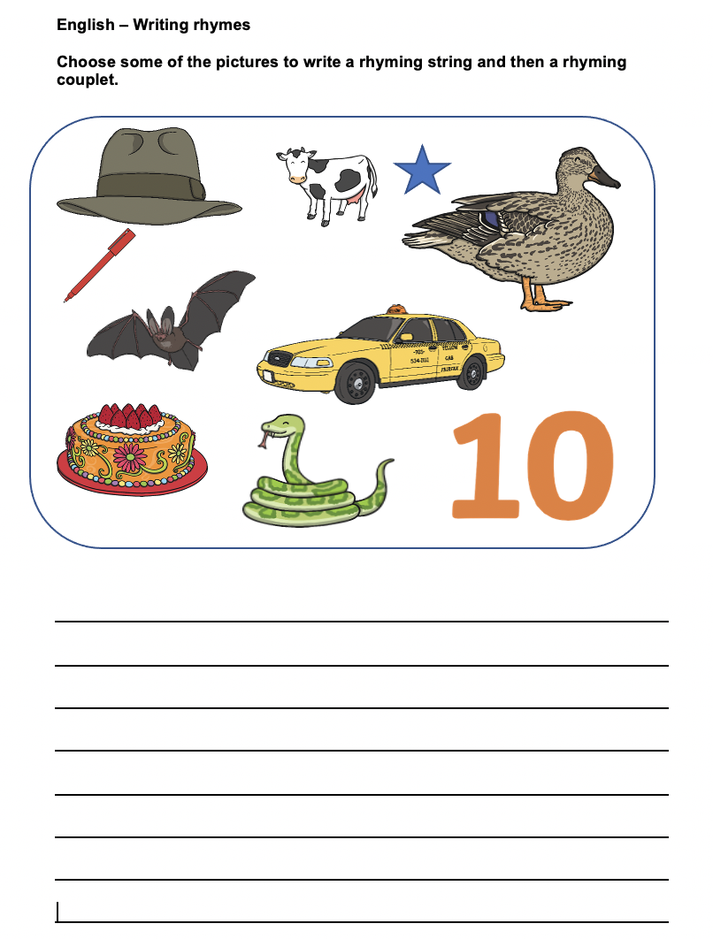

Slide 11
Warm up! Be the teacher.
Amjed needs to use finger spaces, a capital letter and a full stop.
thecatisfluffy
Amjed
The cat is fluffy.
Destiny

