Slide 1
Learning Intention
To use inverted commas

Slide 2
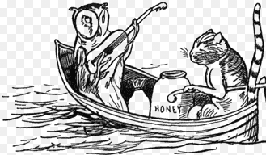

What are they saying to each other?
I Look I have got a large pot of honey with me.
MI will play you a beautiful
song.

Slide 3
How do we put in inverted commas
Make sure your speech is correctly punctuated.
This includes a piece of punctuation before closing the inverted commas.
“There are times I feel that you are a little cold,”
I said.
“ ”

Slide 4
Now let’s add the inverted commas.
I Look I have got a large pot of honey with me.
MI will play you a beautiful
song.
Make sure you put the “ “ around the words being spoken. Don’t forget a comma before the last “
“I will play you a beautiful song,” said Owl.

Slide 5
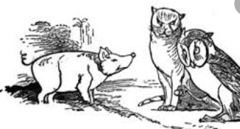
What are they saying to each other?
I
M
I

Slide 6
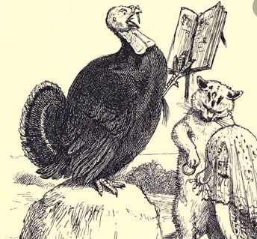
What are they saying to each other?
M
I

