Slide 1
The Great Kapok Tree
To explain my ideas using the text

Slide 2
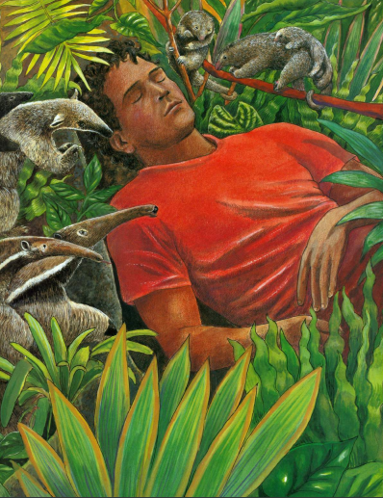
Recapping from yesterday
The man is sleeping. What his he dreaming about?
The sloths are talking to him. What are they saying to him?
The anteaters are talking to him. What are they saying?
Now read or listen to the next part of the story.

Slide 3
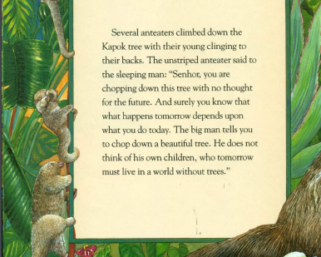
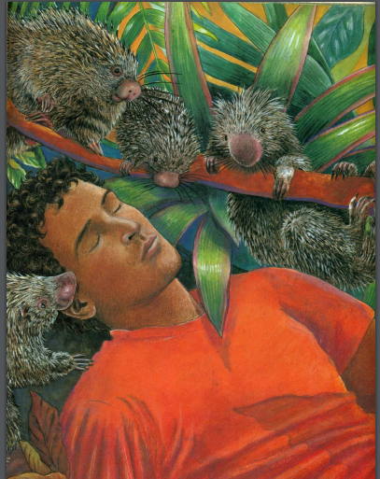

read and listen to the text carefully.

Slide 4
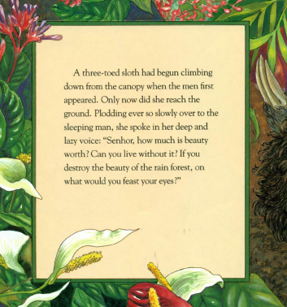
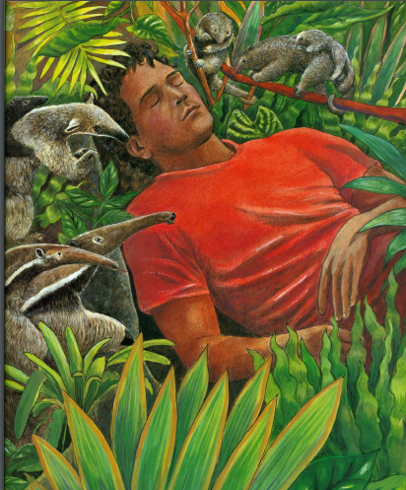
Look at the image and read the text carefully.

Slide 5
How does animals feel about the man?
Why have these animals surrounded him?
What are the animals saying to each other?
What are the animals saying to the man?
Now let’s look at these questions.

Slide 6
How do the animals feel about the man ?
The animals are angry that this man is here. We know this because as they are trying to convince him not to chop the tree down. In the text it says ‘you chop down this tree with no thoughts for the future.’
How do I explain my answers fully.
I am explaining how we know
I am using evidence from the text

Slide 7
Why do the animals think the world will be destroyed?
How do they think they will stop him?

