Slide 1
Learning intention: to retrieve information from a text.

Slide 2
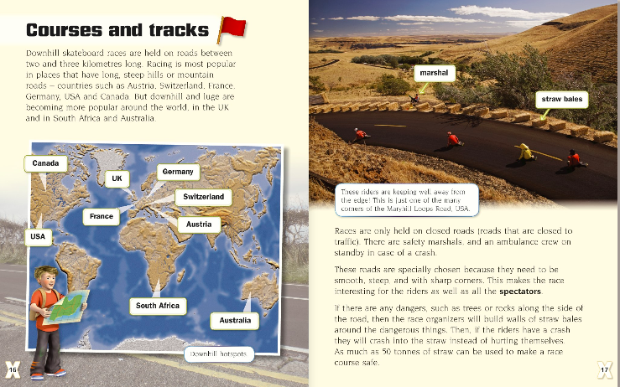

Slide 3
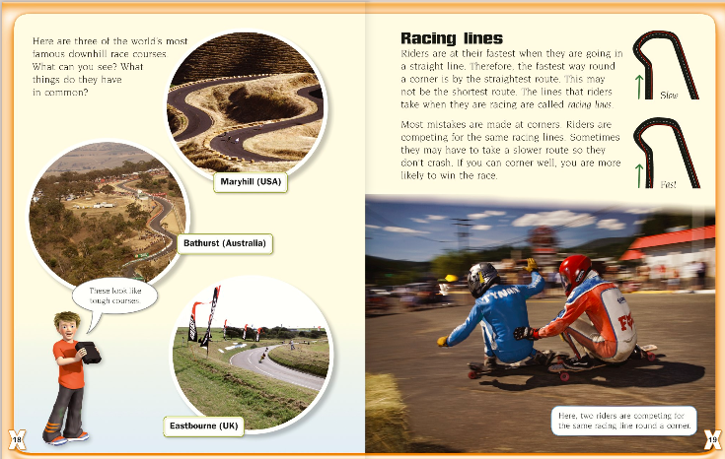

Slide 4
Activity
Write five facts that you have learnt about courses and tracks.

