Slide 1

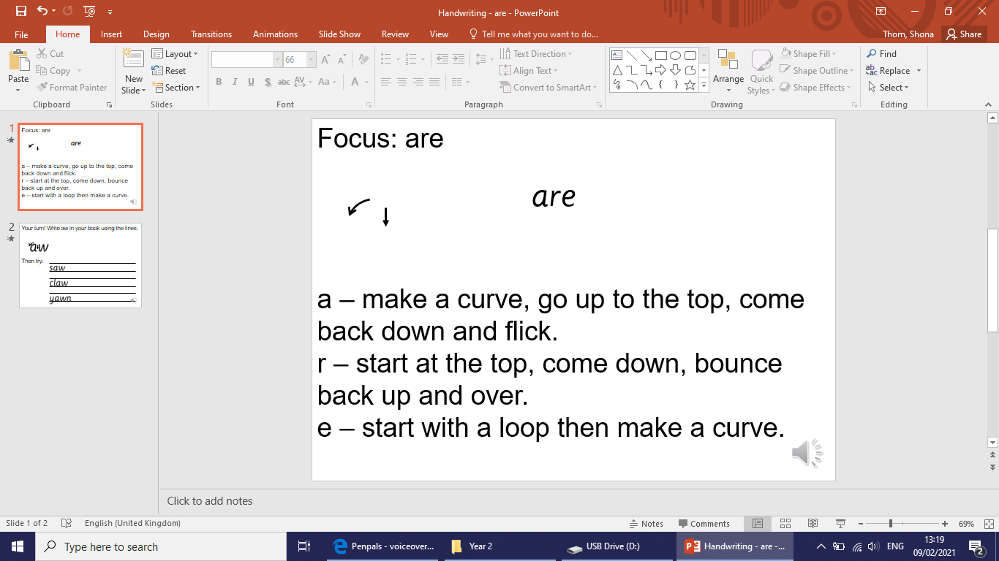

Focus: or
o – make a curve, go all the way around
r – start at the top, come down, bounce back up and over

Slide 2
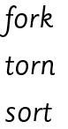
Your turn! Write or in your book using the lines.
Then try:

