Slide 1
Learning Intention
To multiply two numbers

Slide 2
Here is our question 323 x 4 =
First:
3 2 3 Multiply 4 x 3 = 12
x 4 As the answer is larger than 9, we need to carry the ten into the tens column
2
1

Slide 3
What do we need to do next?
3 2 3
x 4
9 2
1
Multiply 4 x 2 = 8
But don’t forget, we have one to add on from our carry over. So
8 + 1 = 9
Remember to cross out the carry over so you don’t add it again.

Slide 4
What do we do next?
3 2 3
x 4
1 2 9 2
1
Multiply 4 x 3 = 12
As this equals more than 9, we need to place our one from the 12, in the thousands column
323 x 4 = 1292

Slide 5
Now it’s your turn
Complete the following questions remembering to set the out using the correct method.
116 x 4 = 115 x 5= 213 x 6 = 418 x 5 =
107 x 4 = 312 x 6 = 215 x 7 = 119 x 6 =
529 x 5 = 136 x 7 = 356 x 4 =
Can you try our reasoning question too on the next page.

Slide 6
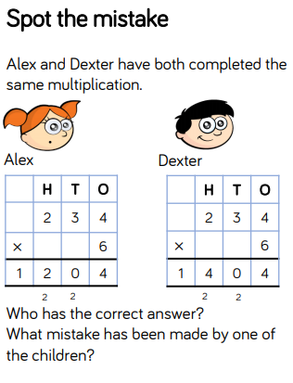
How will we work this out? First read the question carefully.
Remember the easiest way to check who is right or wrong is to work the calculations out yourself. Then you can check who is right.

