Slide 1
Learning intention:
To identify the regions of Europe

Slide 2
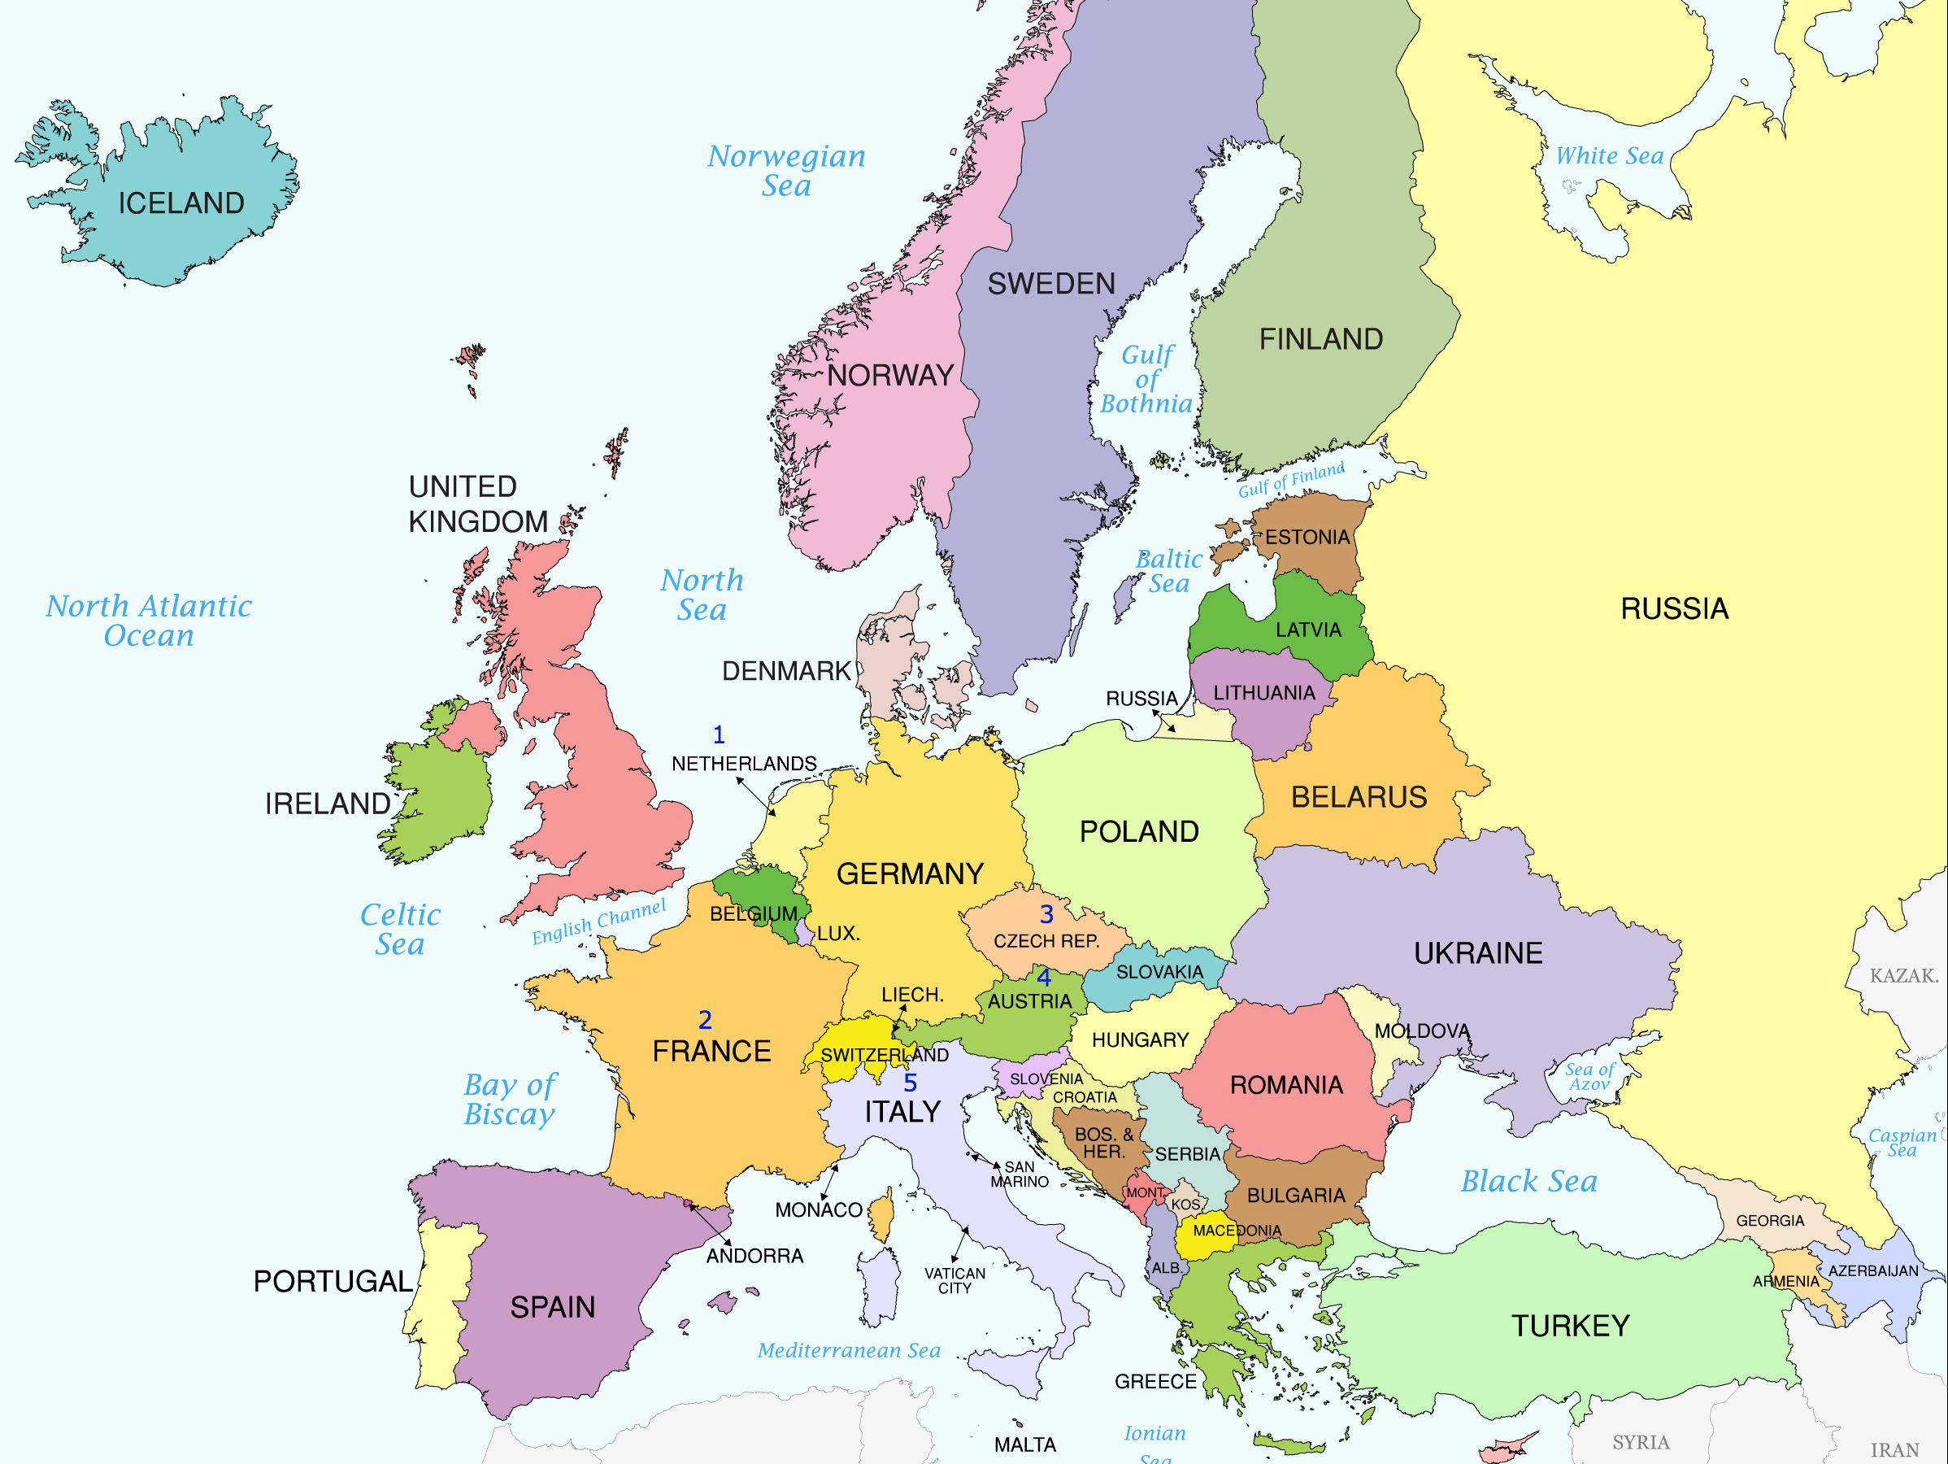
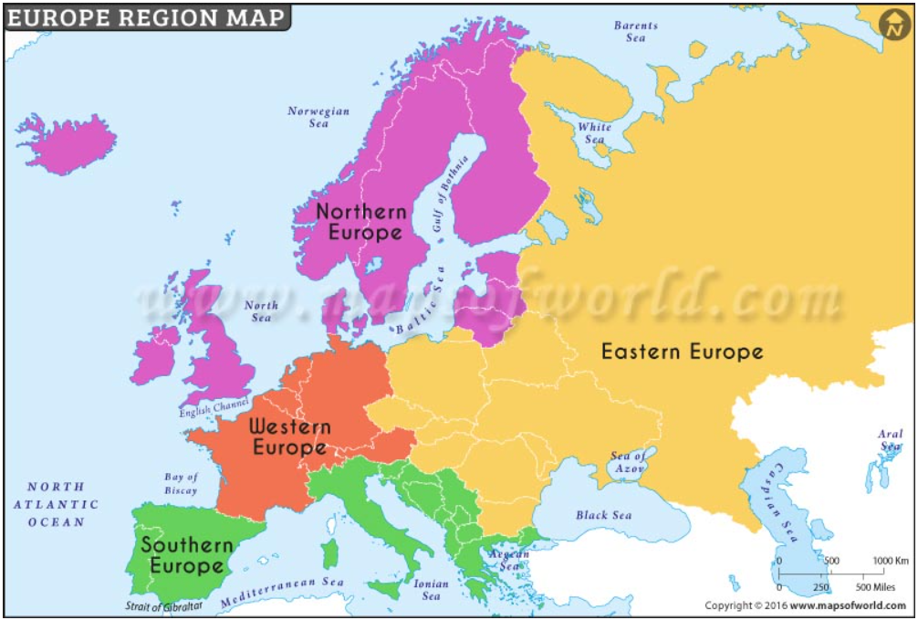
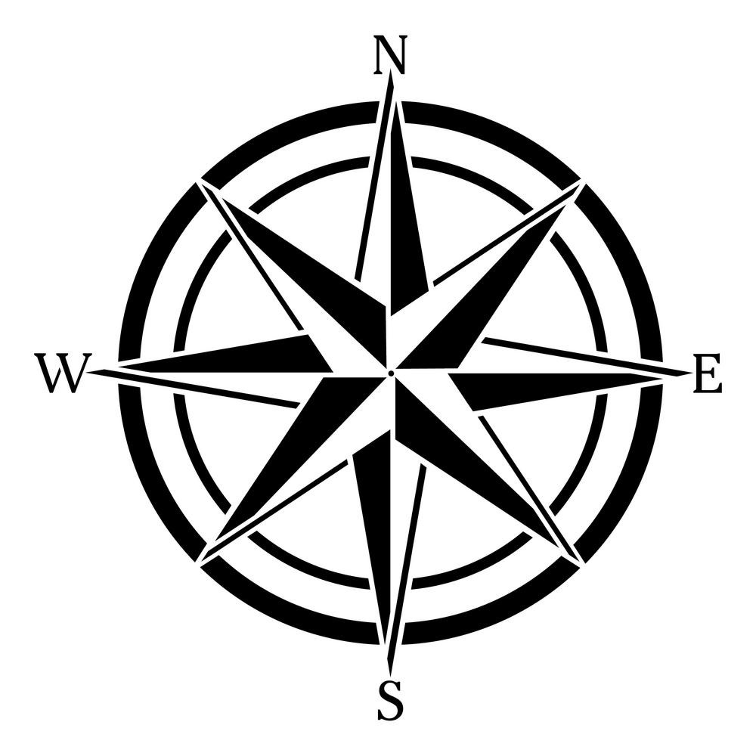
Europe is split into different geographical regions based on the points of the compass.
Which countries do you think are in each region?

Slide 3
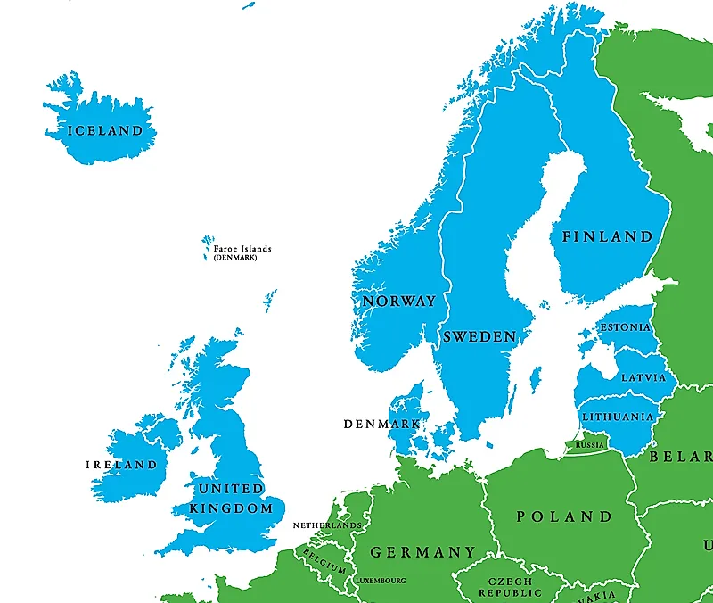
Northern Europe
Which country is farthest North?
Northern Europe can be divided into three parts: Scandinavia, the British Isles, and the Baltics.
The United Kingdom is made up of England, Wales, Scotland, and Northern Ireland.
The British Isles also include Ireland
Scandinavian (Nordic countries) are Finland, Norway, Denmark, Iceland and Sweden
And the Baltic states are Estonia, Latvia and Lithuania.
The North European Region has lots of rainfall, warm summers and very cold winters.
Few people live in the very far North as it is in the Arctic circle so has extremely cold and dark winters.

Slide 4
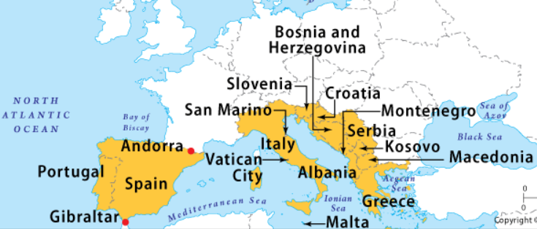
Southern Europe
Southern European countries are nearly all on the coast of The Mediterranean Sea. Only Serbia, Kosovo and Macedonia are not.
The weather is usually warmer than any other region of Europe with hot summers and cool winters, especially in coastal regions. This leads to a dryer climate, perfect for growing some fruits.
This region has the least amount of rain in Europe and is well populated, specially on the coast.
It is the most popular region in Europe for tourism due to the great climate.
Which Country’s capital is Rome?

Slide 5
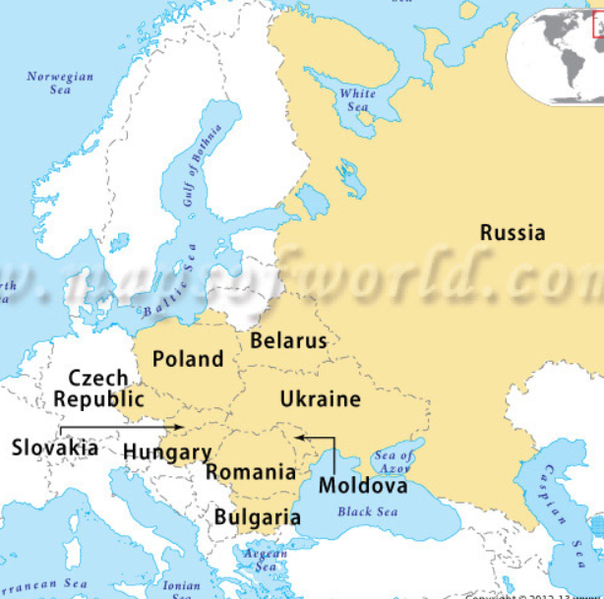
Eastern Europe
Name one country on the Black Sea.
Eastern European countries are all east of Germany and include the largest country in the world, Russia (which is half in Europe and half in Asia).
The summers can be quite hot and the winters can be very cold, especially in the north of Russia, where hardly anyone lives.

Slide 6
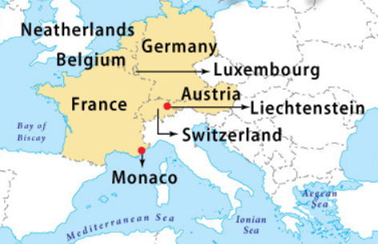
Western Europe
Which four countries does the Alps mountain range go through.
These countries are North of The Alps mountain range and often on the North Sea Coast.
France has a coast line on the Mediterranean too!
The climate can be hot in summer and cold in winter especially in the Alpine (mountainous) parts.
The population in this region is spread right across with the biggest cities such as Berlin and Paris, away from the sea.

Slide 7
Comparing regions of Europe
Find the sheet ‘Comparing regions of Europe.’
You are going to compare the Northern European Region with the Southern European Region.
Follow the instructions on the sheet to identify different features.

