Slide 1
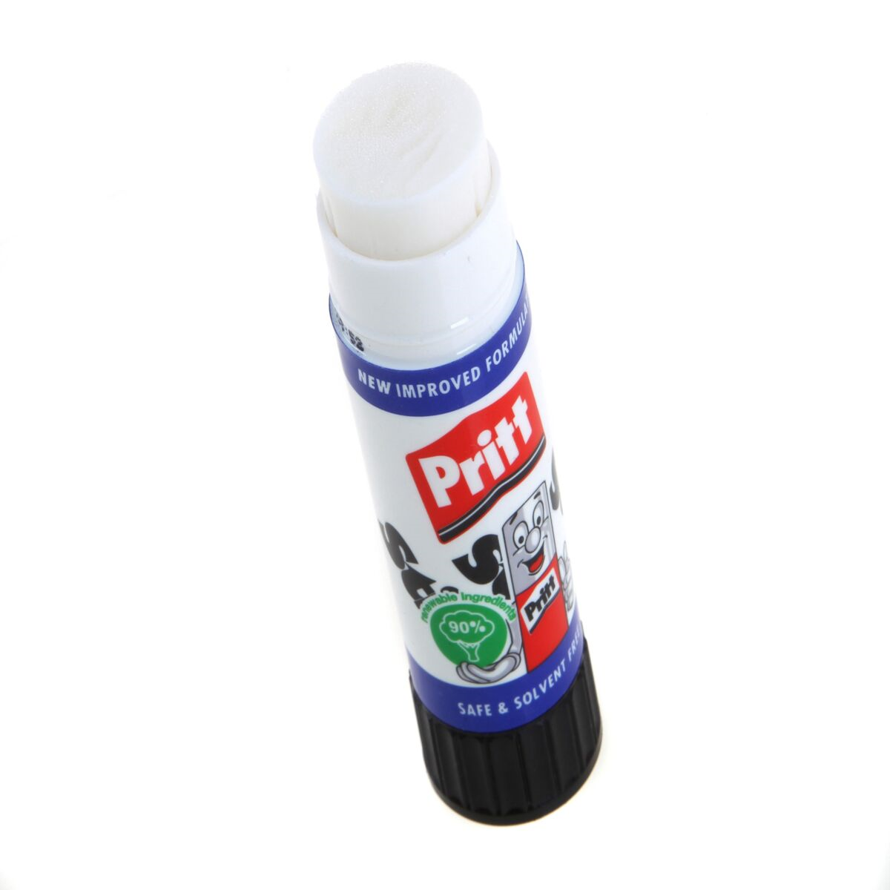
Today we will be looking at conjunctions. Can you remember what a conjunction does?
Hint:

Slide 2
A conjunction is used to join (or stick) two parts of a sentence together. These parts are called clauses.
We have learned three co-ordinating conjunctions so far. These can be used to join two clauses together.
Can you remember the conjunctions?

Slide 3
Co-ordinating conjunctions
and or but
Can you spot the conjunctions in the following sentences?

Slide 4
Gretel was scared that they were all alone in the forest so she cried bitterly.
The children were still lost but all of the breadcrumbs had disappeared.
Eventually they saw a tiny house in the woods and they decided to go closer.

Slide 5
Gretel was scared that they were all alone in the forest so she cried bitterly.
The children were still lost but all of the breadcrumbs had disappeared.
Eventually they saw a tiny house in the woods and they decided to go closer.
The underlined conjunctions join the clauses together.

Slide 6
Co-ordinating conjunctions
and or but
You can make sentences more interesting by extending them. You can do this by joining clauses together with conjunctions.

Slide 7
Co-ordinating conjunctions
and or but
Extend the sentences on the worksheet by adding a conjunction and the second clause to the sentence. Make sure you choose a conjunction that makes sense.

