Slide 1
“Hello children Hope you are all well today”
Here are some of our favourite songs, rhymes and poems that we have been learning in school.

Slide 2
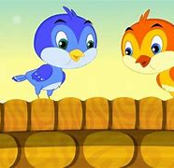
Two Little Dicky Birds
Finger play: "Two Little Dicky Birds" is often used as a "finger play". Doing the finger play while singing, makes this song even more fun. So let's learn how to do "Two Little Dicky Birds" as a finger game:
The finger game is played with both hands. Point both index fingers in the air and let them represent to different "persons" - Peter and Paul. So we go like:
Two little dicky birds sitting on the wall: both index fingers up in the air, move both of them.
One named Peter: Wiggle one index finger ("the Peter finger")
One named Paul: Wiggle the other index finger (the Paul finger)
Fly away Peter: quickly draw the hand with "the Peter finger" behind your head and hide it.
Fly away Paul: quickly draw the other hand ("the Paul finger's hand") behind your head and hide it.
Come back Peter: reverse the last action with "the Peter finger" hand
Come back Peter: reverse the last action with "the Paul finger" hand

Slide 3
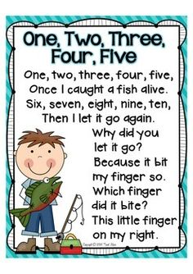
One, Two, Three, Four ,Five once I caught a fish alive.

Slide 4
Baa, Baa Black Sheep

Slide 5
Incy Wincy Spider

Slide 6
5 Little Speckled Frogs
`

Slide 7
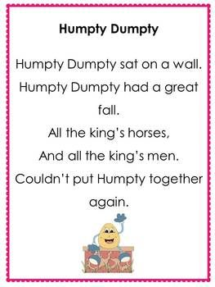
Humpty, Dumpty

Slide 8
Well boys and girl that is the end of our favourite nursery rhymes today. Hope everyone has had fun! Keep safe and keep singing until next time.

