Slide 1


RWI Pink: In the sun.

Slide 2
flag
jam
frock
blob
stuff
rug
mug
Mr Punch
bu cket
funn y
loll y
com ic
Story green words.

Slide 3
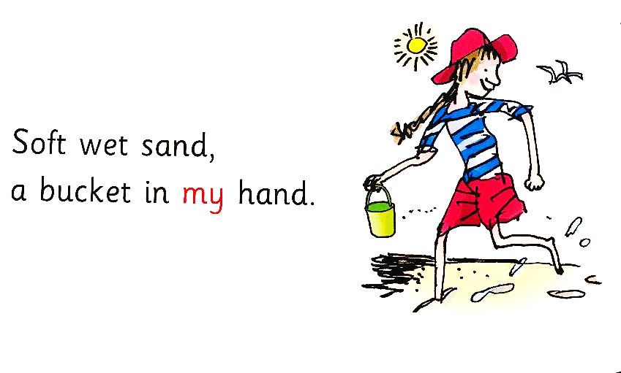
RWI Pink: In the sun.

Slide 4
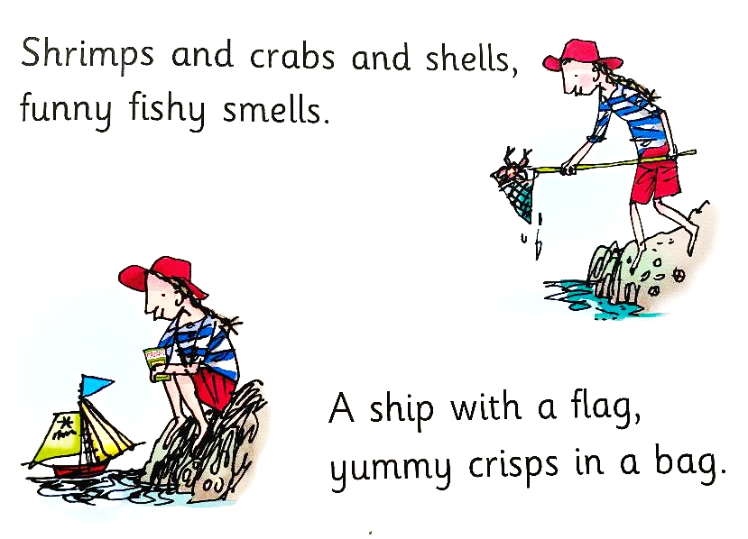
RWI Pink: In the sun.

Slide 5
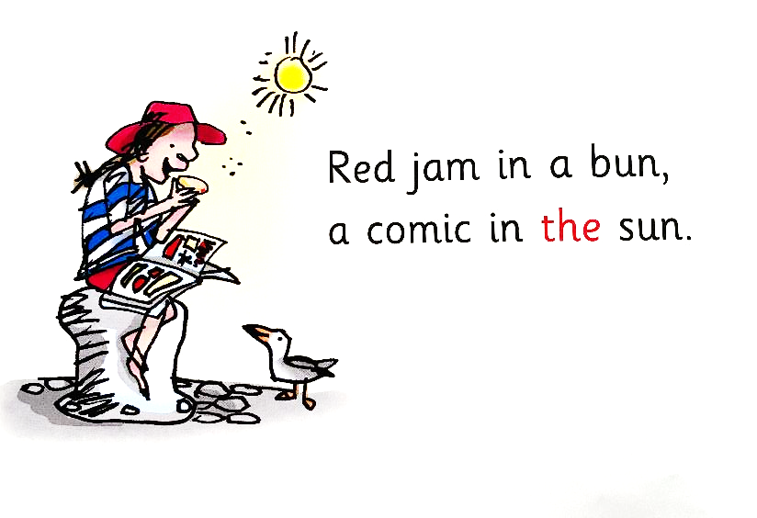
RWI Pink: In the sun.

Slide 6
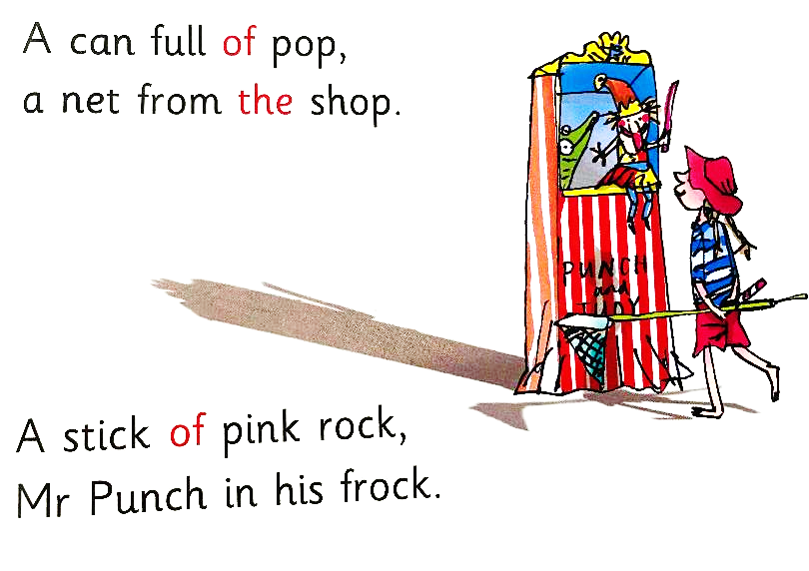
RWI Pink: In the sun.

Slide 7
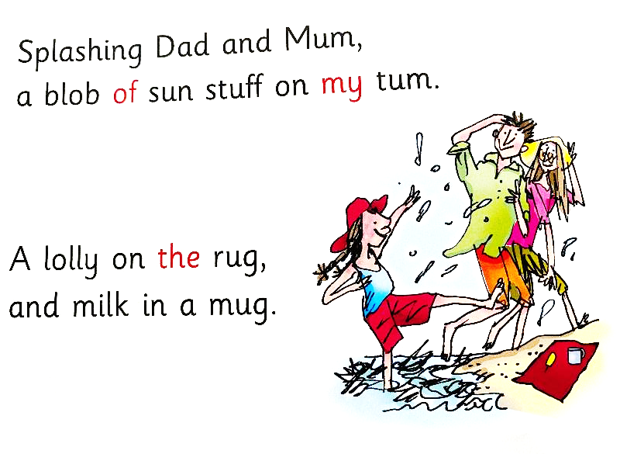
RWI Pink: In the sun.

Slide 8
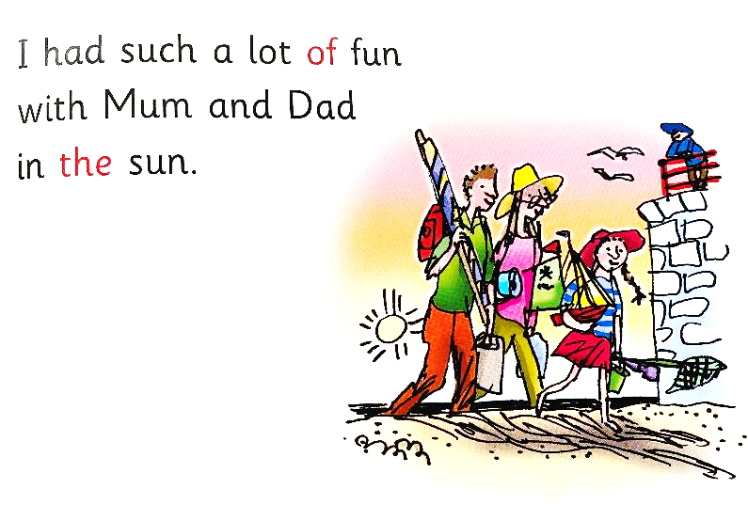
RWI Pink: In the sun.

