Slide 1

Friday the 29th January.
To use pronouns to avoid repetition.

Slide 2
Pronoun
A pronoun is a word that takes the place of a noun (name of a thing, object, place or person) . It stops the noun being repeated to often.

Slide 3
How can we avoid repetition in our writing?
Repetition is when something that is said or written is used
over and over again, for example:
Gary ate supper when Gary got home. Gary enjoyed the food.
After its first use, instead of repeating 'Gary', we could replace further uses with pronouns to avoid repetition, such as:
Gary ate his supper when he got home. He enjoyed the food.
noun
pronoun
pronoun

Slide 4
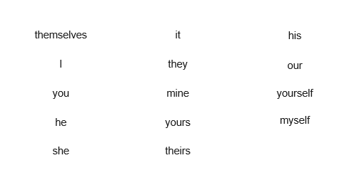
Different types of pronouns

Slide 5

Pronoun or not?
Which of these words are pronouns?
Pronouns
Not Pronouns
The answers are on the next slide.

Slide 6
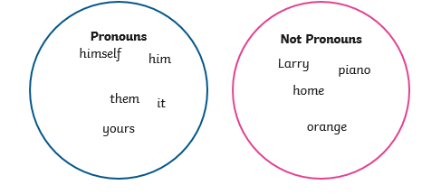
Pronoun or not answers…

