Slide 1
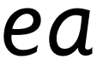

Focus: ea
e – start with a loop then make a curve. a - make a curve, go up to the top, come back down and flick.

Slide 2
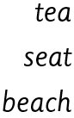
Your turn! Write ea in your book using the lines.
Then try:

