Slide 1
Learning intention: to explore features of instructions.
Can you remember what all these features of instructions are or what they do?
Second person
Imperative verbs
Numbers or bullet points
List

Slide 2
Features of instructions
Imperative verbs: bossy verbs. E.g.
Run to the shop. Get a pen.
Numbers or bullet points: instructions can be written in a list with numbers or bullet points. E.g.
Stand up.
Jump up high.

Slide 3
Features of instructions
List: instructions can be written in a list. E.g. Go into the wood, jump over the wall then find the path.
Second person:
instructions are
addressed to the
reader. They talk to
‘you’.

Slide 4
Features of instructions: can you find the features of instructions as we read the text?
Second person
Imperative verbs
Numbers or bullet points
List

Slide 5
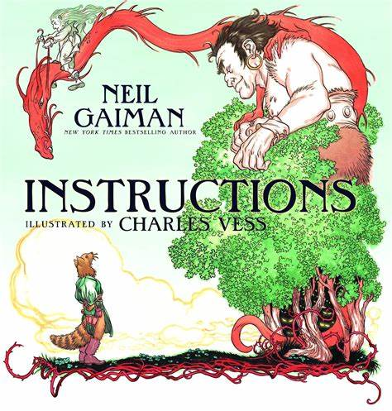

Slide 10
Inside it are three princesses. Do not trust the youngest. Walk on.
In the clearing beyond the castle the twelve months sit, warming their feet, exchanging tales. They may do favours for you, if you are polite. You may pick strawberries in December’s frost.
Trust the wolves, but do not tell them where you are going.

