Slide 1
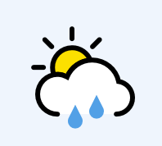

Slide 2
What is the weather like today? Draw a symbol to show the weather.

Slide 3
What is the weather going to be like this week?

Slide 4
I am going to do an experiment!
I want to test how much rain we have this week.

Slide 5
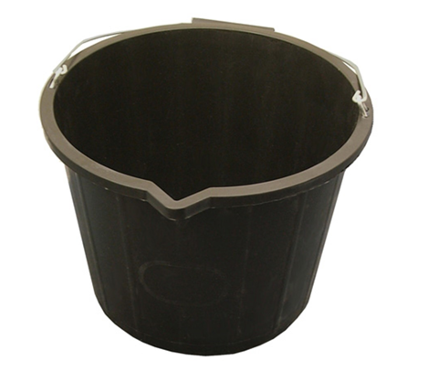
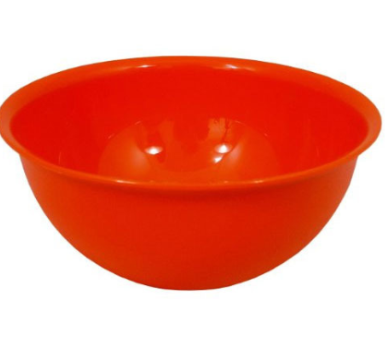
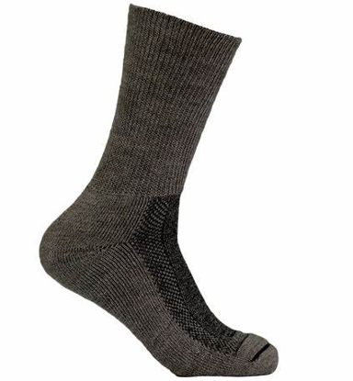
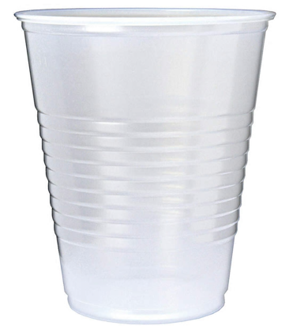
How can I measure the rain?

Slide 6
My Experiment:
Predict: How much water will be in my cup next Friday?

