Slide 1
Year 1 Maths Alternative 2 Shape Quiz

Slide 2
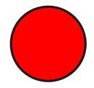
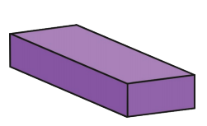
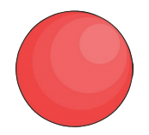
Today in maths we are going to see how much we can remember about 2D and 3D shapes.
2D
3D

Slide 3
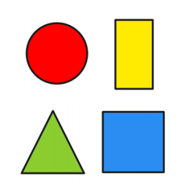
Work out which 2D shape it is from the clues.
I have 3 sides.
I have 3 corners.
What shape am I?

Slide 4
Work out which 2D shape it is from the clues.
I have 1 side.
I have 0 corners.
What shape am I?

Slide 5
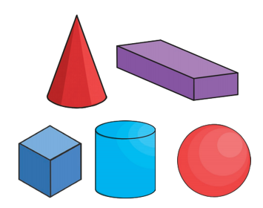
Now lets look at 3D shapes. Work out which 3D shape it is from the clues.
I have 6 faces. All of my faces are the same size.
I have 12 edges.
I have 8 vertices.
What shape am I?

Slide 6
Work out which 3D shape it is from the clues.
I have 2 faces.
I have 1 edge.
I have 1 vertice.
What shape am I?

Slide 7
Answers
Slide 3 – triangle Slide 5 – cube
Slide 4 - circle Slide 6 – cone

