Slide 1
Learning Intention: To use Modern Day Vocabulary.

Slide 2
We can tell that The Highwayman was written a long time ago through the old language that is used.

Slide 3
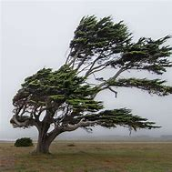
Your task today is to look at the language in the Highwayman and change the old words used in the poem to modern day words.
For example,
The wind blew through the darkness and the gusty trees.
Could become:
The wind blew through the darkness and the breezy trees.
We have changed the word gusty to breezy.

Slide 4
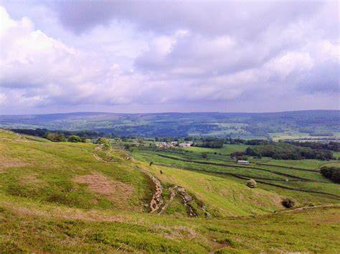
The road was moonlit over the purple moor.
Could be:
The road was moonlit over the grassy fields.
We have changed the words purple moor to grassy fields.

