Slide 1
Learning intention: To retell a traditional tale.
English
To develop our new character by acting as them.

Slide 2
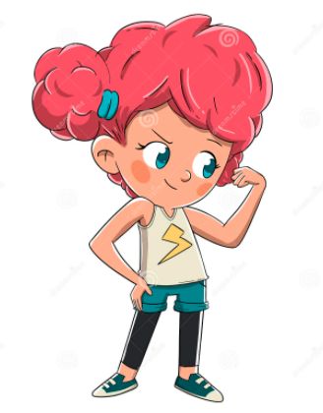
Here is my new character:
Pip

Slide 3
I am Pip!
Let me tell you about me:
I am brave
I have pink hair
I love to run
Books are fun
Pip

Slide 4
Your turn:

