Slide 1
Learning Intention - To learn about music from the 1980’s

Slide 2
Music from the 1980’s
Last half term we looked at music from the 1970’s, listening to music from The Beatles, Queen and The Supremes.
This week we are going to move to the next decade and learn about music from the 1980’s.

Slide 3
Structure of the music
While we are listening to the music, I want you to think about the structure of the music.
This is the way the music is ‘built’ and the parts it has.
Is there a chorus?
Are there parts where it is only instruments?
Are there parts where it is only the singer?
Are there parts where instruments and the singer play together?

Slide 4
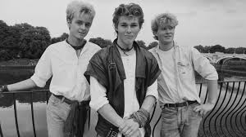
Artist 1 – A-ha
A-ha were a band that were from Norway.
They played a type of music called synth-pop.
They were famous all around the world.
What do you notice about the structure of their music?

Slide 5
Artist 2 – Wham!
Wham! were a pop music duo featuring George Michael and Andrew Ridgeley.
They got together in 1981 and became one of the biggest pop bands of the 1980’s.
What do you notice about the structure of their music?

Slide 6
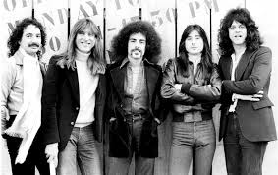
Artist 3 - Journey
The final band we are going to look at are Journey, an American rock band that formed in 1972.
One of their most famous songs was called ‘Don’t Stop Believin’’ from 1981.
What do you notice about the structure of the music?

Slide 7
Your opinions
Which was your favourite piece of music?
Why did you like it?
What do the other people in your house think? Do they like the same as you?

