Slide 1
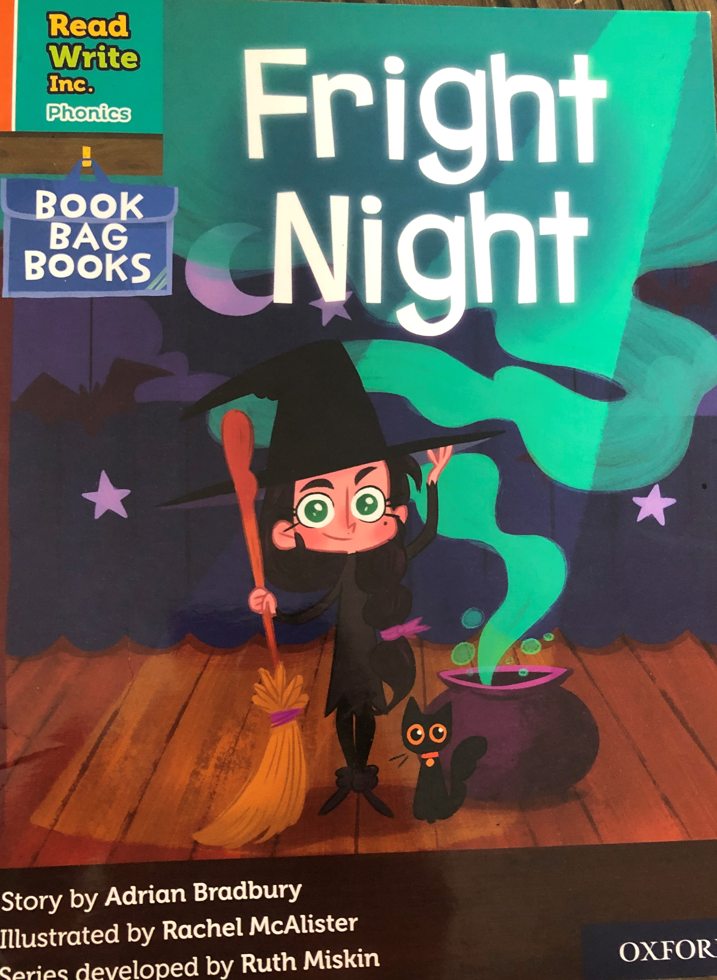

You are going to read the story ‘Fright Night’.
In this story you will hear words with the sound:
igh
The igh sound is in the words:
night
light
Can you write two words with the igh sound in?
Look at the picture. What can you see? What will happen in the story?

Slide 2
Let’s read these words together. These are words you will come across in the story.
Green Words
flight
Red Words
do what
you
to
be
the
I’ve
I

Slide 3
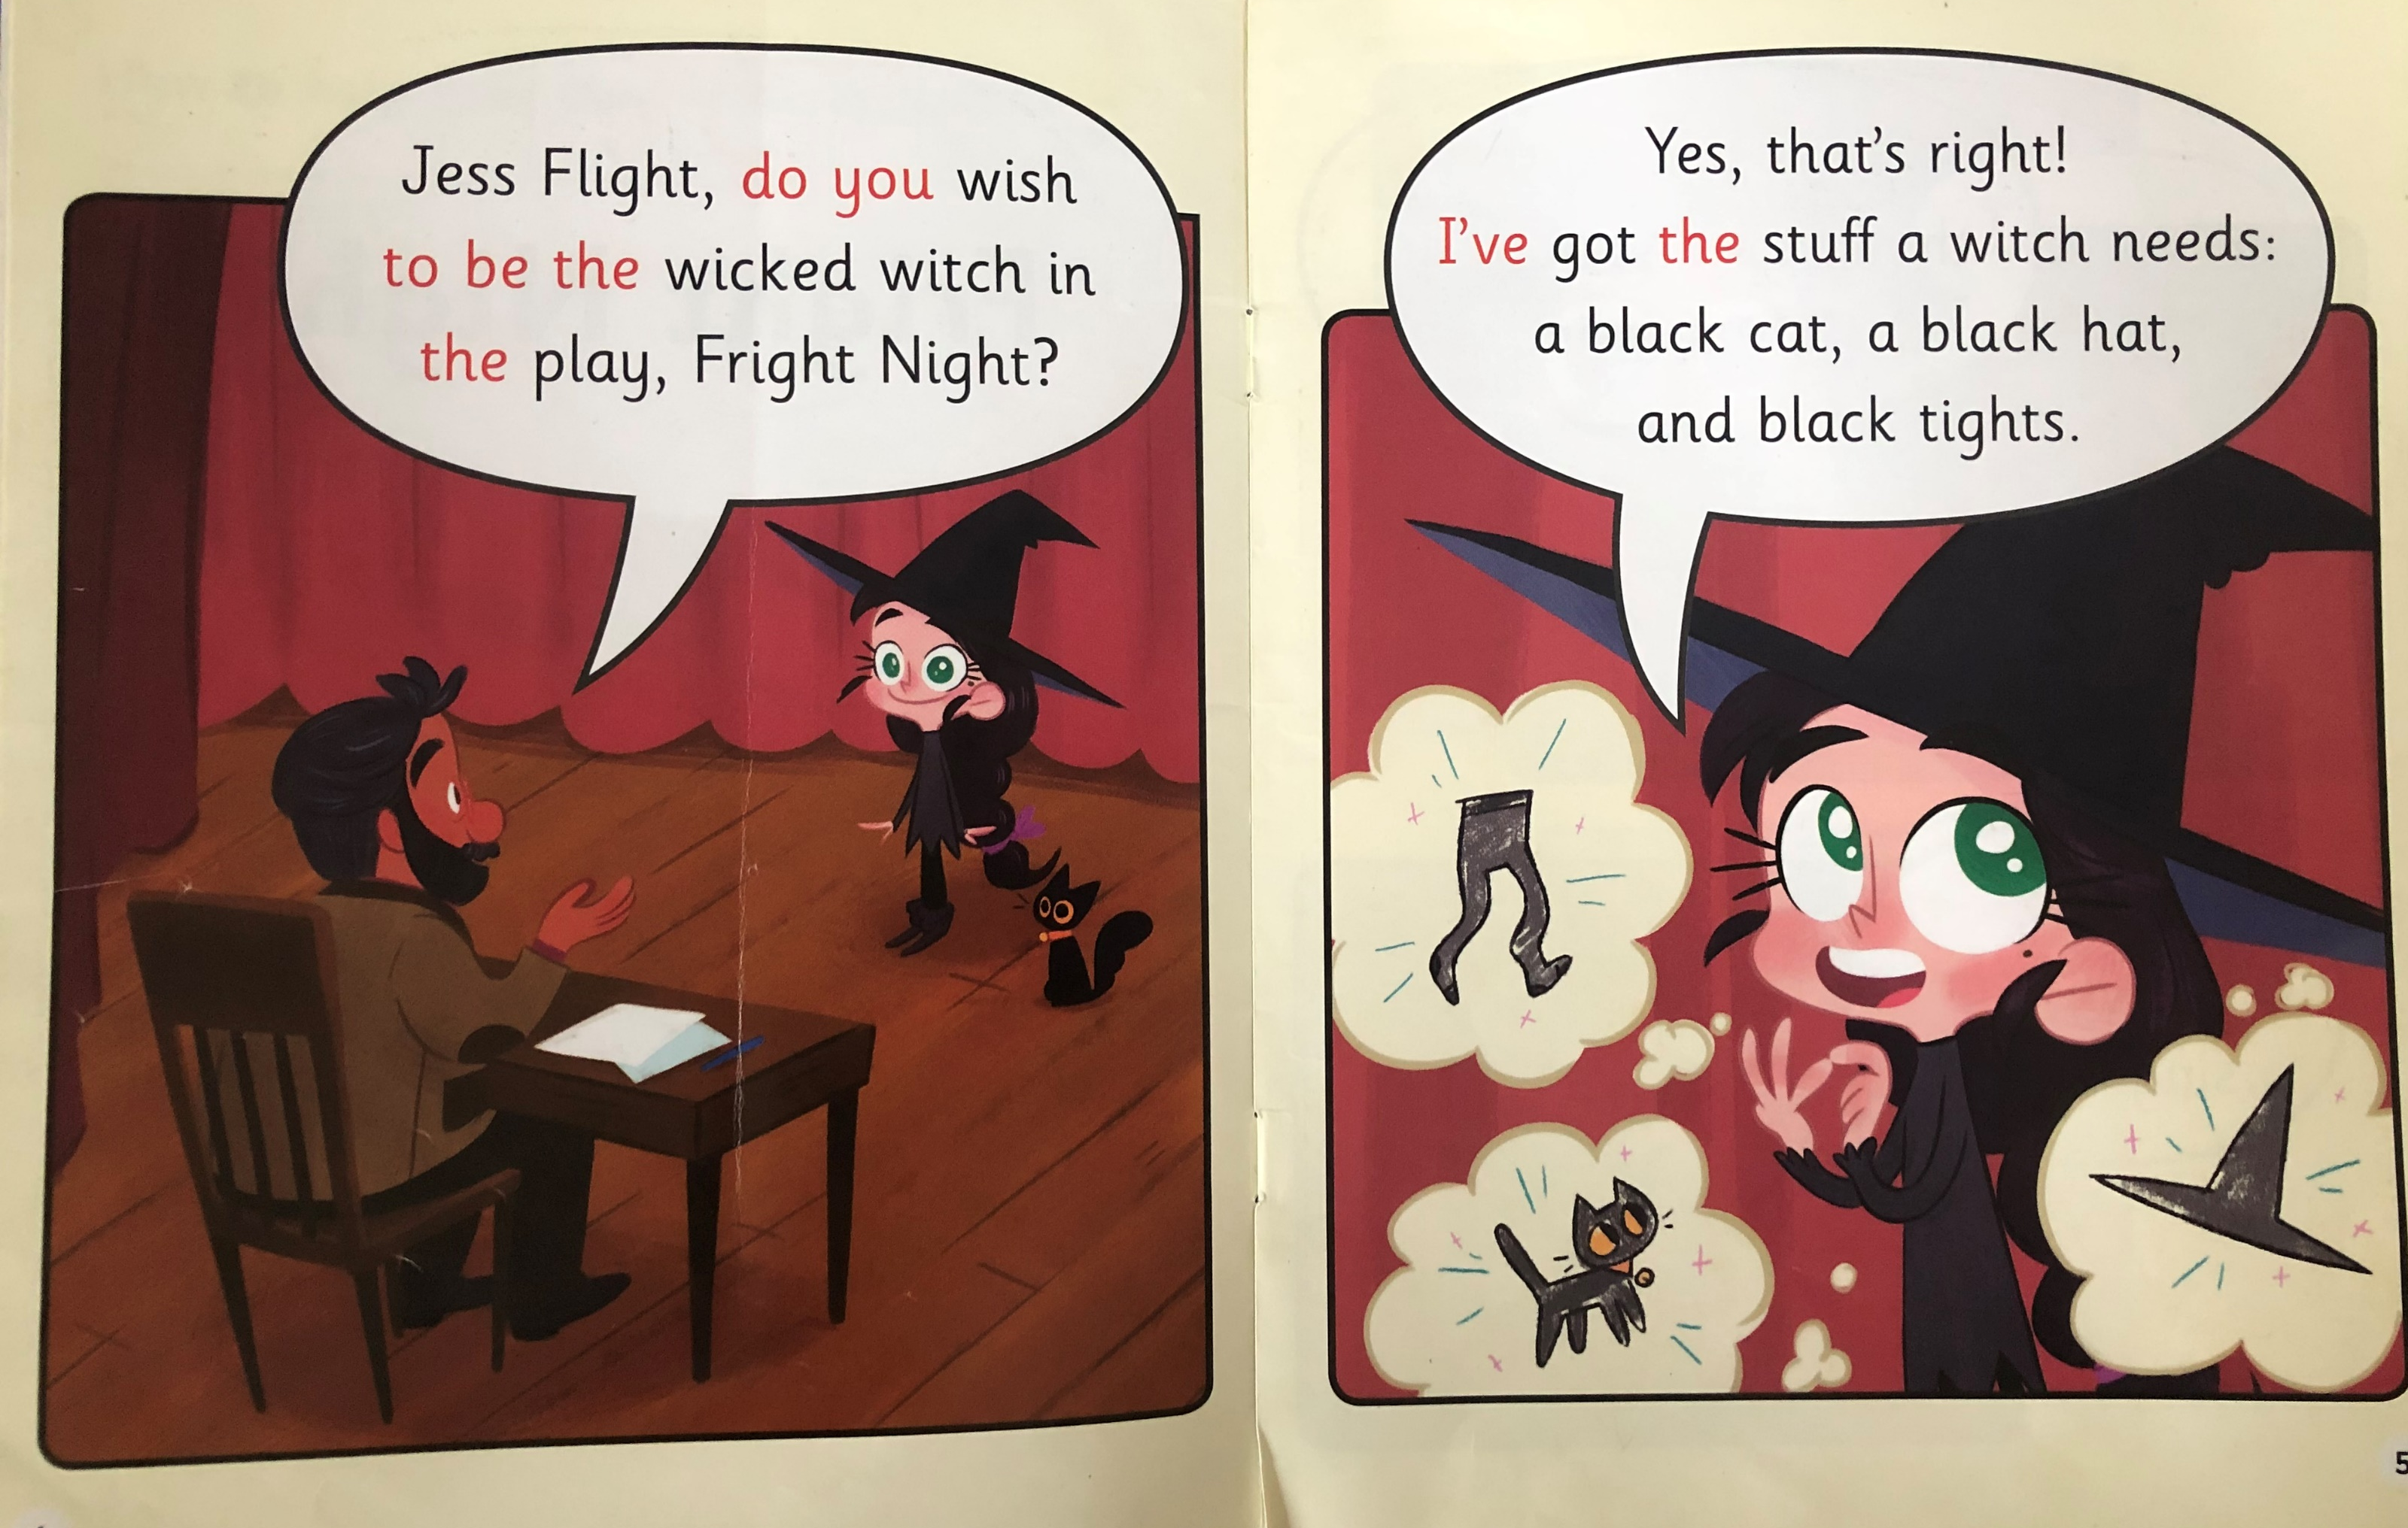
Write down all of the words you can see with the igh sound we are learning today.
What doe Jess Flight want to do?
What were the three things a witch needs?

Slide 4
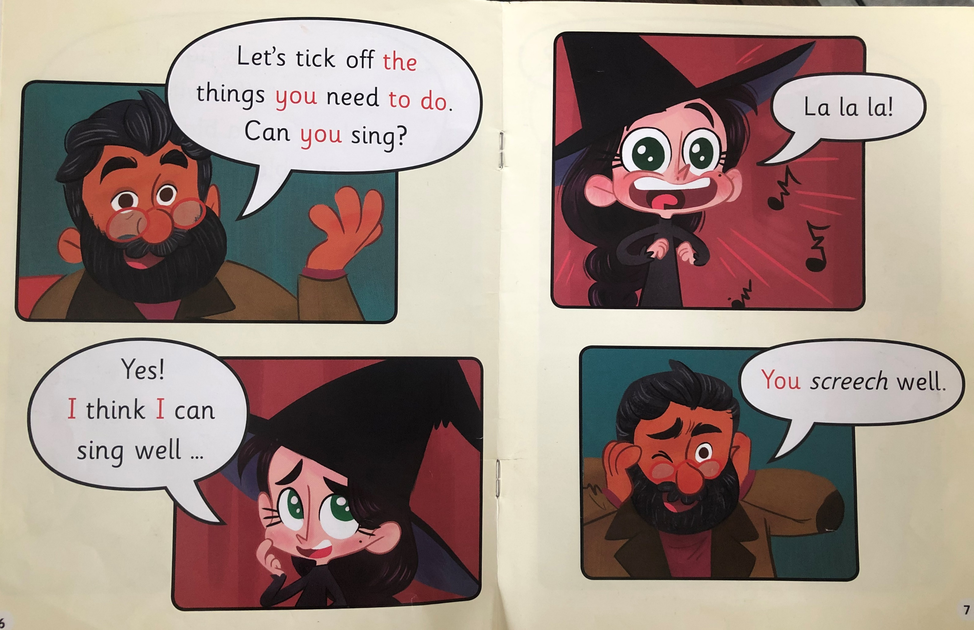
What is the first thing Jess needs to be able to do?
What does she do well?

Slide 5

What does the man ask Jess next?
Does she get the job she wants?

Slide 6
Recap questions
What part does Jess wish to play in Fright Night?
What stuff does Jess have that will help her to be a witch?
What does the teacher ask her to do?
Why do you think Jess got the job as a witch?

