Slide 1
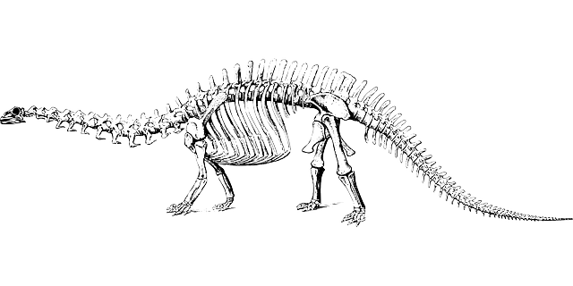
Learning intention: Describe how fossils are made

Slide 2
Key Vocabulary
Fossil
Rock
Skeleton

Slide 3
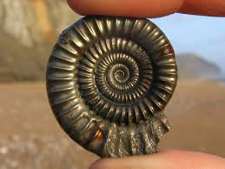
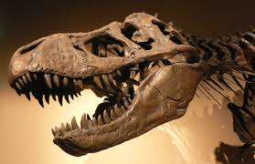
What is a fossil?
Fossils are the stone remains of animals or plants that were once living. Fossils are really old!
Fossils are not easy to find.
There are different ways that a fossil can be made, one of them is the ‘mould’. and cast’.

Slide 4
Step 1: An animal (such as a dinosaur or fish) dies.

Slide 5
Step 2: The animal rots away and the bones or shell are left.

Slide 6
Step 3: Mud, rock and sand fall onto the remains.

Slide 7
Step 4: Layers of rock are formed.

Slide 8
Step 5: Small amounts of water come through the rock and the bones are washed away.

Slide 9
Step 6: A space is left in the size and shape of the bones.
This is called a mould.

Slide 10
Step 7: The water moves tiny pieces of rock, which are left inside the mould.
Pieces of rock

Slide 11
Step 8: The mould starts to fill up with these pieces of rock, in the shape of the animal.
Pieces of rock

Slide 12
Step 9: Over time the whole skeleton will become a rock.

Slide 13
Step 10: The fossil comes to the surface and people dig them up.

Slide 14
