Slide 1
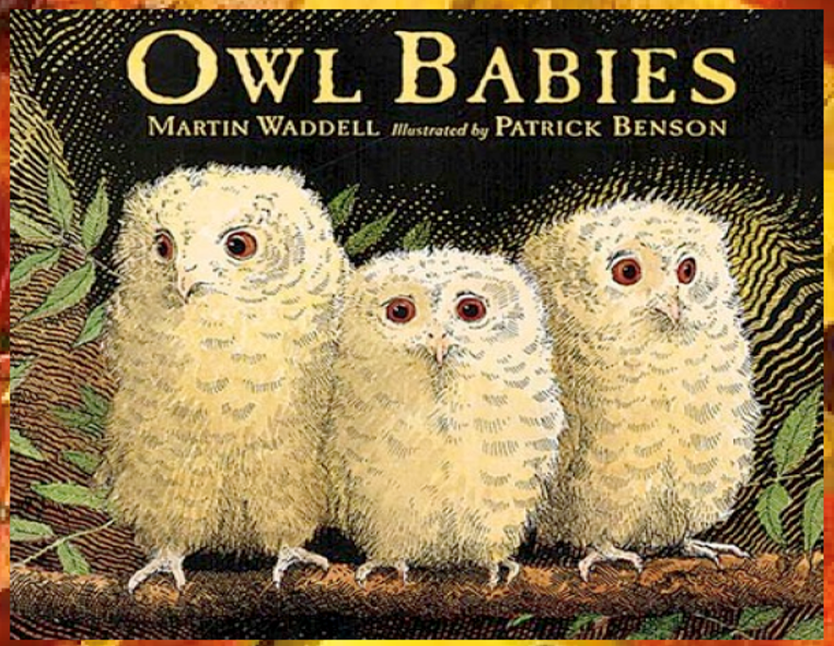
Today we will share the beginning of the story.

Slide 2
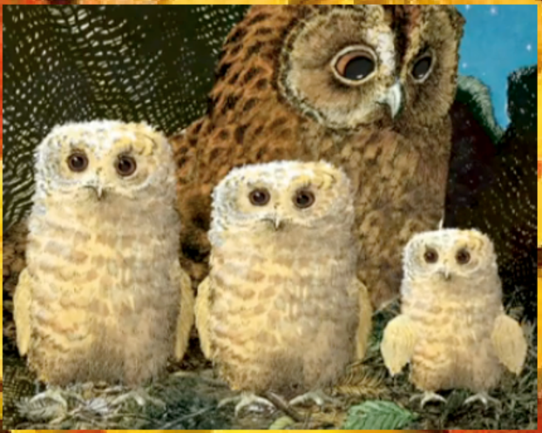
Once there were three owls, Sarah, Percy and Bill. They lived in a whole in the trunk of a tree with their Owl Mother.

Slide 3
Look at the different sizes of the owl babies. Who do you think is the smallest?

Slide 4
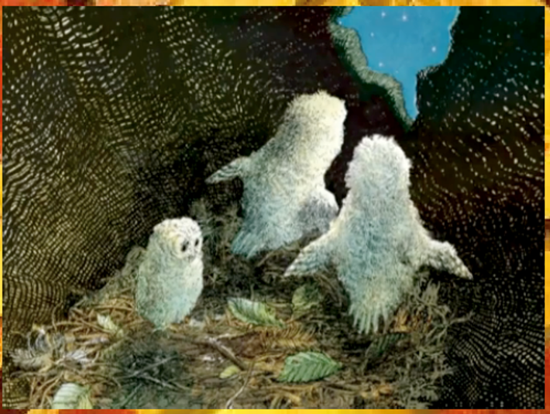
One night they woke up and their Owl Mother was gone!

Slide 5
How do you think they are feeling? The smallest owl looks sad.

Slide 6
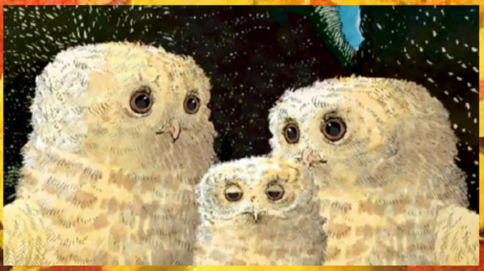
“Where’s Mummy?” asked Sarah. “Oh my goodness!” said Percy. “I want my Mummy!” said Bill. But their Owl Mummy didn’t come . . .

Slide 7
Where could Owl Mother have gone? Do you think she will come back?

