Slide 1
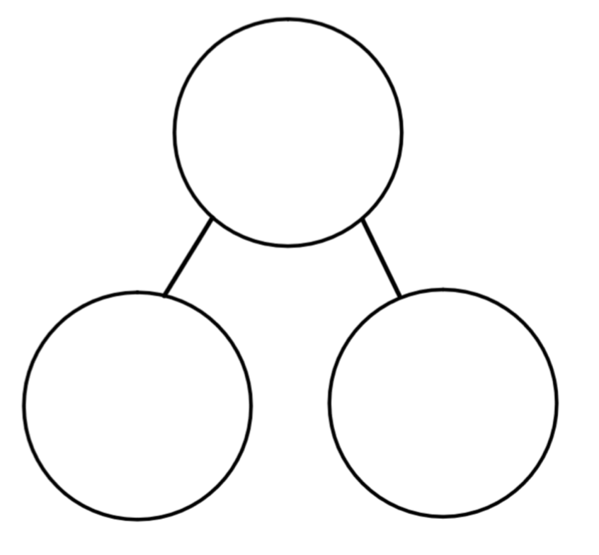
Making equal parts
Whole Whole
Parts Parts
10
…..
…..
5
5
…..
…..

Slide 2
Match the whole to the part
Whole Part

Slide 3
Match the whole to the part
Whole Part
Try task one.

Slide 4
Shade one part

Slide 5
Shade one part
(quarter)$\frac{1}{4}$
(half)$\frac{1}{2}$
Try task two.

Slide 6
Equal groups
groups of

Slide 7
Equal groups
2 groups of 5 flowers.
Try task three.

Slide 8
Try the challenges on the worksheet if you are confident.

