Slide 1
Learning intention: to make a prediction

Slide 2
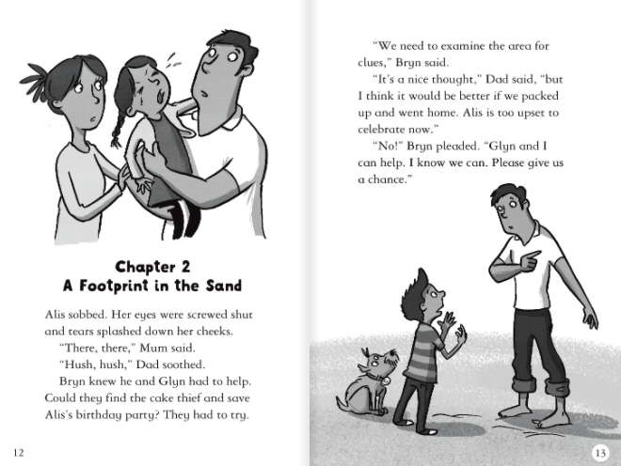

Slide 3
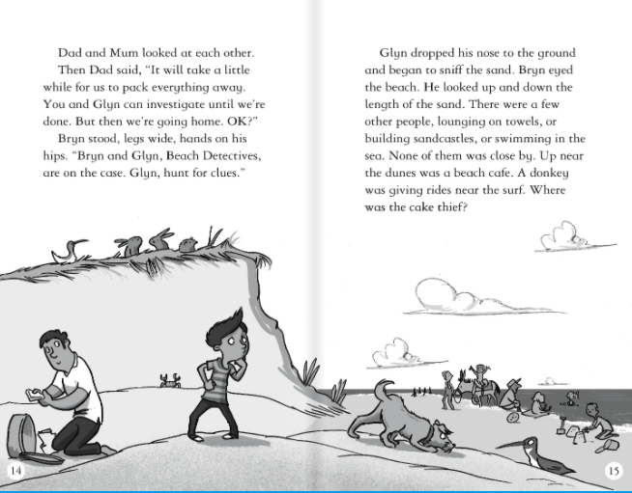

Slide 4
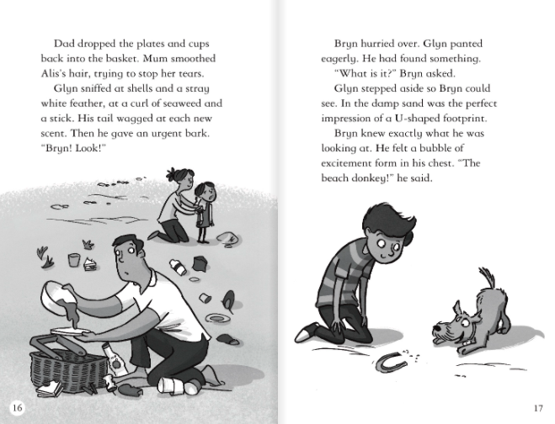

Slide 5
Activity
Using chapter 1 and chapter 2, can you predict who you think is the cake thief? Explain your answer.

