Slide 1
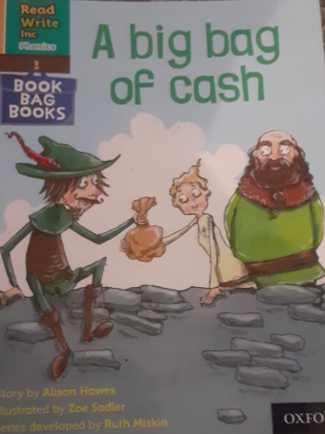
You are going to read the story ‘A big bag of cash’.
In this story you will hear words with the sound:
oo
The oo sound is in the words:
wood
stood
Look at the picture. What can you see? What will happen in the story?
Notes:
1

Slide 2
Let’s read these words together. These are words you will come across in the story.
Green Words
woods
robbing
rich
bow
shot
Red Words
are
was
what
Notes:
2

Slide 3
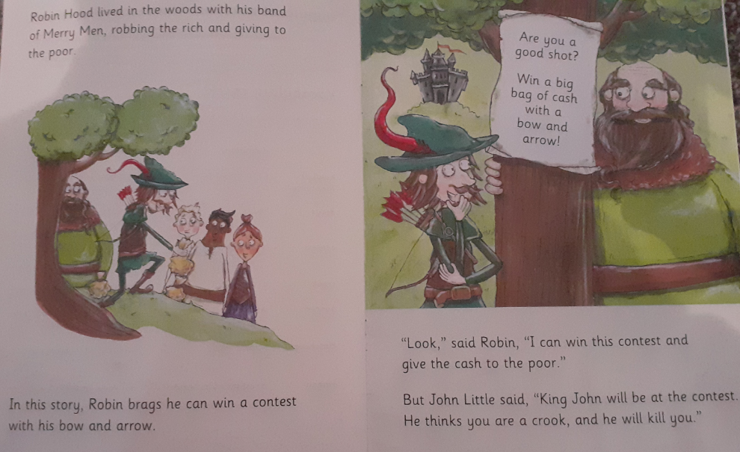
What words can you see on these pages which have the oo sound?
Write down two other words that have the oo sound.
Who do Robin Hood and his Merry Men rob from?
Notes:
3

Slide 4
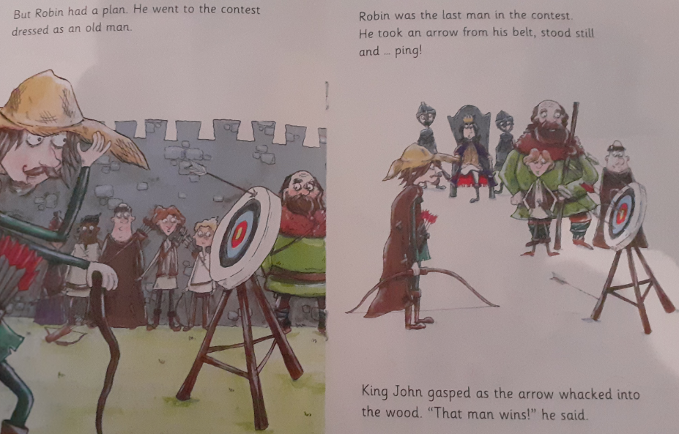
What did Robin dress up as when he went to the contest?
What did King John do when Robin hit the target?
Notes:
4

Slide 5
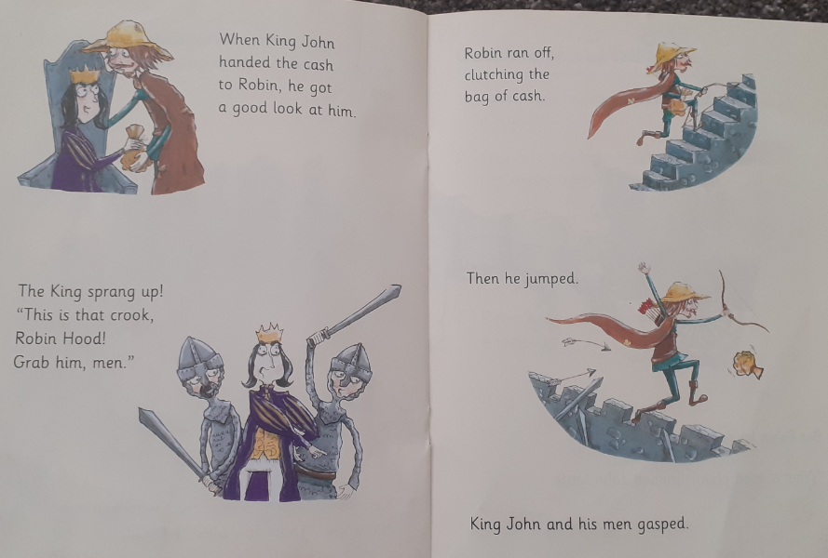
What did King John tell his men to do?
When Robin ran off, what was he clutching?
Notes:
5

Slide 6
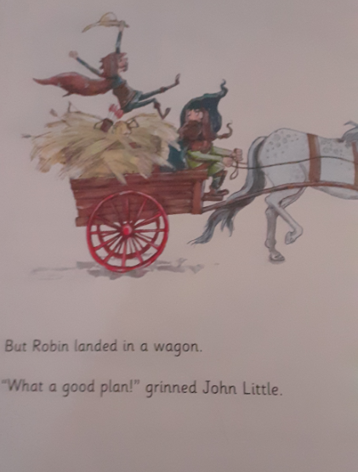
Why did John Little think it was a good plan?
Do you think they will get caught? Explain why.

Slide 7
Recap questions
What does Robin brag about being able to do?
Where does Robin keep his arrows?
Who does Robin run away from?
When Robin jumped, what did he land in?
Notes:
7

